Slide 1
Introduction to Neural Networks
Holger Wittel

Slide 2
Outline
Motivation
Neural Networks & Topologies
Perceptron
Multi-layered networks
Training
Time dependence
Neural Networks for Filters
Example usages
Summary

Slide 3
Motivation
Computers are fast, still certain tasks are difficult for them
Your brain took ~100 cycles (0.1s) to classify the picture as ‘cat‘, what can your computer do in 100 cycles?
 | brain | computer
No. of processing units | 10¹¹ | 10⁹
Type of processing units | neurons | transistors
Type of calculation | massively parallel | usually serial
Switching time | 10⁻³ sec | 10⁻⁹ sec
Possible switching operations | 10¹⁴ per sec | 10¹⁸ per sec
Table taken from: D.Kriesel: Neuronal Netze, http://www.dkriesel.com/_media/science/neuronalenetze-en-zeta2-2col-dkrieselcom.pdf

Slide 4
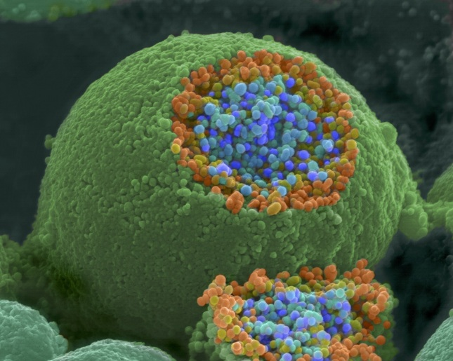
A real Neuron
Dendrite
Axon terminal
Node of Ranvier
Soma
Axon
 | # neurons
roundworm | 302
ant | 10⁴
fly | 10⁵
mouse | 5·10⁶
cat | 3·10⁸
human | 10¹¹
elephant | 2·10¹¹
Schwann
cell
Myelin sheath
Nucleus
SEM image of a neuron, cut open to show sacks of neurotransmitters
Images: http://en.wikipedia.org/wiki/Neuron
http://www.cellimagelibrary.org/images/214

Slide 5
Neuron Model
Input₁
weight w₁
Input₂
weight w₂
response
function
.....
Out = resp(Σ input_{i} · w_{i})
weight w_{i}
Input_{i}
Most important response functions:
Linear: resp(x)= x
Sigmoid: resp(x)= $\frac{1}{1+e^{−x}}$

Slide 6
The Perceptron / Input Neurons
Output sigmoid → use for classification
The magic happens in the connections & weights!
Input neurons
Output neurons
weight w₁
weight w₂
Output =response(Σ input_{i} · w_{i})

Slide 7
The Bias Neuron
No inputs, constantly outputs bias
Often omitted in drawings
Implement as input neuron
Input neurons
Output neurons
weight w₁
weight w₂
weight w₃
-1

Slide 8
Two-Layered Networks
Always linear, no processing
Response depends on desired output
Input layer
Output layer
w₁₁
w₁₂
w₂₁
w₂₂
...
...

Slide 9
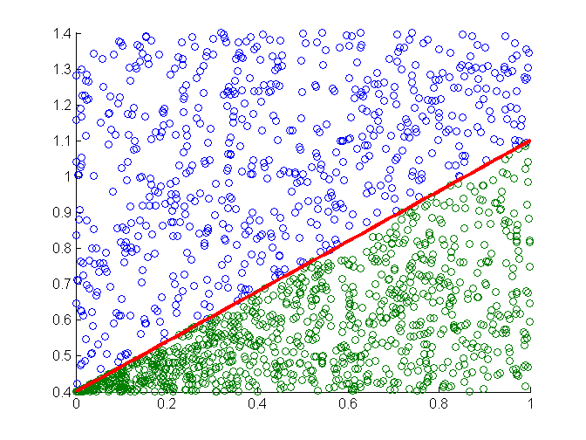
History: OR / XOR
1958: Perceptron
1969: Minsky & Papert: Perceptron can only classify linearly separable data
This killed nearly all research on NNs for the next 15 years
No XOR as popular example:
i1 | i2 | or | xor
0 | 0 | 0 | 0
0 | 1 | 1 | 1
1 | 0 | 1 | 1
1 | 1 | 1 | 0
OR
XOR
1
1
0
1
0
1

Slide 10
Multi-layered Networks
Adding a middle (‘hidden‘) layer solves the problem!
At least one nonlinear layer
A 3-layered perceptron can represent virtually anything!
-1
-1

Slide 11
Network Topologies
Feed forward network (fully connected)
with shortcuts
-1
-1

Slide 12
Network Topologies
Recurrent network
with lateral connections
-1
-1

Slide 13
Network Topologies
Recurrent network
with direct feedbacks
-1
-1

Slide 14
Network Topologies
Recurrent network
with indirect feedback
-1
-1

Slide 15
Network Topologies
Fully connected network
(omitted some connections)

Slide 16
Three-Layer Perceptron
We consider a 3-layer feed forward Perceptron
By far most used NN in practice
-1
-1

Slide 17
Training
How to determine the right connection weights?
Prepare training data set: inputs & desired outputs
Optimize weights :
Backpropagation
Standard text book method
Gradient based
Useful for adaptive networks
May get stuck in local minimum
local minimum
Genetic algorithm
Biology inspired
Finds global minimum
May be slow
global minimum

Slide 18
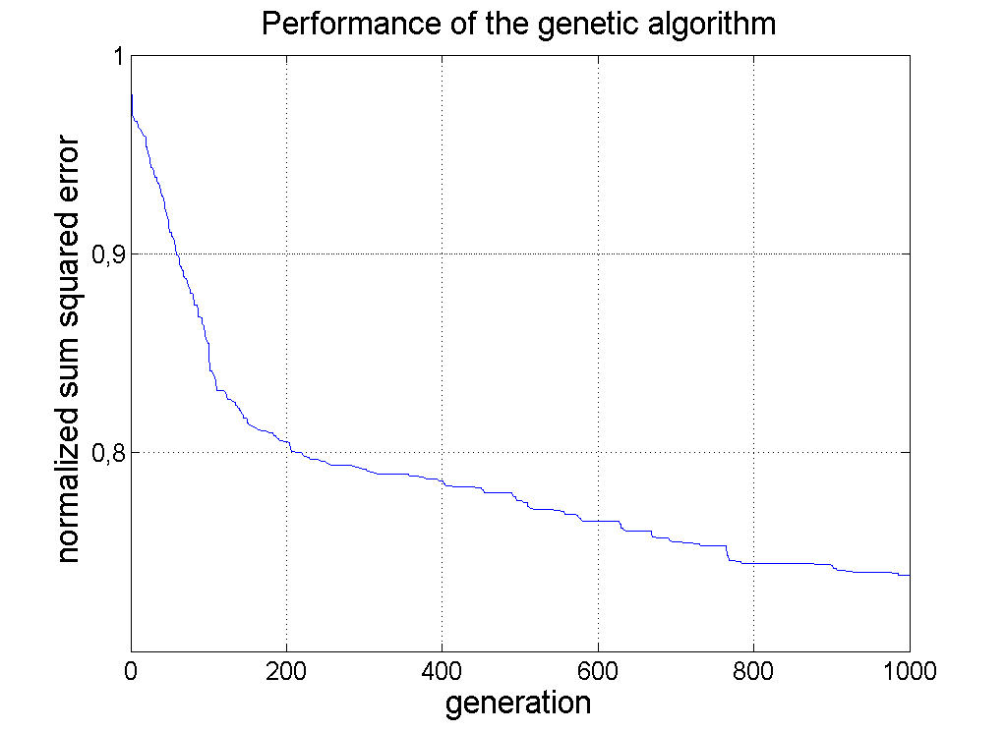
Excurs: Genetic Algorithms
Start with random population
Evaluate each individual & select best
Make next generation:
Migration – copy best individuals
Mutation – copy best and randomly change some attributes
Crossover – copy best and mix their attributes
Next Generation

Slide 19
Adding time-dependence
Until now the NNs cannot represent relationships in time, they need memory
Input (t)
output (t)
Input (t-1)
This is an IIR filter!
This is an FIR filter!
Input (t-2)
...

Slide 20
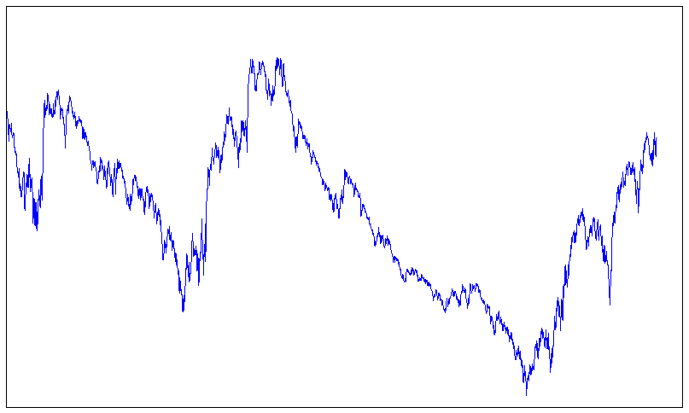
Uses of NNs
Pattern recognition:
Face recognition
Character recognition
Sound recognition
Predicting the future
Stock market
Weather
Signal processing
abcdef
ghijk
?
DAX 2000 - today

Slide 21
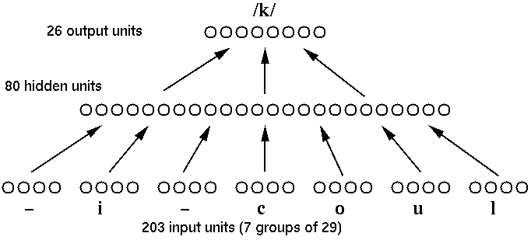
Example: NETTALK
Written language → spoken language
Nontrivial problem:
pronounce ‘a‘ in have, brave, read
Simple Network: 3-layer perceptron
After 10.000 words trained
Reading a new text
Training
Ref: Sejnowsk, Rosenberg: ‘Parallel Networks that Learn to Pronounce English Text’,
Complex Systems 1 (1987) 145-168

Slide 22
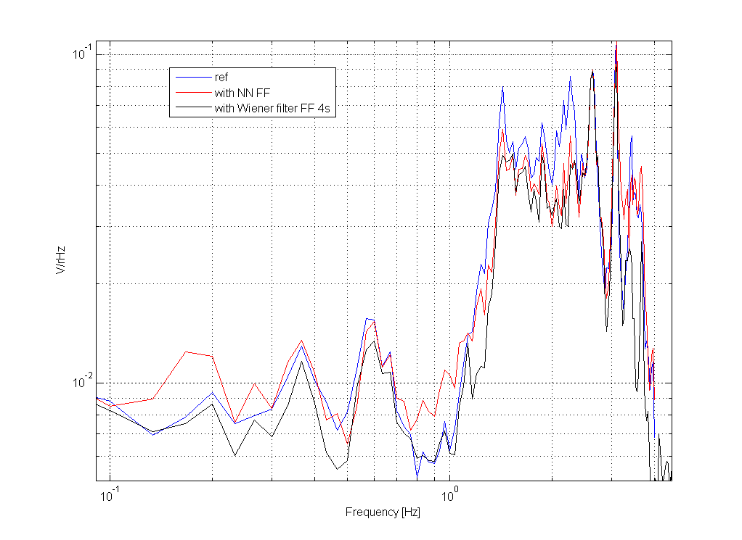
Seismic feed forward system
NN of your choice
Training with GA:
Inputs: Seismometer
Desired output: Interferometer channel, for example: michelson rotation
300 Generations, training time ~ mins
1 hidden neuron

Slide 23
Adaptive Filters
Arbitrary sine wave
Power in GEO, unlocked, flashing

Slide 25
Pitfalls
Creation:
Which type of network?
Number of neurons?
Number of layers?
Training:
Which algorithm for training?
When to stop training?
Does the training converge to the global optimum?
Training can take long
Make sure the NN doesn‘t memorize the training data and loses ability to generalize

Slide 26
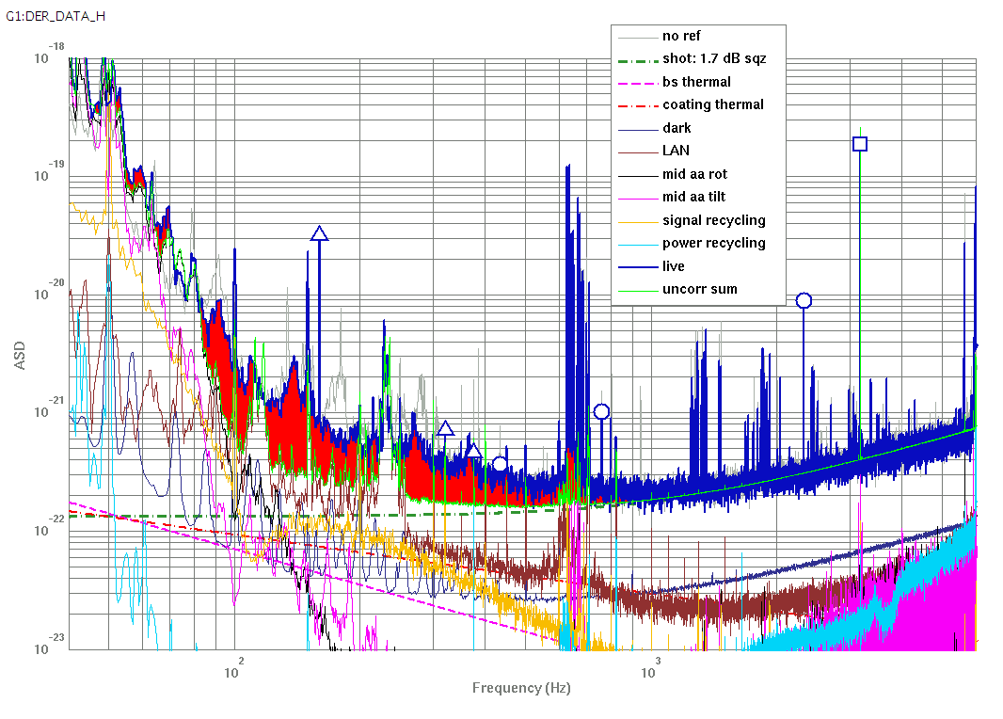
Ideas for NNs
Automated classification
Locklosses
Detector state
Filters
Nonlinear filters
Adaptive filters
Predict the future
Identify and characterize nonlinear couplings
Nonlinear noise projections

Slide 27
Summary
NNs can be used in many ways
Easy to implement
3-Layer perceptron can model (virtually) any function or coupling, even nonlinear couplings
NNs can be used as filters
Training can be an issue & time intensive
Computationally expensive for high frequency data
For linear coupling no advantage over ‘traditional‘ (Wiener) Filters

Slide 28
Thank you for your attention!
References:
http://dkriesel.com/science/neural_networks
Handbook of Neural Network Signal Processing, CRC Press

Slide 29
NARX
Nonlinear AutoRegressive network with eXogenous inputs
-1
-1
29

Slide 30
Nonlinear Noise Projections?
Unexplained noise

