Slide 1
GEO-HF EOMs
Christoph Affeldt
&
Stefan Hild
29.08.2011

Slide 2
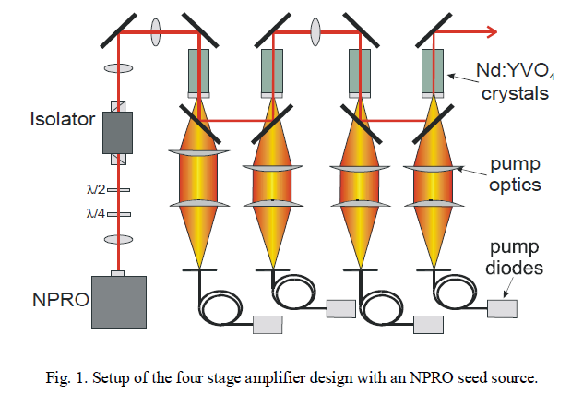
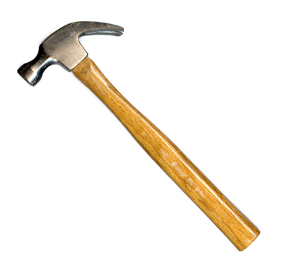
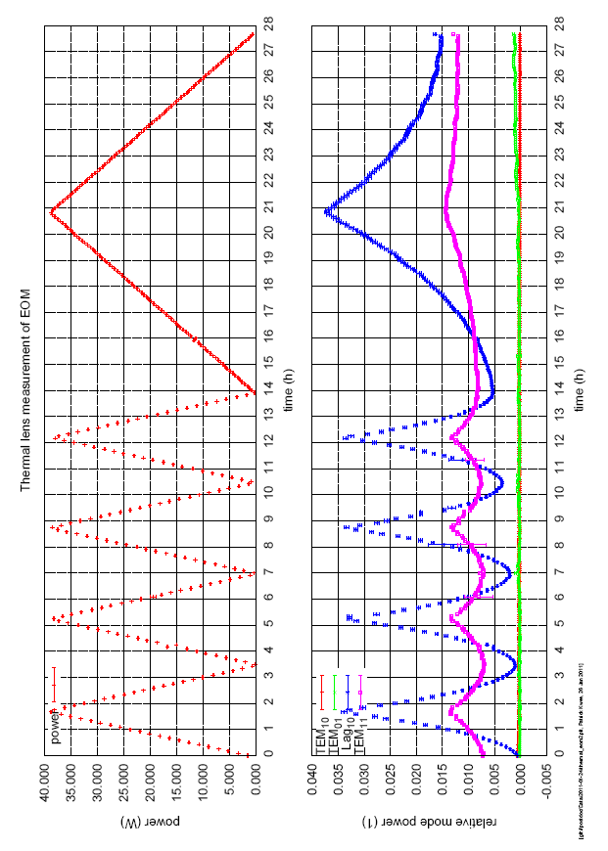
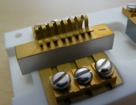
Outline
Intro
Basics
Options
- 6x6x35mm³
- 8x8x10mm³
- ???
Discussion & decision!

Slide 3
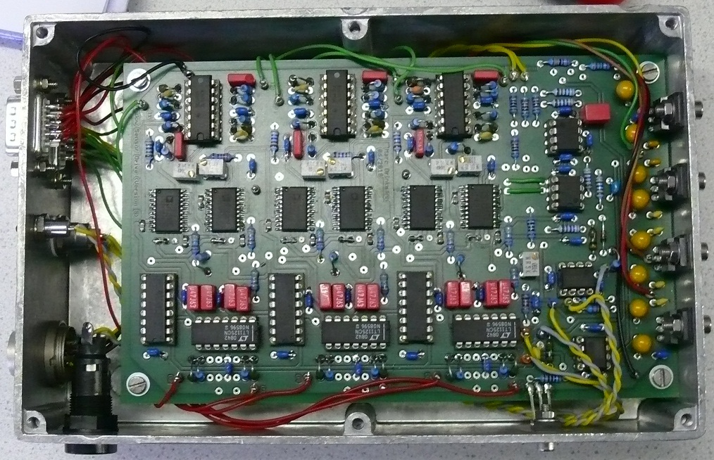
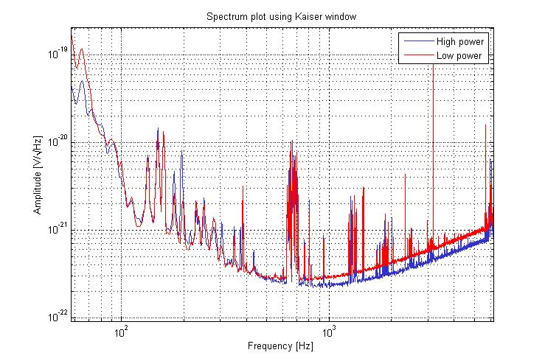
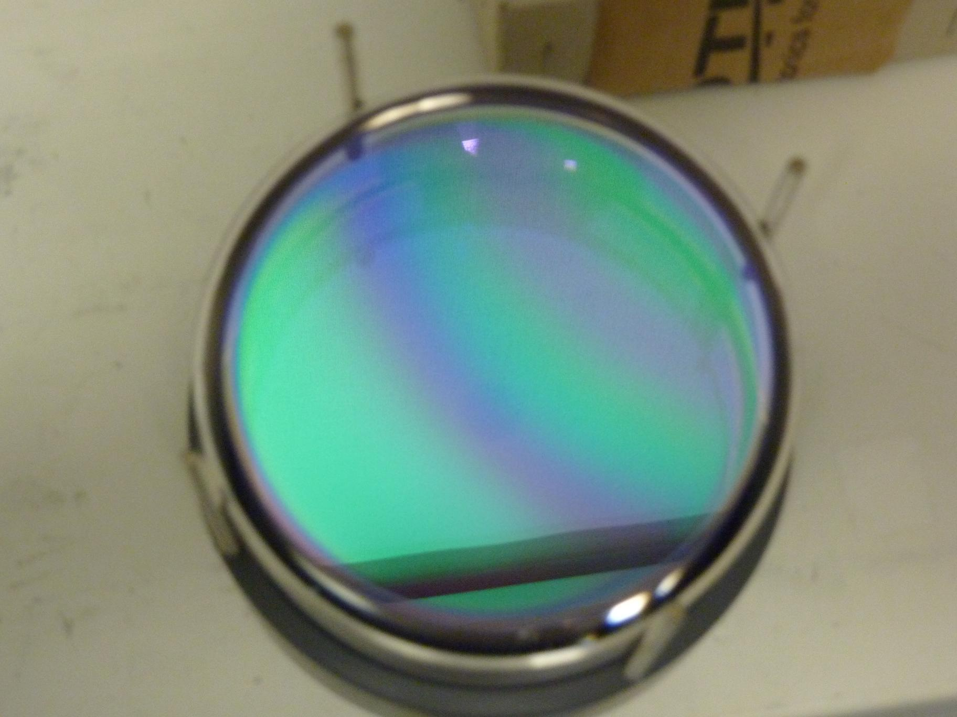

Slide 4
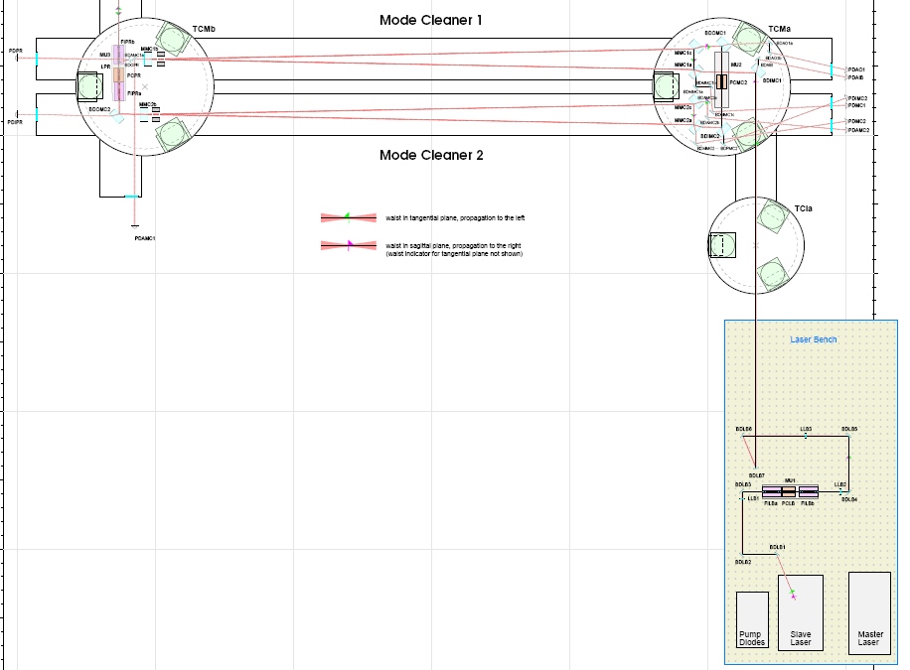
MID (15MHz, 4.25Vrms)
SR (21.7MHz, 2.73Vrms) (& power stab.)
MC2 (13MHz, 2Vrms)
PR (37MHz, 3.54Vrms)
MC1(??)
Notes:
Seitenbänder…

Slide 5
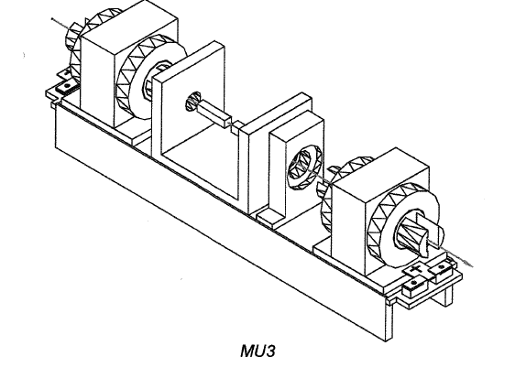
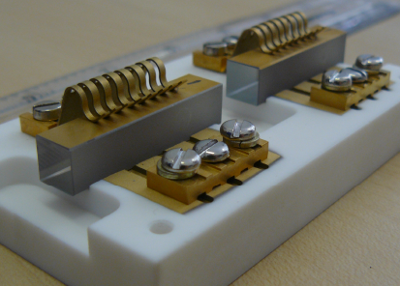
Thermal lens
Mounting Unit (MU)

Slide 6
Thermal lens
Thermal lens & crystal destruction
We need other EOM crystals!
Notes:
LIGO investigations have shown…

Slide 7
Two options!
Two RTP (RbTiOPO4) options:
6x6x35mm³
8x8x10mm³
instead of 8x8x35mm³ LiNbO3.
Why RTP? See:
Notes:
Rubidium Titanyle Phosphate r33 – electro optical coeff. nz – refractive index

Slide 8
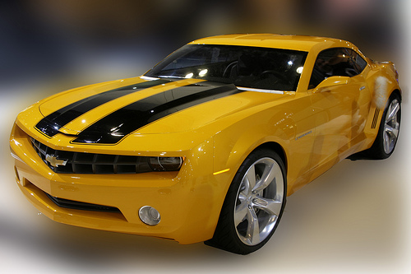
Decision!
Oder doch lieber Tor zwei?

Slide 9
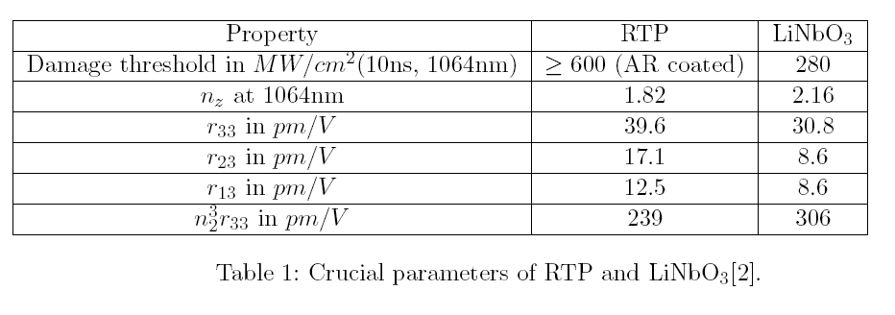
Basics
Two RTP (RbTiOPO4) options:
6x6x35mm³
8x8x10mm³
instead of 8x8x35mm³ LiNbO3.
Notes:
Rubidium Titanyle Phosphate r33 – electro optical coeff. nz – refractive index

Slide 10
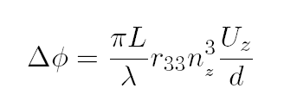
Basics
6x6x35mm³ →
8x8x10mm³ →

Slide 11
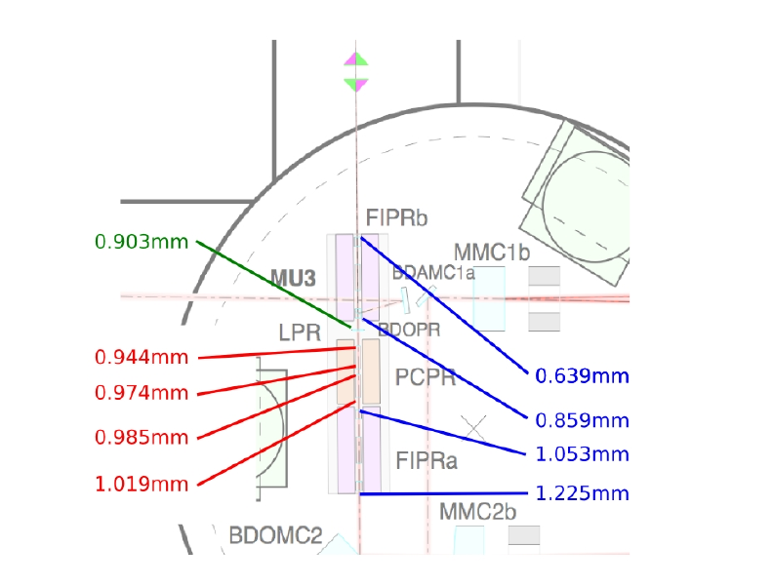
Option 1: 6x6x35mm³
clipping @ first Faraday: 6.4ω
With 6x6mm² aperture:
Clipping @ first EOM: 5.9ω
And:
Expensive
Never manufactured

Slide 12
Option 2: 8x8x10mm³
Optimization of the matching circuit
Application of higher modulation voltage to the EOM crystal
Application of more than one RF modulation frequency per EOM crystal
Use of more than 2 EOM crystals on MU3

Slide 13
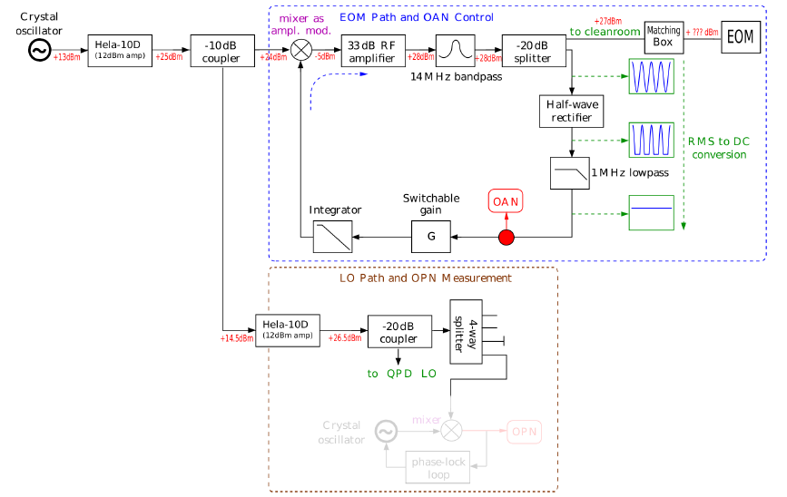
MID modulation path?!

Slide 14
Higher modulation voltage?
Yes, at least partly!
Factor 2 is easy! (just decreased MID sidebands after MSR change. Can go back from 4.25Vrms (0.4W) to 10Vrms (2W))
Commercial low noise RF amplifiers available! (e.g. “QBS-544”, but: 8W necessary, >1000€)
Notes:
Infos!!

Slide 15
Option 2: 8x8x10mm³
Optimization of the matching circuit
Application of higher modulation voltage to the EOM crystal
Application of more than one RF modulation frequency per EOM crystal
(see also G1000297-v1.pdf K. Izumi et al. “Development of Tripple Resonant EOM for Advanced Detectors” )
Use of more than 2 EOM crystals on MU3

Slide 16
More crystals
Recovering modulation strength by using more crystals. (At least 3 necessary for MU3)
→ More potential parasitic cavities.

Slide 17
Proposal for 8x8x10mm³
Using three 8x8x10mm³ RTP crystals in MU3
One for SR and two for MID.
Existing electronics should be capable of recovering the remaining factor of 2.24 for MID modulation.

Slide 18
Mixing? (MU3 case – crazy?!)
One 8x8x10mm³ for SR SBs.
One 6x6x35mm³ for MID SBs
→6.16ω

Slide 19
Let´s make a choice!
6x6x35mm³
+ same modulation
− smaller aperture
− more expensive
(12800GBP)
− never fabricated before
8x8x10mm³ (x2)
+ same aperture
+ Cheaper
(7000GBP)
− lower modulation (1:4.5)
− more parasitic cavities

Slide 20
Other questions
What should we use in MU2?
What is going on in MU1? (Do we even need new crystals there?)

Slide 21
Thank you for your attention!

Slide 22
Options
6x6x35mm³
+ same modulation
− smaller aperture
− never fabricated before
− more expensive
(12800GBP)
8x8x10mm³
+ same aperture
+ Cheaper (7000GBP)
− lower modulation (1:4.5)
− more parasitic cavities
− needs higher modulation voltage
Further questions
What should we use in MU2?
What is going on in MU1? (Do we even need new crystals there?)

Slide 23
Costs…

Slide 24
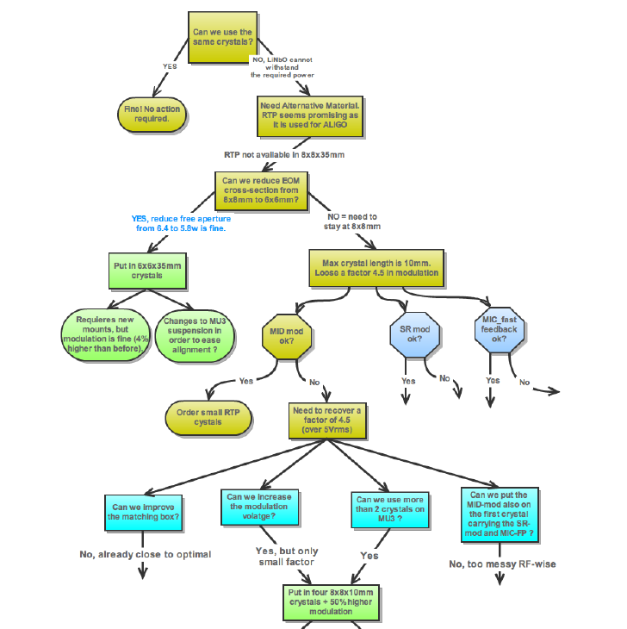
Decision!

Slide 25
More than one RF modulation frequency per EOM crystal?
See K. Izumi et al. “Development of Tripple Resonant EOM for Advanced Detectors”

