Slide 1
University of Edinburgh
Physics Research
Astronomy (also links to ATC)
Condensed Matter and Complex Systems
Particle and Nuclear Physics
EPCC

Slide 2
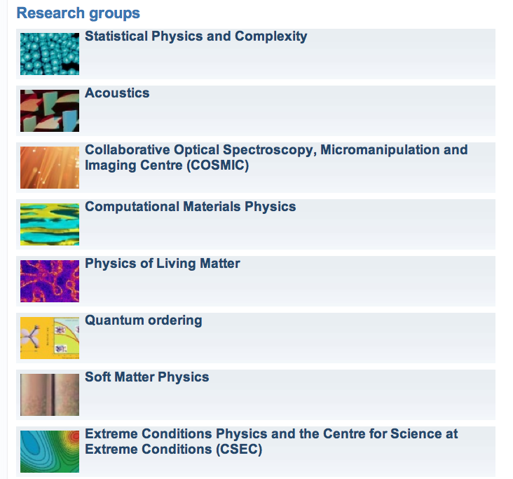
Notes:
Statsitical Physics and Complexity: Ackland/Cates/Evans/Marenduzzo/Blythe
Acoustics: Murray Campbell
COSMIC: Jason Crain
Computational Materials: Graeme Ackland / Mike Cates
Physics of Living Matter: Wilson Poon, Cait McPhee, Rosiland Allan, Charles Cockrell, Bartek Waclev
Quantum Ordering: Andrew Huxley, Chris Stock
Soft Matter: Paul Clegg, Simon Titmus
CSEC: McMahan, Loveday, Gregoryanz, Loa….

Slide 3
Natural links to MPIs
Quantum ordering
(i) ICPS and (ii) complex systems, Dresden
Soft matter:
MPI for Polymers, Mainz, especially Kremer group (simulation)
MPI for Complex Systems, Dresden, especially Juelicher group (biological physics)
Dynamics and self organisation MPI and Intellegent Systems MPI (both Goettingen). Overlap with Dietrich group and existing collaboration with Stephan Herminghaus.

