Slide 1
GEO600 Control aspects where do the error signal come from?
Harald Lück / Hartmut Grote
ISC Meeting, Hannover, 26/03/2014

Slide 2
Mod. Frequencies at GEO
Some Principles
RF frequency sufficiently high to have low freq. and amplitude noise (ideally shot noise limit on the full laser power) → > few MHz
Low-noise generator available ? (Initially a batch of HP-15MHz generators was chosen for GEO, which limited the mod. freq. To 15 MHz max., later this idea got obsolete due to usage of crystal oscillators)
Choose freq. to be off-resonant for refl. locking signals (I.e.modecleaners, PR cavity).
Choose freq. to be on-resonance for Schnupp modulation (in combination with power recycling), and on resonance or near resonance for signal recycling / depending on SR tuning.
Avoid integer multiples of all mod. Frequencies to match each other
Take an RF ambient spectrum of the site before choosing to avoid close-by beats (no guarantee though that it will remain like this of course)
In case of squeezing we chose the mod. Freq. close to MI mod. Freq. to use existing hardware multiply and be flexible with readout (slide by Hartmut Grote)

Slide 3
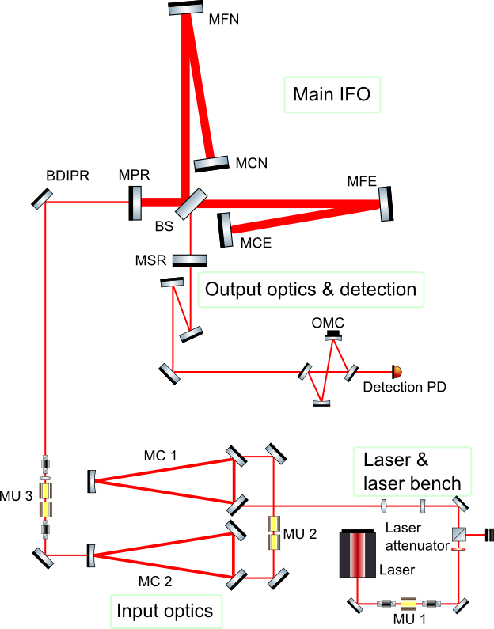
GEO600 Optical Layout
Cavities to be locked:
Laser slave
2x Mode Cleaner
Power Recycling cavity
Differential Michelson
Signal Recycling Cavity
OMC
Squeezing
Optical Layout: Christoph Affeldt

Slide 4
GEO600 Optical Layout
MC1: (MU1) 25.25 MHz (HP 1GHz generator, noisy)
MC2: (MU2) 13.0 MHz (HP 15MHz generator, medium)

Slide 5
Power Recycling
On dark fringe equivalent to a Fabry Perot
PDH Lock
Actuator: Laser frequency
PRC = reference
Michelson
PRM
EOM
To have a continuous locking signal (independent from Michelson position)
GEO600 has a 48/52 Beam Splitter

Slide 6
GEO600 Optical Layout
PRC Modulation applied @ MU2 between MC1 and MC2
Modulation has to pass through MC2
37.16 MHz (crystal oscillator, phase noise <~ -140dBc at 100Hz)

Slide 7
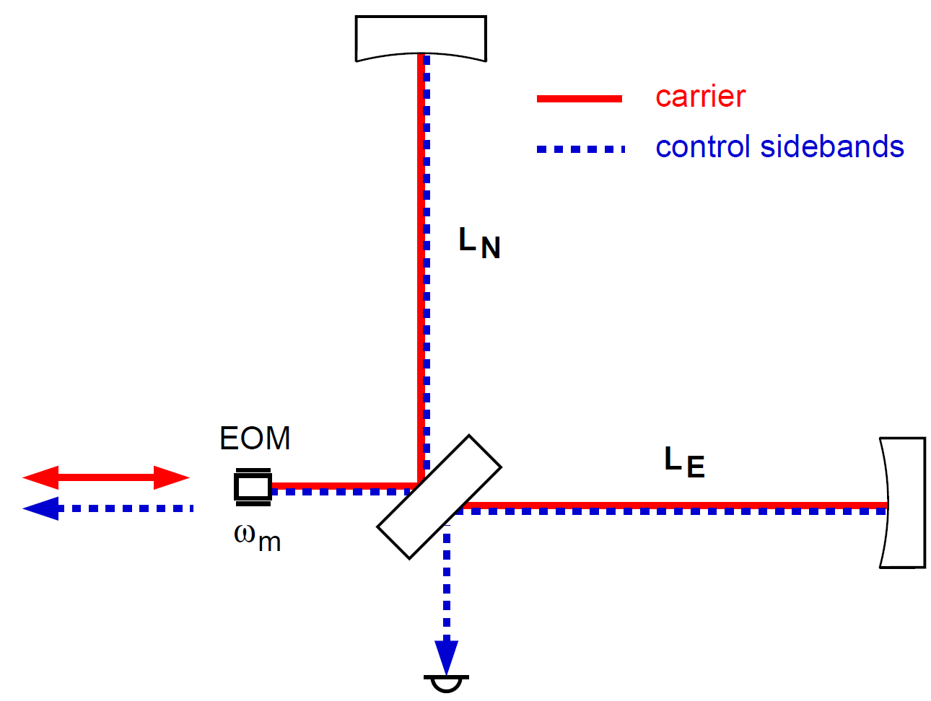
Differential Michelson (early days): Schnupp Modulation
Dark port is only dark for carrier.
If Michelson deviates from
dark fringe,
sidebands beat with carrier.
Thesis: Andreas Freise

Slide 8
Differential Michelson (early days): Schnupp Modulation inside PRC
Schnupp Modulation Sidebands: Have to be resonant in the
power recycling cavity.
In GEO600 : 119th FSR PRC
14.904932 MHz
L_{N} = L_{E} +/- 13.5 cm
(forgotten which way ☺)
PRM

Slide 9
Signal Recycling
Modulation sidebands off resonant in PRC
Closest resonance ~1kHz away
PRC HWHM ca. 20Hz
Resonant in SRC
(9.017350 MHz, 72th FSR of SRC)
Michelson
PRM
EOM
T=900 ppm
But only sidebands in SRC
No carrier at dark port
2f beat of both sidebands depends on MSR position

Slide 10
Signal Recycling Control in GEO600
Modulation sidebands offf resonant in PRC
Closest resonance ~1kHz off
PRC HWHH 15Hz
Resonant in SRC
Michelson
PRM
EOM
But only sidebands in SRC
No carrier at dark port
Pick carrier + sidebands from BS AR side

Slide 11
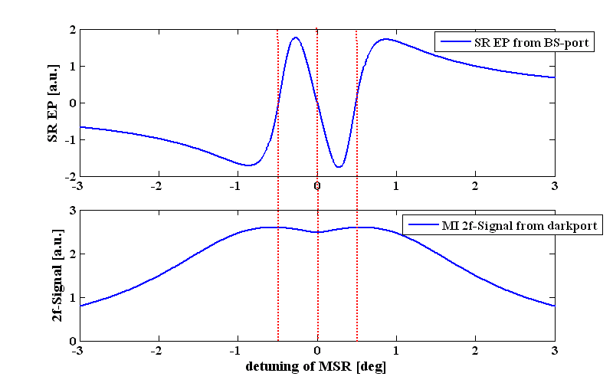
Signal-Recycling errorsignal
Nominal operating point,
SR detuned,
upper sideband
SR detuned,
lower sideband
tuned SR
Slide: Stefan Hild2006

Slide 12
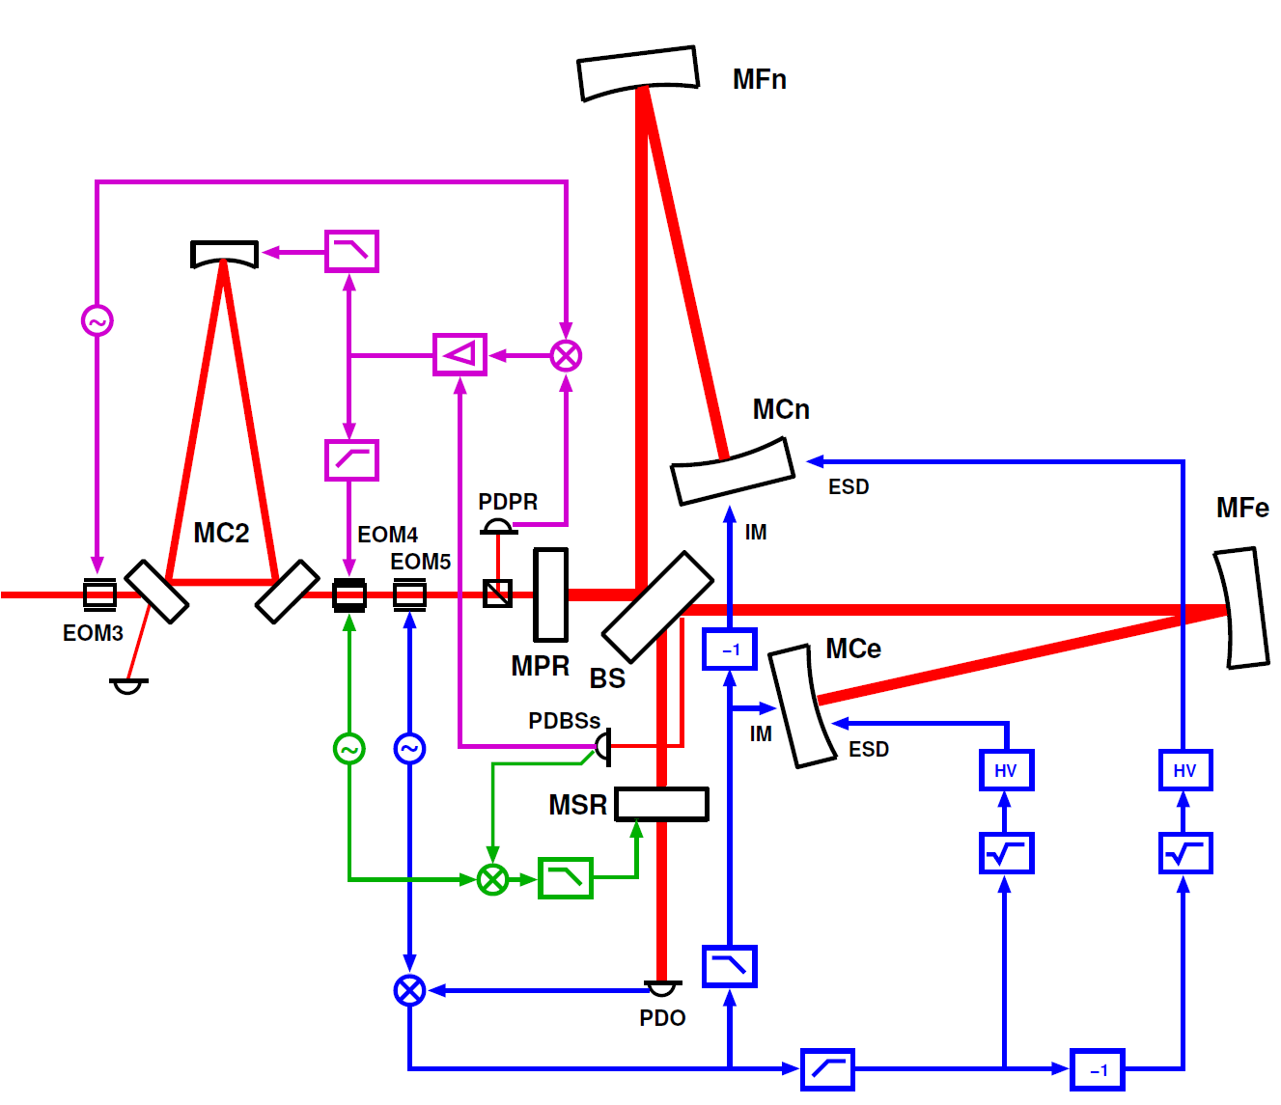
GEO600 Control (Thesis: Hartmut Grote) Today DC readout

Slide 13
GEO600 Optical Layout
RF readout still used in DC readout for AA
AA: all RF readouts can be used for AA if using quad.diodes
Squeezing:
Same principle as power recycling PDH Lock 15.216 MHz (74.5 x FSR SRC, crystal osc.)
T=1%
RF readout

Slide 14
Locking sequence
Lock laser and MCs
Lock PRC (survives almost all of a Michelson fringe)
If Michelson crossed dark fringe: lock Michelson
In the short time that Michelson is in „locking range“
Lock Signal recycling cavity Not deterministic (Michelson and SRC) have to come into locking range at the same time
SRC is locked to 2f-Error signal and then switched to low noise 1f signal
Adjust a bunch of parameters, e.g. Michelson modulation depth
Lock OMC
Switch Michelson to DC locking signal

Slide 15
GEO frequencies Overview
MC1: 25.25 MHz (HP 1GHz generator, noisy)
MC2: 13.0 MHz (HP 15MHz generator, medium)
PR cavity: 37.16 MHz (crystal oscillator, phase noise <~ -140dBc at 100Hz)
Michelson: 14.904932 MHz (119th FSR of power recycling cavity, crystal osc.)
Signal recycling: 9.017350 MHz (72th FSR of SRC, crystal osc.)
Squeezing control Sb's: 15.216 MHz (74.5 x FSR, crystal osc.)

