Slide 1
Alternative suspension control
Quantum Control
Dirk Schütte
”Quantum Control“ group

Slide 2
Outline
Motivation
Design and implementation of an
Linear Quadratic Gaussian controller

Slide 3
„Why LQG?“
Traditional control works perfectly well for SISO & MIMO systems (e.g. laser freq. stab.) => so where is the benefit of modern control techniques?
Answer: simplify the compensation of cross-correlations related to more complex systems (SIMO or MIMO)

Slide 4
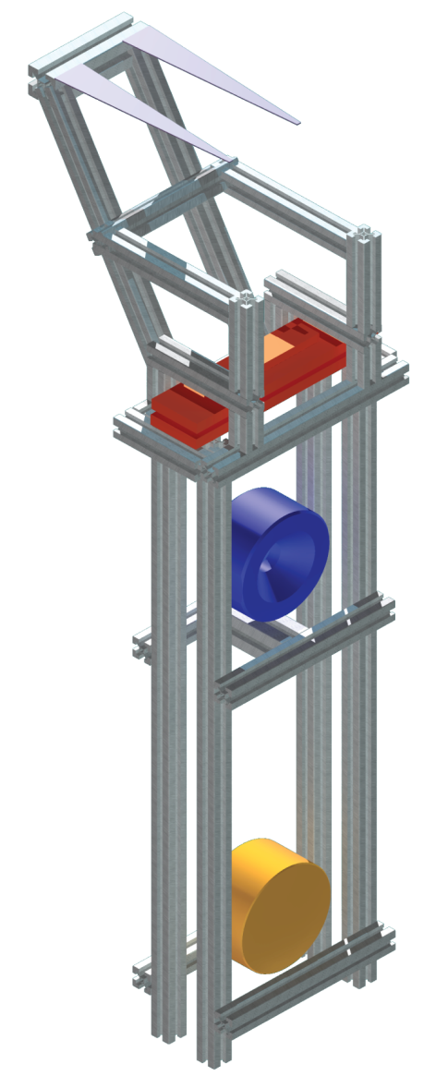
Triple pendulum
Suspension developed for the
10m Prototype reference cavity
triple cascaded pendulum
two vertical stages
compound lower mass

Slide 5
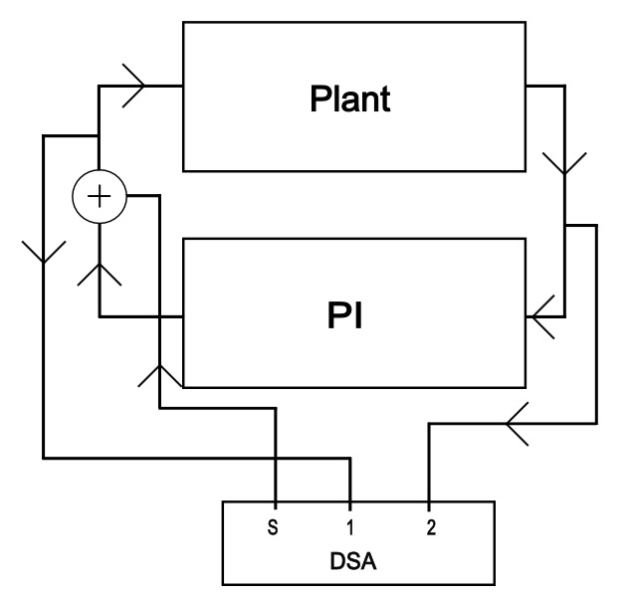
TFs for the plant
TFs needed to characterise the system (plant)

Slide 6
System identification
Linear estimation model based on
A: system matrix, B: input matrix
C: output matrix
describing the state
space model

Slide 7
LQR
Consider linear time-invariant system
Control law
Eigenvalues of must have negative real part => system stable

Slide 8
LQR
Formulation of the control problem leads to quadratic integral criteria
where Q and R are design parameter
Find the u which minimises the cost function

Slide 9
Kalman Filter
Takes account of noise
Optimal estimator for state x
w process noise
v sensor noise

Slide 10
LQG
Combining LQR and Kalman filtering
=> Linear Quadratic Gaussian (LQG)
Resulting cost function
Solution of the feedback regulator replaces x by its minimum mean square linear estimator

Slide 11
Thanks for your attention & let the
discussion begin !

