Slide 1
Yet another SQL?
Tobias Westphal
http://www.qi.aei-hannover.de/
Geo ISC meeting, May 2011

Slide 2
outlook
The SQL - a fundamental limit for classical interferometry
Basics
Heisenberg uncertainty
Time evolution of a free mass
Shot noise vs. radiation pressure noise
Free mass SQL
Free mass → oscillator
Transfer function
Oscillator SQL
Nano oscillators
There is no „force SQL“
Membrane interferometer (B12)

Slide 3
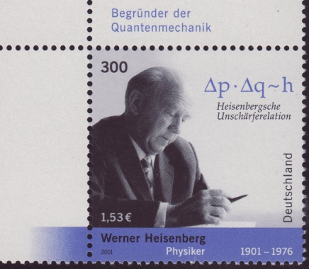
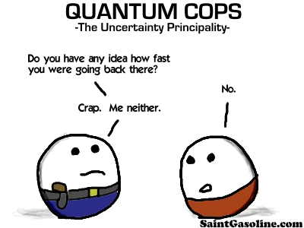
Heisenberg uncertainty
Non commuting operators
Position x
Momentum p
Variance
Measure of the spread
Δx= <(x- <x>)²
= <x²> - <x>²
Heisenberg says
Δx Δp ≥ ħ/2
→ Measuring x exactly smears out p

Slide 4
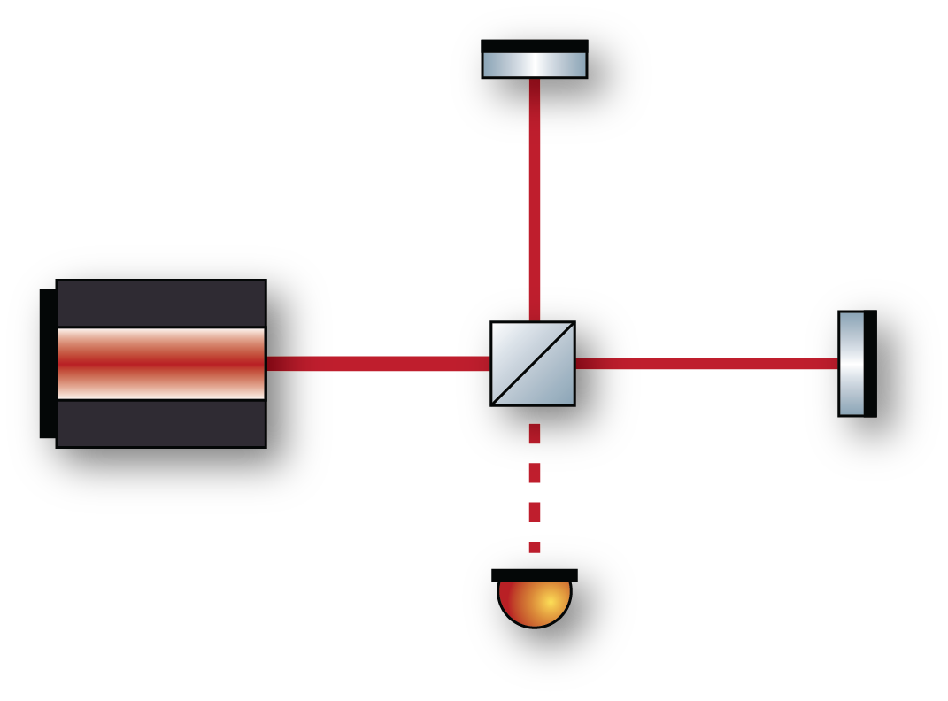
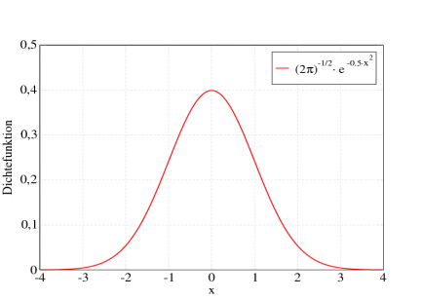
Measuring positions exactly
Interferometry
measures differential displacements
Single measurement sets limit on Δx(0)
Consequences
Δp(0) is set (state collapses)
Time evolution translates
Δp(0) → Δx(τ)
Position measurements at different times do not commute
→ back action noise
Δx(0)
Δx(τ)
→ Δp

Slide 5
How to: back action noise
Standard text book explanation
Momentum uncertainty converts to (uncertain) position change
(Δx)²(τ) = (Δx)²(0) + [(Δp)²(0) /m²] τ
≥ 2 Δx(0) Δp(0) τ/m
≥ ħτ/m
(Δx)(τ) ≥ √(ħτ/m)
Caves states
Free mass undergoes unitary evolution
Time evolution of collapsed (measured) state
(Δx)²(τ) = (Δx)²(0) + [(Δp)²(0) /m²] τ
+ [<x(0)p(0)+p(0)x(0)> -2<x(0)> <p(0)> ] τ/m
Last term could be negative (contractive states)
Standard argument is valid for linear x-readout
Δx(0)
Δx(τ)
→ Δp

Slide 6
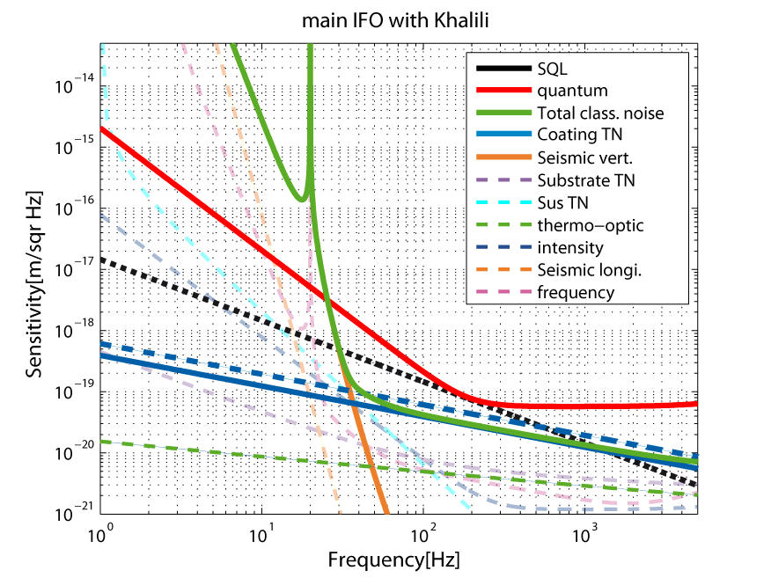
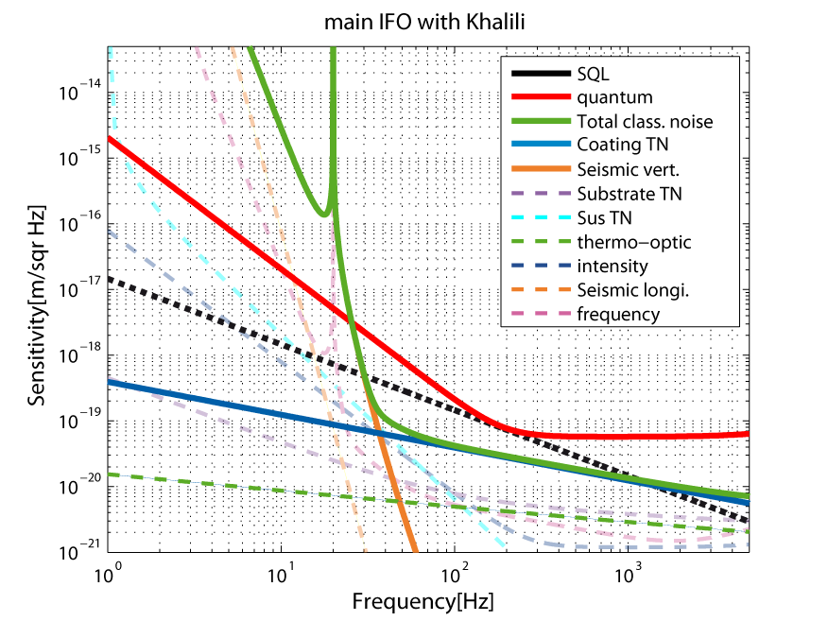
Welcome the quantum noise

Slide 7
Interferometers point of view
Inputs into the interferometer:
Laser amplitude a_{las}
sent into bright port
Vacuum amplitude a_{vac}
enters dark port
Combined by beam splitter
Vacuum anti corollated by BS phase
a_{north}= (a_{las} + a_{vac})/ √2
a_{east} = (a_{las} - a_{vac})/ √2
a_{las}
a_{vac}

Slide 8
Shot noise
Limit for position measurement
a_{bright} = a_{north} /√2 + a_{east}/√2
= a_{las}
a_{dark} = a_{north} /√2 - a_{east}/√2
= a_{vac}
With signal at dark port:
a_{dark} = a_{sig} + a_{vac}
P_{dark} = (a_{sig} + a_{vac})²
= a_{sig}² + a_{vac}² + 2a_{sig} a_{vac}
Signal normalized shot noise:
a_{sig} a_{vac} /a_{sig}² ~ 1/√P_{las}
a_{north}= (a_{las} + a_{vac})/ √2
a_{east} = (a_{las} - a_{vac})/ √2
a_{las}
a_{vac}
Shot noise

Slide 9
Radiation pressure noise
P_{north} = a_{north} ²
= a_{las}²/2 + a_{vac}²/2 + a_{las}a_{vac}
P_{east} = a_{east} ²
= a_{las}²/2 + a_{vac}²/2 - a_{las}a_{vac}
P_{diff} = P_{north –} P_{east}
= 2 a_{las}a_{vac}
Back action noise
F_{diff} = 2P_{diff}/c
x_{diff} = H F_{diff}
= H 4a_{las}a_{vac} /c
~ √P_{las}
a_{north}= (a_{las} + a_{vac})/ √2
δp_{γ} = 2E_{γ}/c
a_{east} = (a_{las} - a_{vac})/ √2
a_{las}
a_{vac}

Slide 10
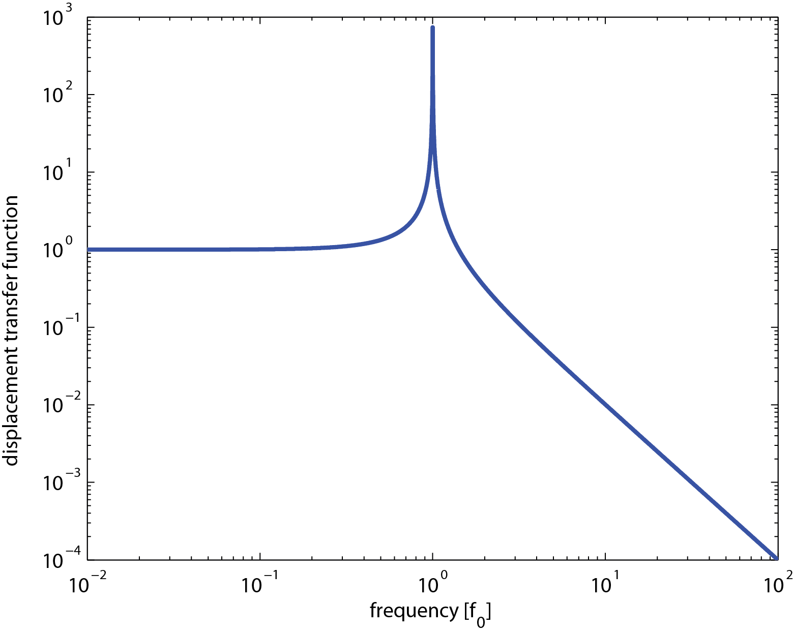
Suceptibility / transfer funtion
Displacement of clamping point moves suspension point
Clamping point
x_{CP}
x_{SP}
Below resonance: no isolation (1)
At resonance: enhancement (Q)
Above resonance: isolation (~1/f²)
Suspension
point

Slide 11
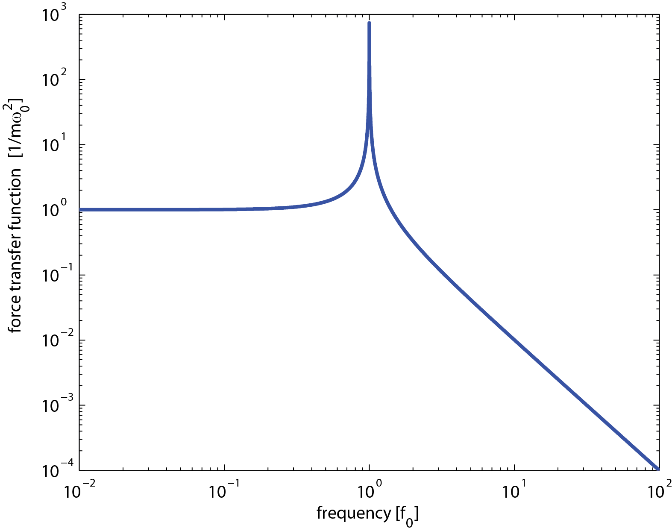
Suceptibility / transfer funtion
Force onto suspension point moves suspension point
Clamping point
F_{SP}
x_{SP}
Below resonance: constant response (1/mω₀²)
At resonance: enhancement (Q)
Above resonance: isolation (~1/f²) →
Suspension
point
Free mass!

Slide 12
Welcome the SQL
Shot noise
√G_{shot}(f)=const
√G_{shot} ~ 1/ √P_{las}
Radiation pressure noise
√G_{rad} (f)~ 1/ω²
√G_{rad} ~ √P_{las}
Total quantum noise
√G_{Qtot} = √(G_{rad} + G_{shot})
Standard quantum limit
√G_{SQL} = √G_{Qtot} (P) |G_{rad}=G_{shot}
= √(2 G_{rad}(P_{opt}) )

Slide 13
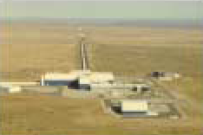
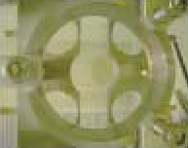
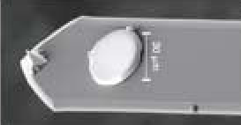
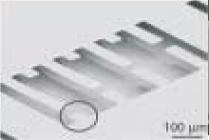
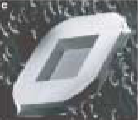
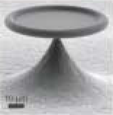
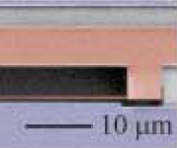
Trend towards nano oscillators
kg
Effective Mass
Hz
pg
Resonance Frequency
MHz
[Kippenberg, Vahala, DOI: 10.1126/science.1156032]

Slide 14
Back to the roots
Susceptibility: free mass → oscillator
m_{mem}= m = mass of oscillator
ω_{mem}= ω₀ = resonance frequency
Q = quality factor
Below resonance: constant response (1/mω₀²)
At resonance: enhancement (Q)
Above resonance: isolation (~1/f²)

Slide 15
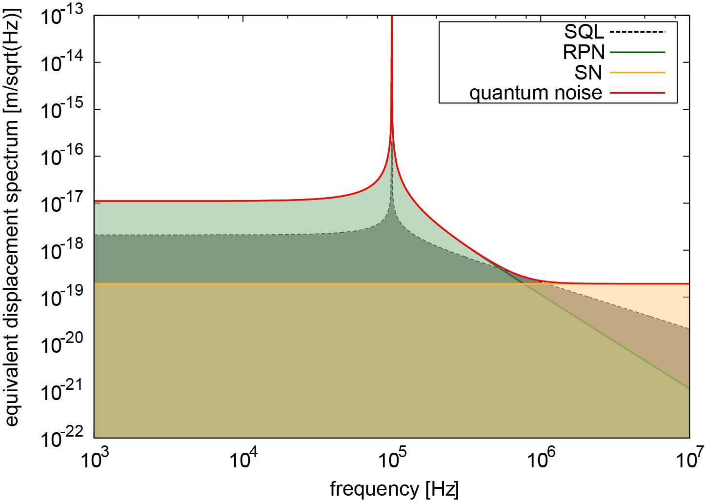
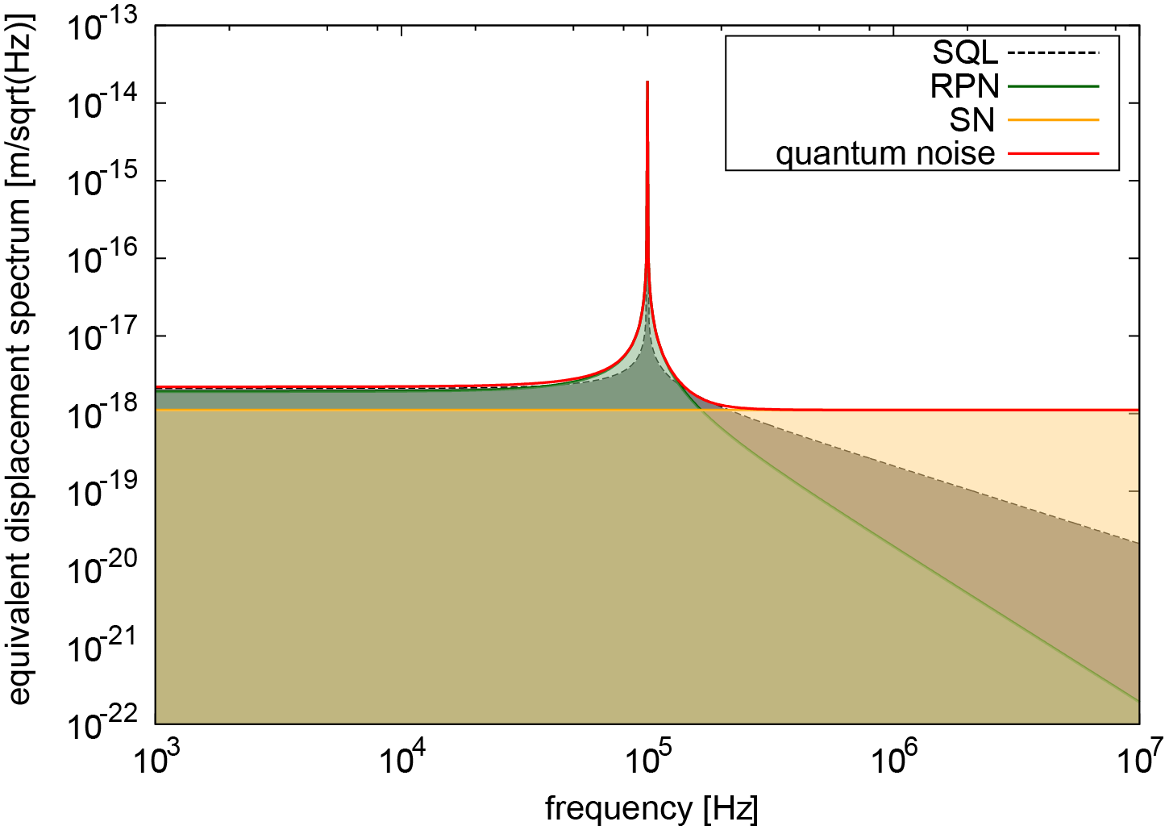
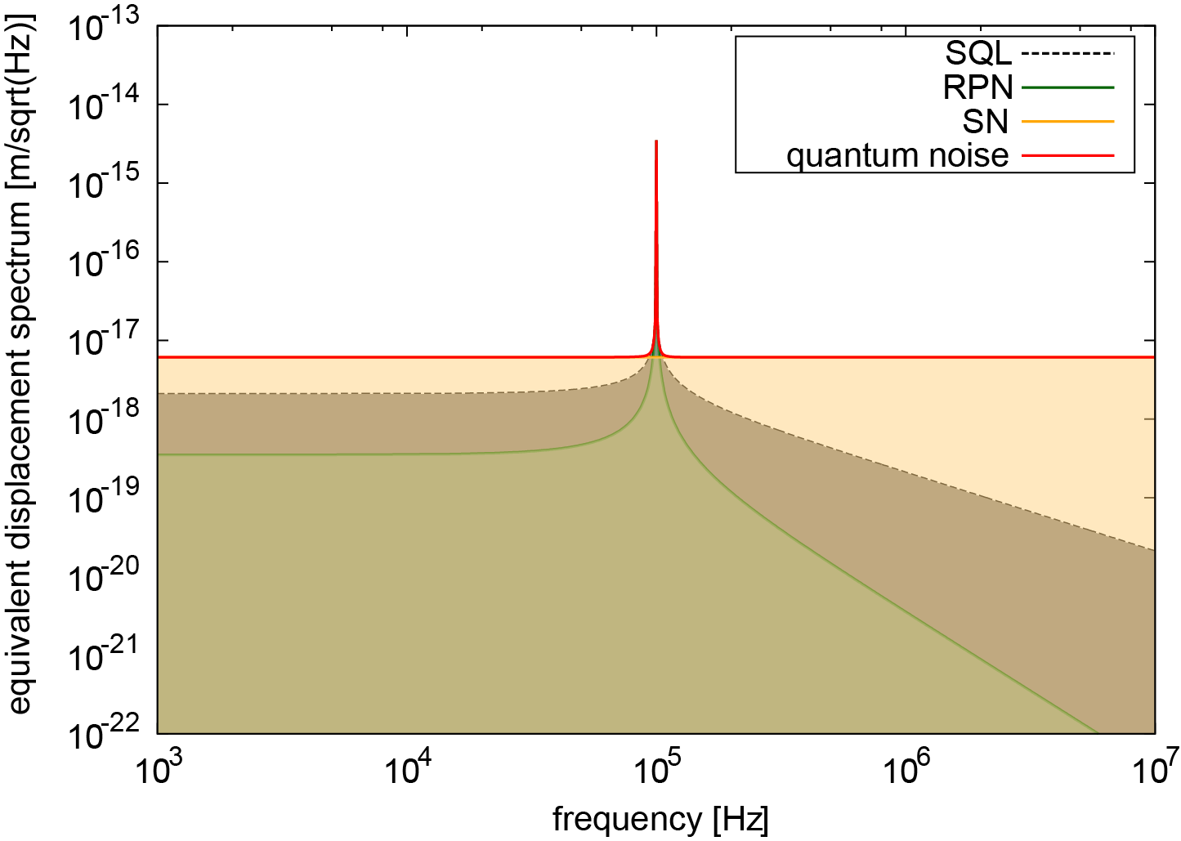
SQL below free mass limit
r²P₀ = total reflected power
(Formulas valid for B12 interferometer)

Slide 16
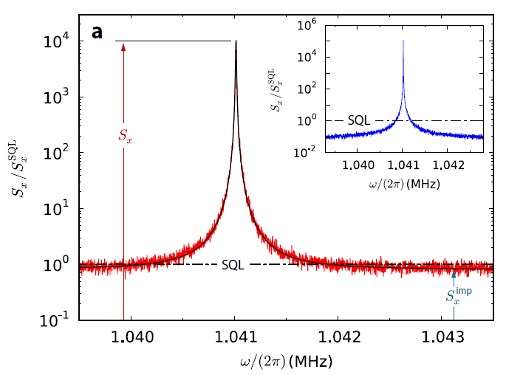
Wrong interpretation
Lehnert group
Sensitivity was normalized to peak value of SQL
But neither oscillator nor free mass SQL were (could be) beaten
→ Linear position readout
Trick:
A force SQL is introduced
Positions are measured and forces is inferred
BUT force is classical
→ no back action, no SQL

Slide 17
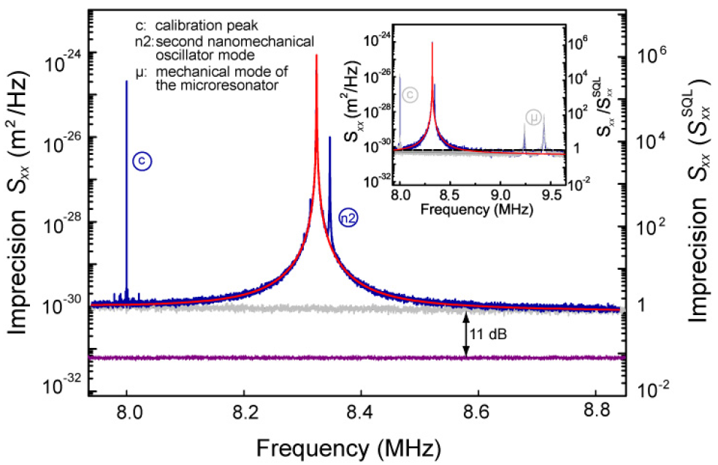
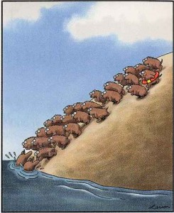
„Lets play lemmings“
Kippenberg group
Followed Lehnert
People tend to „forget“ the SQL definition?
Inferred shot noise below other noises

Slide 18
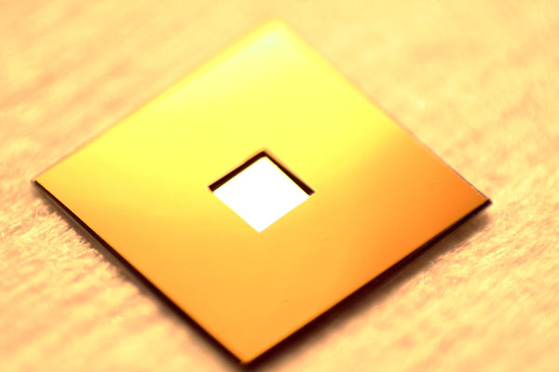
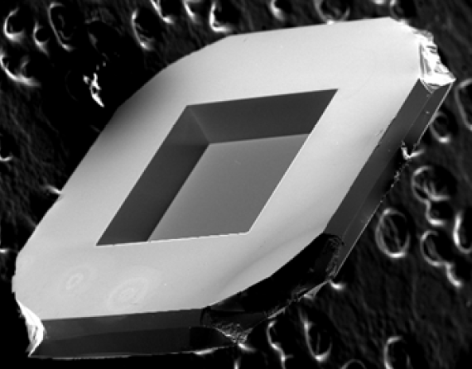
B12 mirror suspension
SiN membrane in SI frame
mechanical properties
frame: 7,5² mm² x 200 µm
area: 1,5 mm x 1,5 mm
thickness: 75 nm
effective mass: ~ 100 ng
resonance freq.: ~ 100 kHz
Q-factor: ~ 10⁶
optical properties
reflectivity: ~ 30%
absorption: ≤ 150 ppm
scattering: → 0
flatness: 1 nm?
roughness: 0,2 nm?
[J.D. Thompson et al. arXiv:0711.2263]

Slide 19
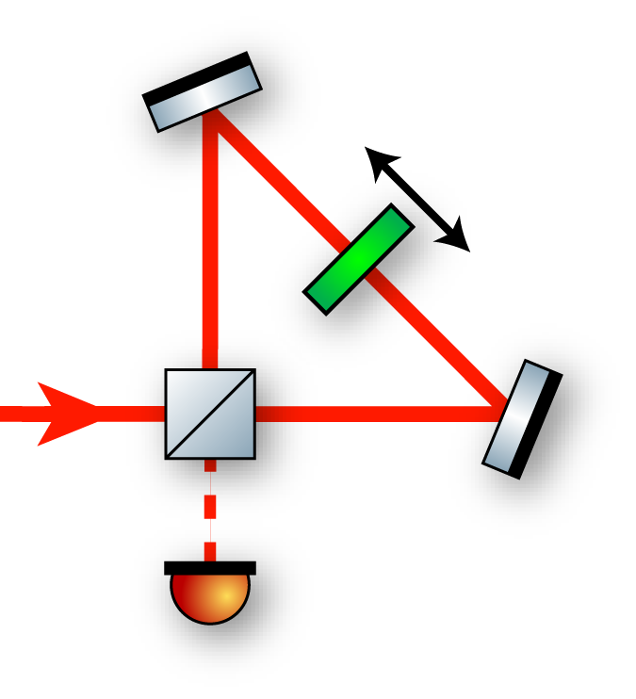
B12 interferometer
Michelson Sagnac configuration
Membrane as common end mirror
of a Michelson interferometer
→ displacement sensitivity doubled
Transmitted light circulates in a Sagnac mode
→ dark output, important for
Common mode rejection
Optical recycling
High amount of symmetry
→ laser frequency noise rejection
Standing wave in Sagnac intererometer
→ low power absorption at the node

Slide 20
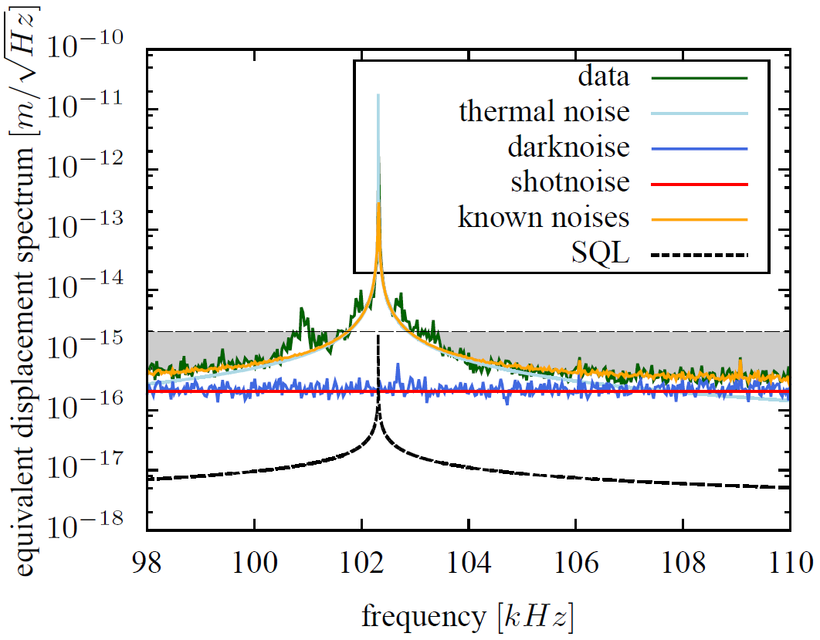
B12 sensitivity
Factor 5.8 below peak SQL value
Sensitivity on resonance limited by
thermal noise
→ cool experiment
Sensitivity off resonant limited by
shot noise
→ non displacement noises below peak:
e.g. laser noise, electronic noise…
Shot noise >10x below peak SQL
→ decrease dark noise

Slide 21
Conclusion
The Standard Quantum Limit
is the set of optimal sensitivities
is defined for linear x-readout
→ can be beaten by QND measurements
→ requires uncorellated quantum noises?
is originally related to a free mass
→ used as quantum noise reference
can be extended to oscillators
There can only be one

