Slide 1
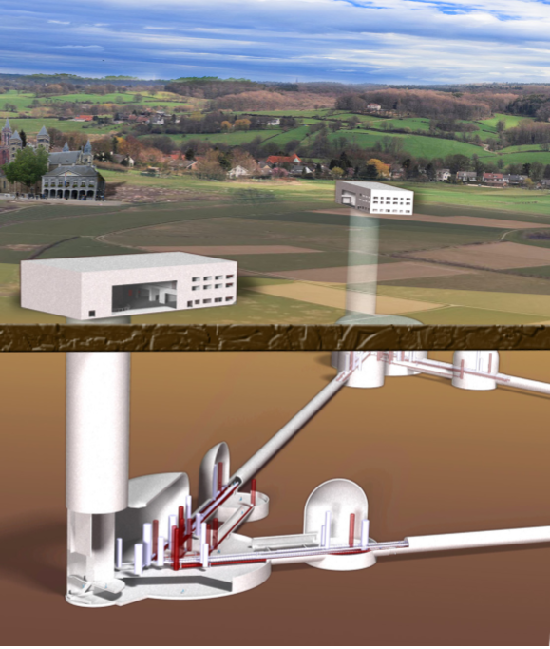
A Time Domain Simulator for Einstein Telescope
*Ayatri Singha, Stefan Hild
*a.singha.1@research.gla.ac.uk
http://www.et-gw.eu
Singha, Hild

Slide 2
Motivation
Why to develop a time domain simulator for ET?
Might be useful in various aspects:
Can test data analysis techniques (see ET Mock data challenge) …
Evaluate what influence have calibration errors between LF and HF?
How do calibration errors influence null stream?
Provide input some detailed design decisions, i.e. how close to put ETMs of one detector to the ITMs of another (is there any optimum in terms coherent or non-coherent Newtonian noise coupling?)
Any questions you have that could be answered with time domain simulator?
Singha, Hild

Slide 3
Contents
Creation of coloured noise data streams
Combining the LF and HF data streams into single data stream, i.e construction of optimal filter.
Simulation for generating null stream.
Effect of calibration error on null stream time.
Future steps
Singha, Hild

Slide 4
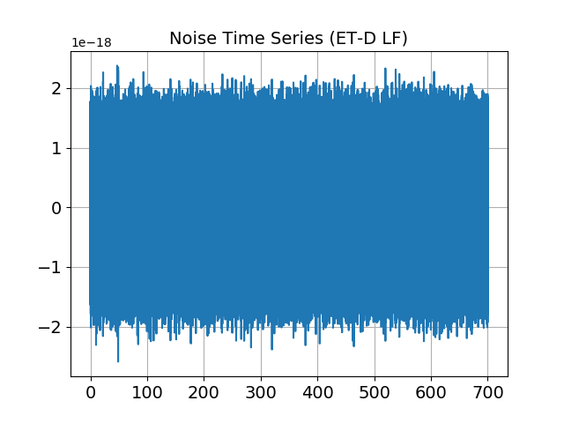
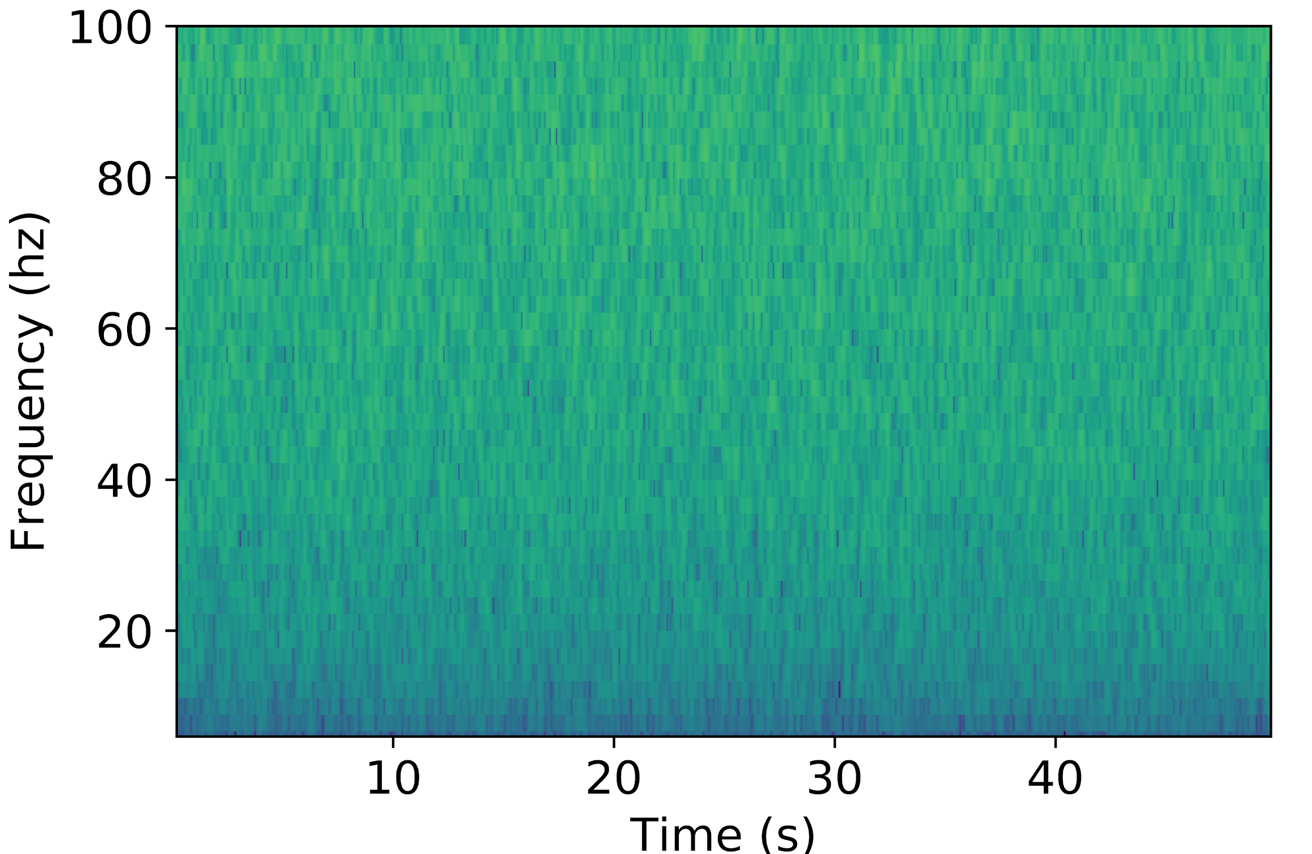
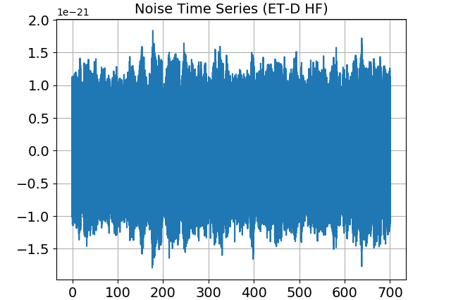
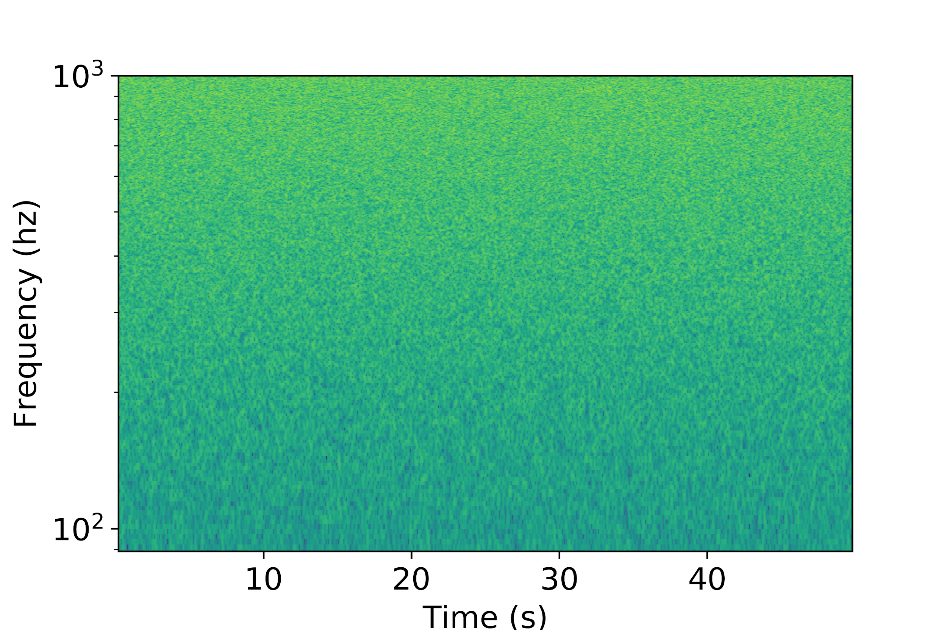
STEP 1: Colour noise generation
Spectrograms
Strain
Time (sec)
Singha, Hild

Slide 5
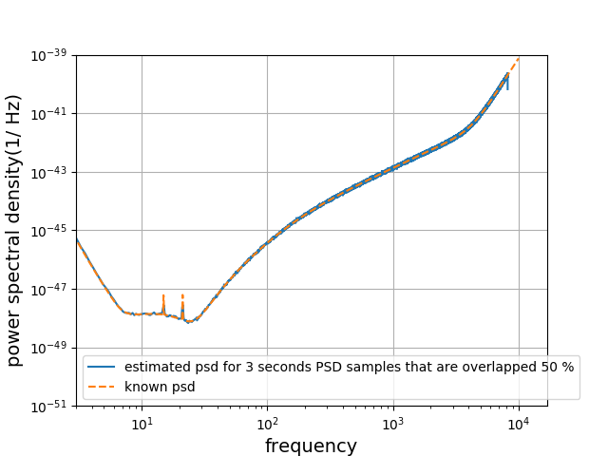
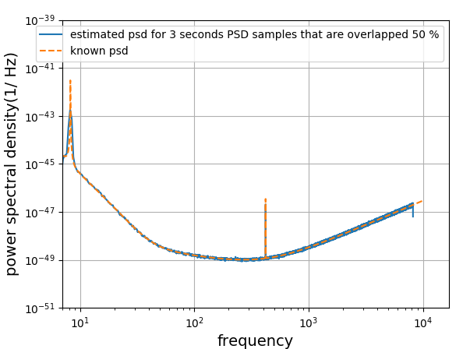
Power spectral density evaluated from generated coloured noise time series
ET-LF
ET-HF
(Hz)
(Hz)
Singha, Hild

Slide 6
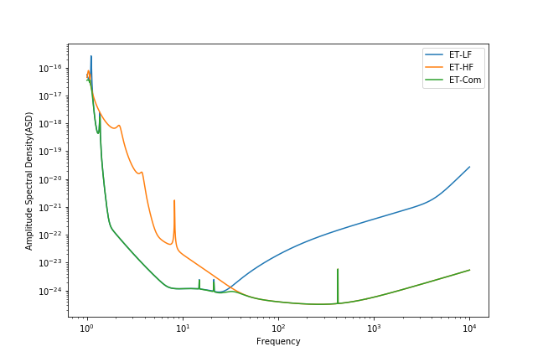
Combining data streams in frequency domain
Data can be combined in frequency domain.
The overall sensitivity will be minimised for both low and high frequency.
ET - LF
ET - HF
(Hz)
Singha, Hild

Slide 7
How to combine data in time series?
It cannot be combined directly as in frequency domain.
Need to construct filter by which one can combine the time series data linearly.
Need to choose optimal filter.
Singha, Hild

Slide 8
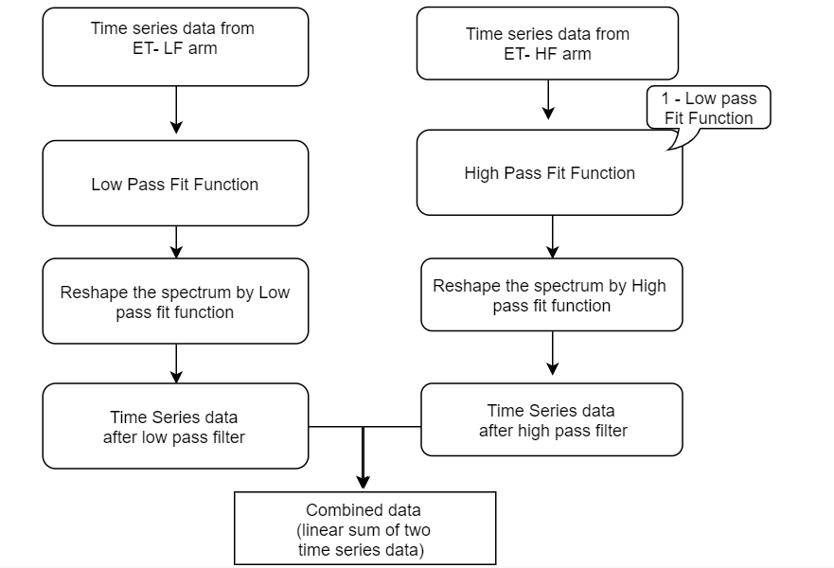
Flow chart for combining two time series data from ET low and high frequency arm.
Singha, Hild

Slide 9
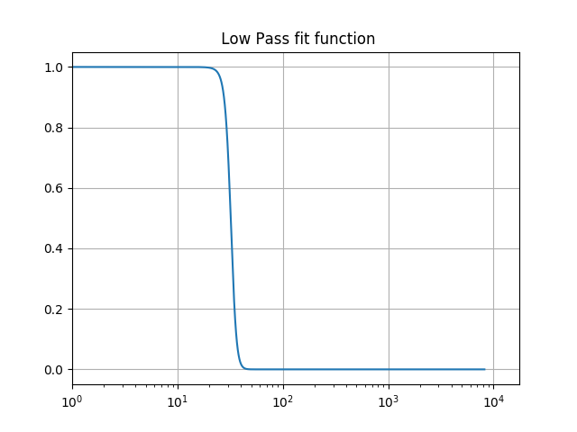
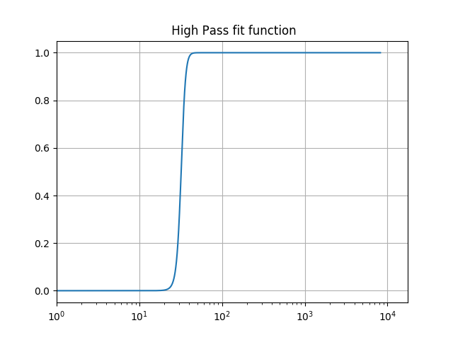
STEP 2: Time domain combination into a single data stream
High pass and low pass fit function
Coefficients
Frequency( Hz)
Frequency( Hz)
Singha, Hild

Slide 10
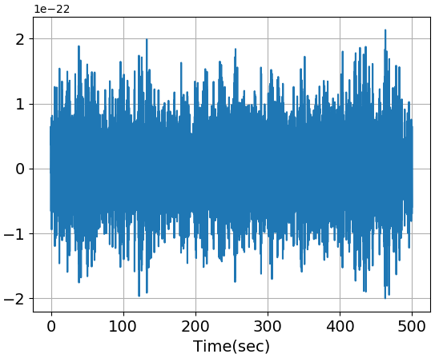
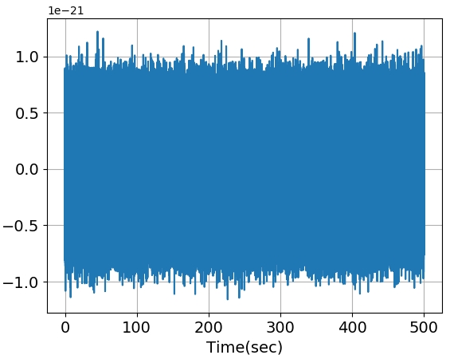
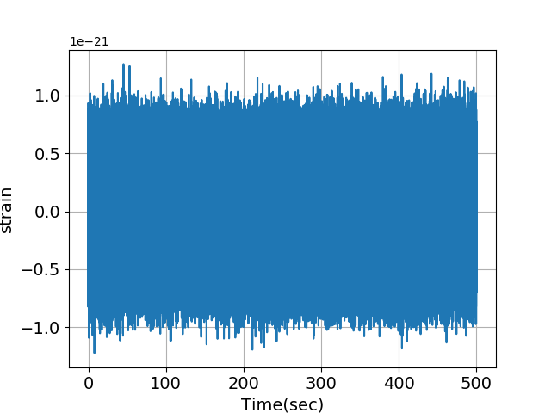
STEP 3: Reshaping the noise time series by low and high pass filter
Time series data from ET-HF and ET-LF
STEP 4: Combining two noise time series
Noise time series from ET- LF after applying low pass filter
Noise time series from ET- HF after applying high pass filter
Noise time series after combining
Strain
Singha, Hild

Slide 11
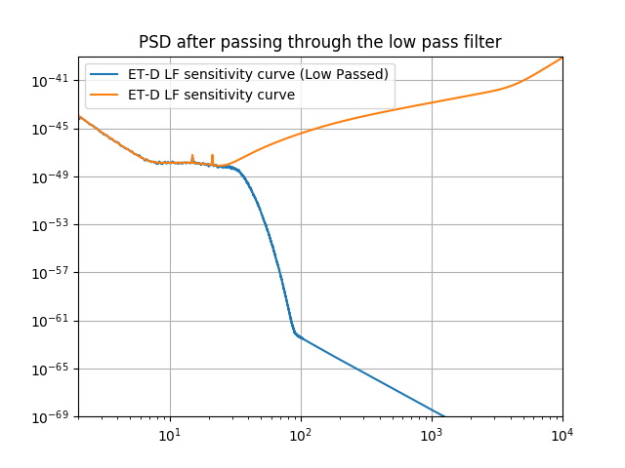
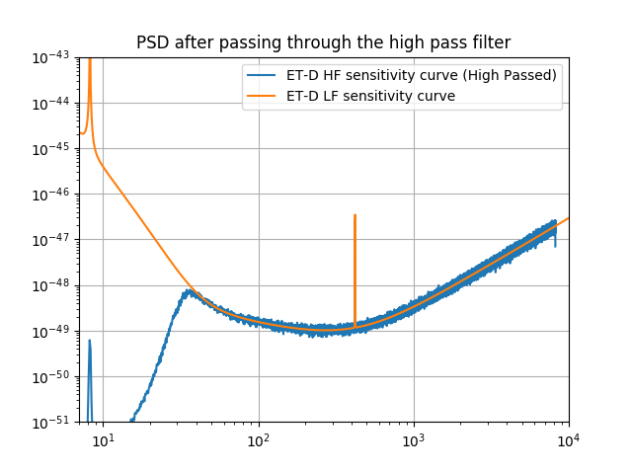
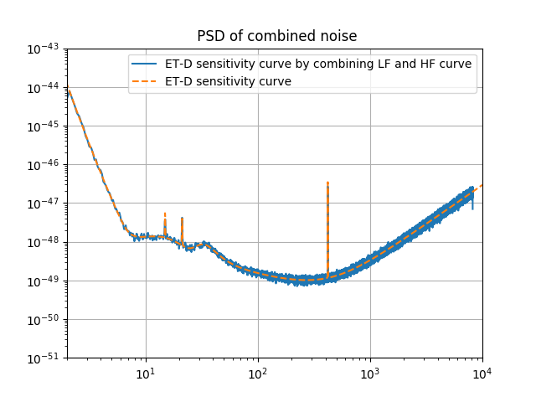
Power spectral density of time series data after passing through high and low pass filter
Power Spectral Density (1/Hz)
Frequency( Hz)
Frequency( Hz)
Frequency( Hz)
Power spectral density has been evaluated by Welch method (considering 7 seconds of samples with overlapping of 50%).
Singha, Hild

Slide 12
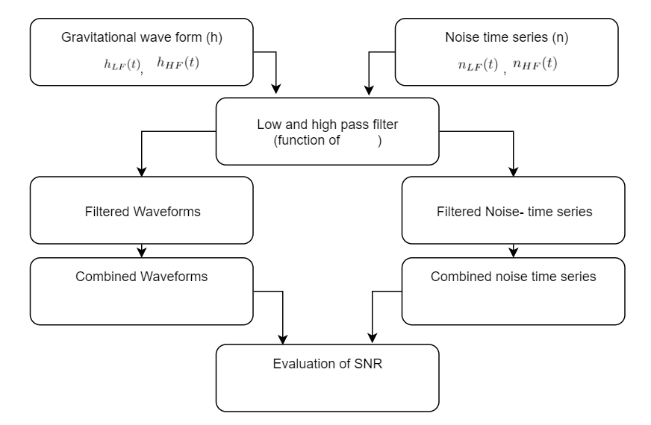
Flowchart to fix optimal choice for the low and high pass filter
Singha, Hild

Slide 13
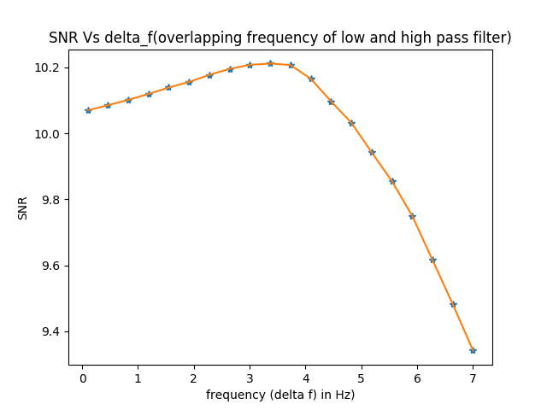
Optimal choice for the low and high pass filter
Gravitational waveform has been generated from following parameters using TaylorF2 model-
Mass1 = 1.4
Mass2 = 1.4,
distance = 5000,
delta_f=1.0/1000,
lower cut off frequency = 2 Hz
𝜹f = 3.6 Hz is our optimal choice for this filter
Singha, Hild

Slide 14
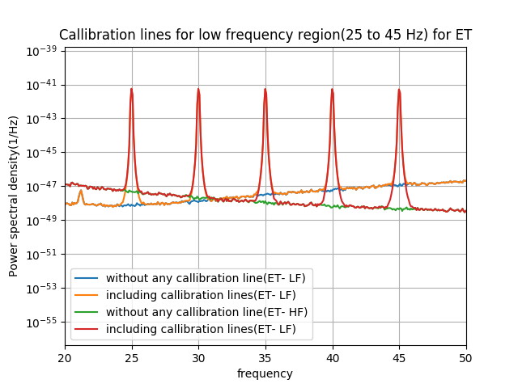
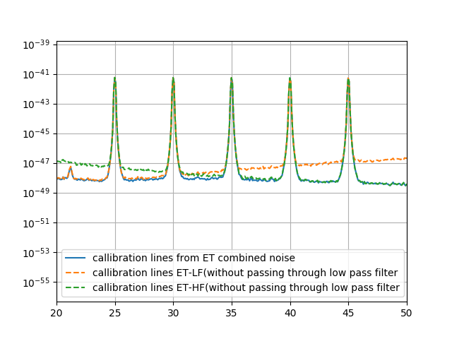
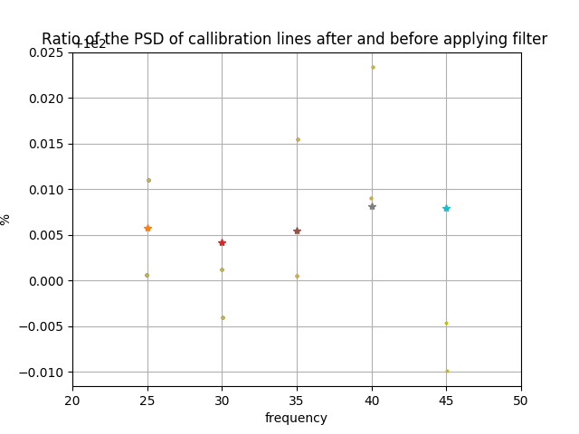
Demonstration the eﬀect on Calibration lines for using Optimal Filters
Equi-spaced calibration lines are injected between frequency range 25 to 45 Hz
Ratio of Reconstructed to injected calibration lines
Injected Calibration lines
Reconstructed Calibration lines
Power Spectral Density (1/Hz)
frequency
(Hz)
frequency
(Hz)
frequency
(Hz)
frequency
(Hz)
Singha, Hild

Slide 15
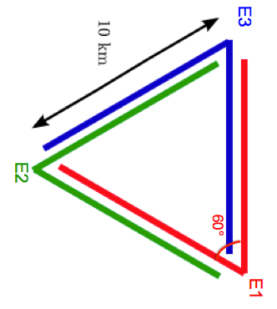
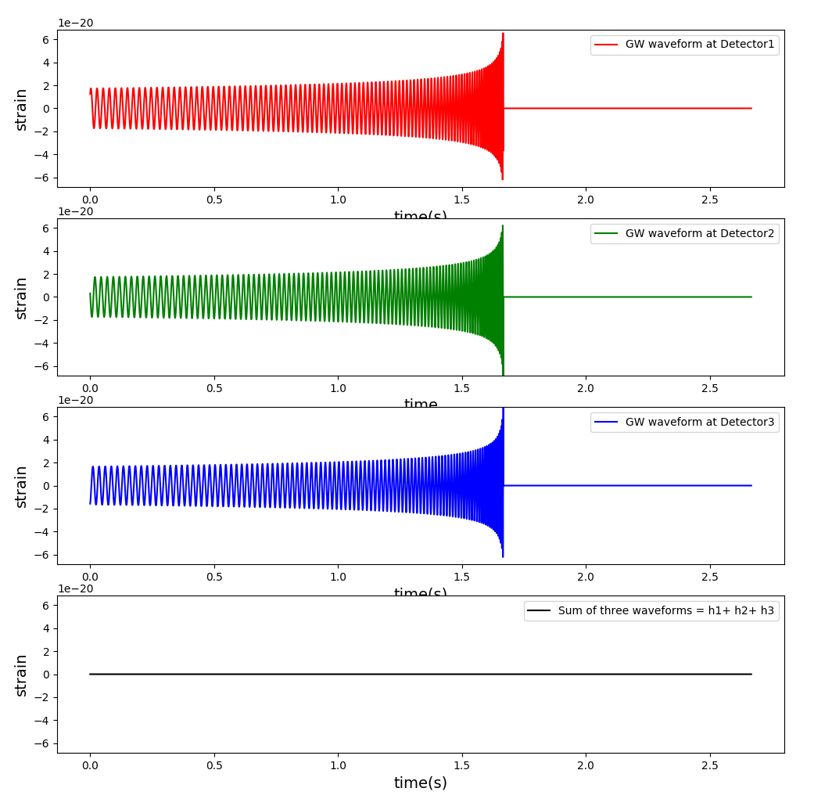
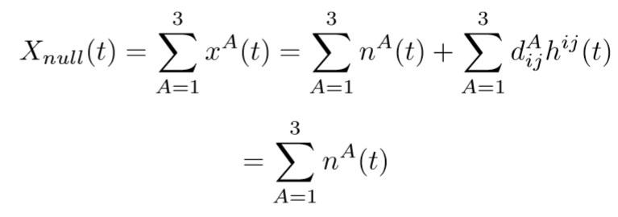
Null Stream Analysis
Data strain at each arm can be expressed as
Null stream can be written as
Singha, Hild

Slide 16
Null steam using mock data generation
Strain Data
Time(s)
Singha, Hild

Slide 17
Null stream using mock data generation
Null Stream = Data Stream1 + Data Stream2 + Data Stream3
Null stream = sum of all the
Waveforms and noise generated for three arms of ET.
As we know , the sum of three waveforms = 0, hence we are left with pure noise.
1e-21
1e-21
Singha, Hild

Slide 18
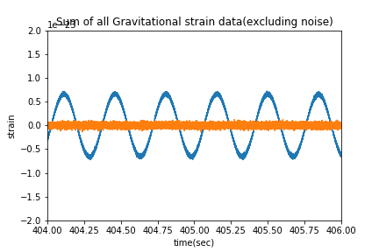
Effect of amplitude calibration error on null stream
The fraction of signal present in null stream due to calibration error
The background blue curve is representing the gravitational waveform including 4% amplitude calibration error. As a result of this calibration error we are getting orange plot, which is simply sum of the tree waveforms(ideally should be zero)
Singha, Hild

Slide 19
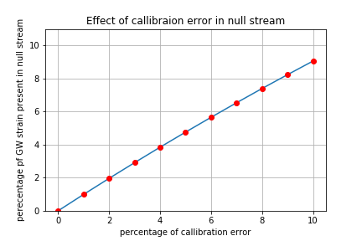
Effect of amplitude calibration error on null stream
The average fractional energy that is being present on null stream can be computed by
Singha, Hild

Slide 20
Summary:
Developed framework for a basic ET Time Domain simulator.
Checked that it delivers required noise characteristics
Developed combining filters to create a single data stream per xylophone detector.
Showed that nullstream can only be as good as the calibration of individual detectors.
Future Steps:
Next simulate realistic movement of all mirrors caused by newtonian noise and explore coherence and subtraction effects.
Happy to hear any ideas you have for other applications or questions that could be looked into with time domain simulator.
Singha, Hild

Slide 21
Singha, Hild

Slide 22
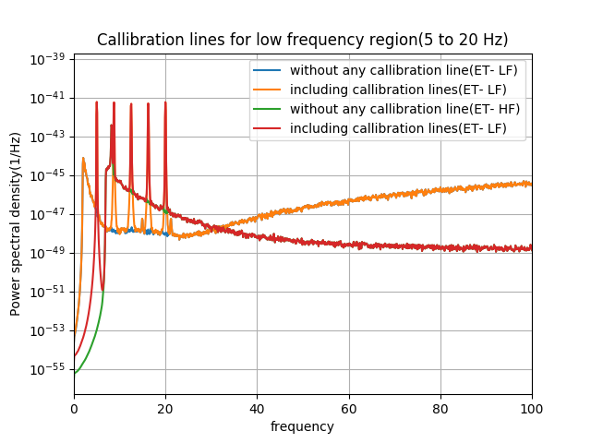
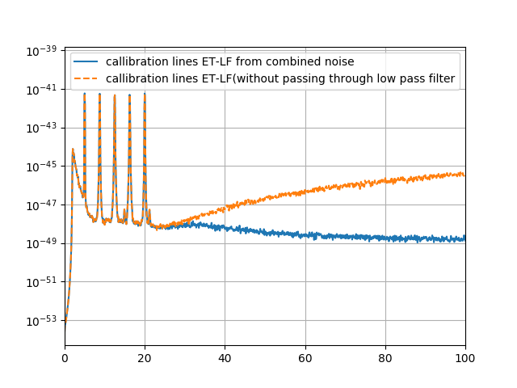
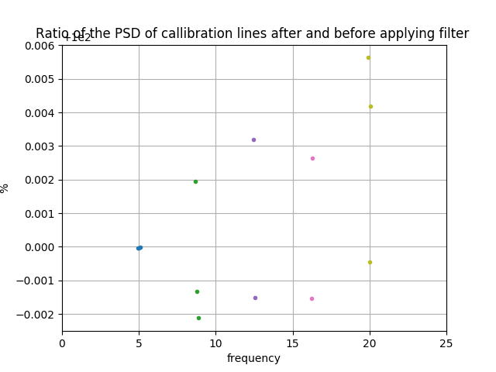
Demonstration the eﬀect on Calibration lines for using Optimal Filters
Equi-spaced calibration lines are injected between frequency range 5 to 20 Hz
Singha, Hild

Slide 23
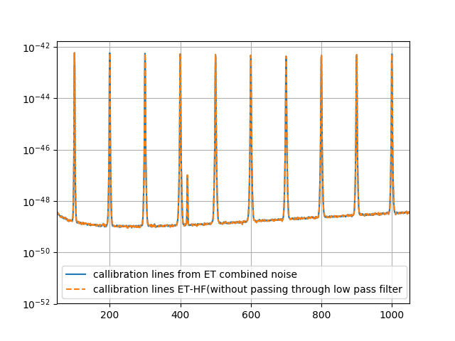
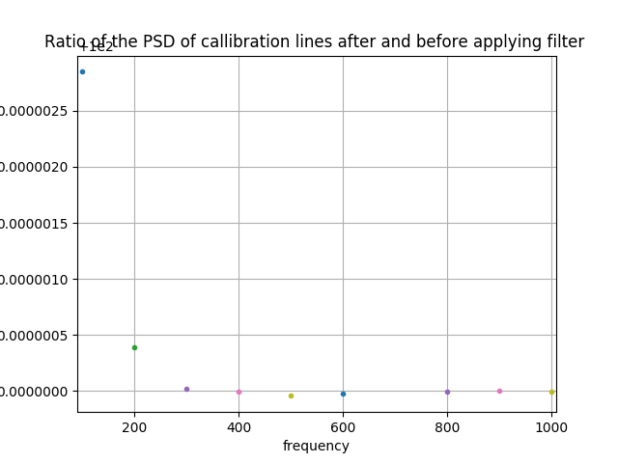
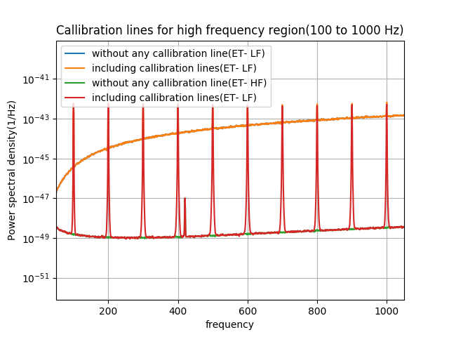
Demonstration the eﬀect on Calibration lines for using Optimal Filters
Equi-spaced calibration lines are injected between frequency range 100 to 1000Hz
Singha, Hild

Slide 24
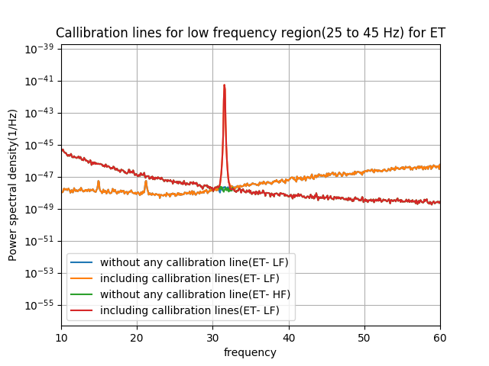
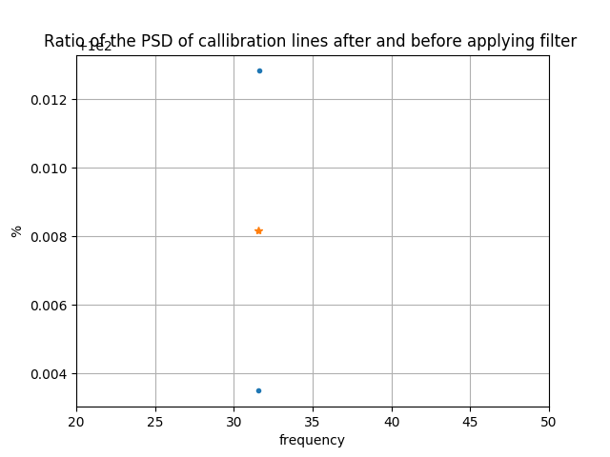
Demonstration the eﬀect on Calibration lines for using Optimal Filters
Calibration lines are injected at 31.56 Hz
Singha, Hild

Slide 25
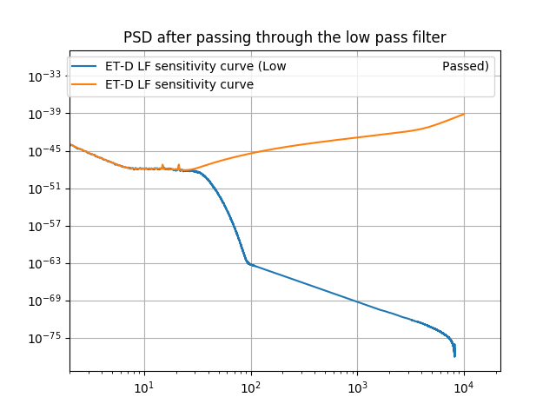
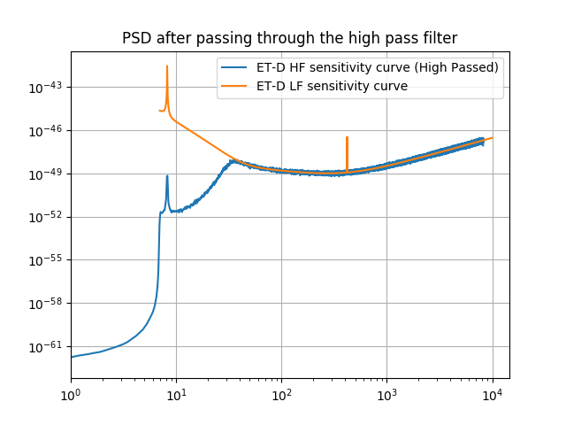
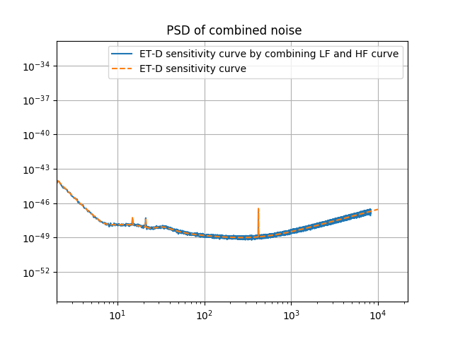
Power spectral density of time series data after passing through high and low pass filter
Power Spectral Density (1/Hz)
Frequency( Hz)
Frequency( Hz)
Frequency( Hz)
Singha, Hild

