Slide 1
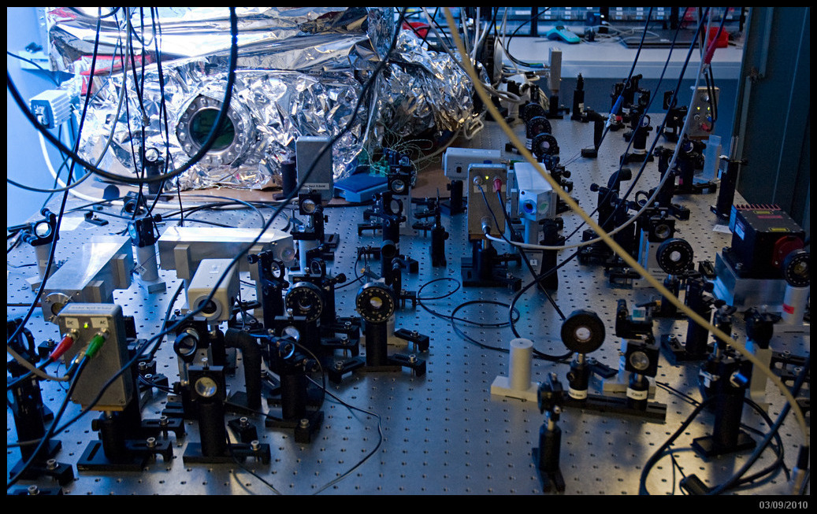
Interferometric sensing and control with higher-order Laguerre-Gauss modes
Paul Fulda
University of Birmingham

Slide 2
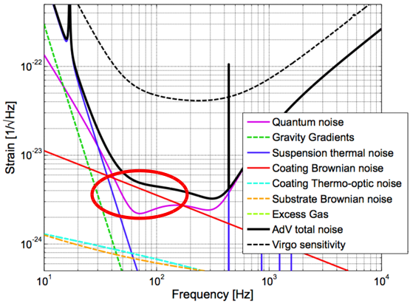
Motivation for Laguerre-Gauss (LG) mode interferometry
Thermal noise of mirrors will limit future sensitivity
Brownian motion causes movement of surface
Couplings of temperature
fluctuations to noise:
Thermo-refractive noise
Thermo-elastic noise

Slide 3
Motivation for LG mode interferometry
Higher-order LG beams spread light power more evenly over a mirror (for a given clipping loss)
Average better over surface distortions

Slide 4
Simulations of LG modes in gravitational wave detectors
Aims:
Perform first phase noise analysis for LG modes in gravitational wave interferometer systems
Build a detailed simulation of a detector with LG modes
Assess potential increase in sensitivity achievable with LG modes
Chelkowski, S. et al, ‘Prospects of LG modes in GWDs’, Phys Rev D, 79, 122002, June 2009, LIGO-P0900006

Slide 5
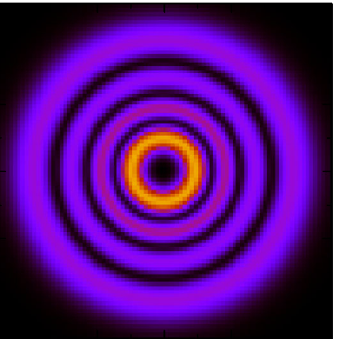
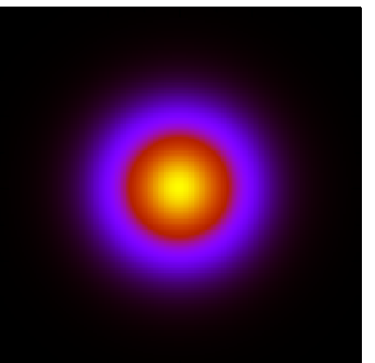
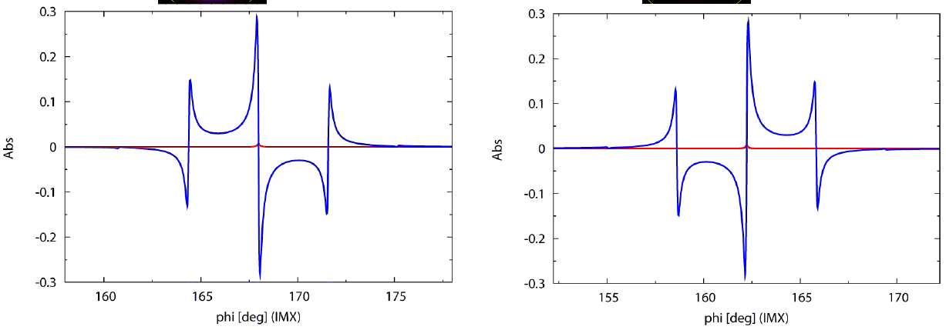
Longitudinal control signals using Pound-Drever-Hall method
LG33
LG00

Slide 6
Longitudinal control signals using Pound-Drever-Hall method
LG33
LG00
LG33 PDH signal identical to LG00 PDH signal

Slide 7
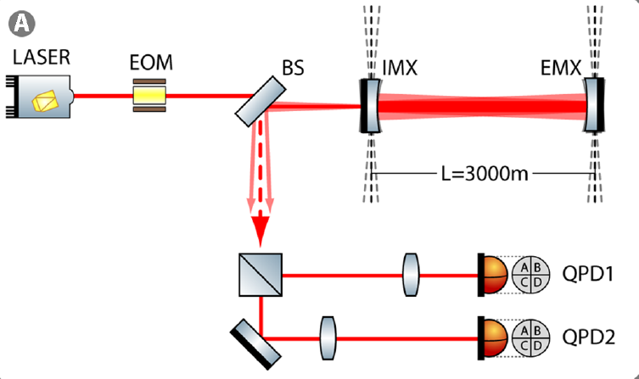
Alignment analysis of an arm cavity
A detailed and realistic simulation of the arm cavity alignment sensing was performed

Slide 8
Alignment analysis of an arm cavity
A detailed and realistic simulation of the arm cavity alignment sensing was performed
Alignment signals equivalent for LG33 and LG00

Slide 9
Sensitivity improvements with the LG33
The scenario of ‘minimal change’ between LG00 LG33 offered and improvement in expected NSNS detection rate of 1.4 for Advanced Virgo
With a full mirror change an improvement by a factor of 2.1 was found to be possible
See Janyce Franc’s ET note/paper for more details on thermal noise scaling with LG modes

Slide 10
Experimental LG mode interferometry
Aims:
Experimental demonstration of higher-order mode interferometry
Experimental verification of our earlier results based on numerical simulations
Observe the mode cleaning effect, and investigate mode degeneracy problem suggested by Rana
Fulda, P. et al, ‘Experimental demonstration of higher-order LG mode interferometry’, Phys Rev D, 82, 012002, July 2010, LIGOP1000040.

Slide 11
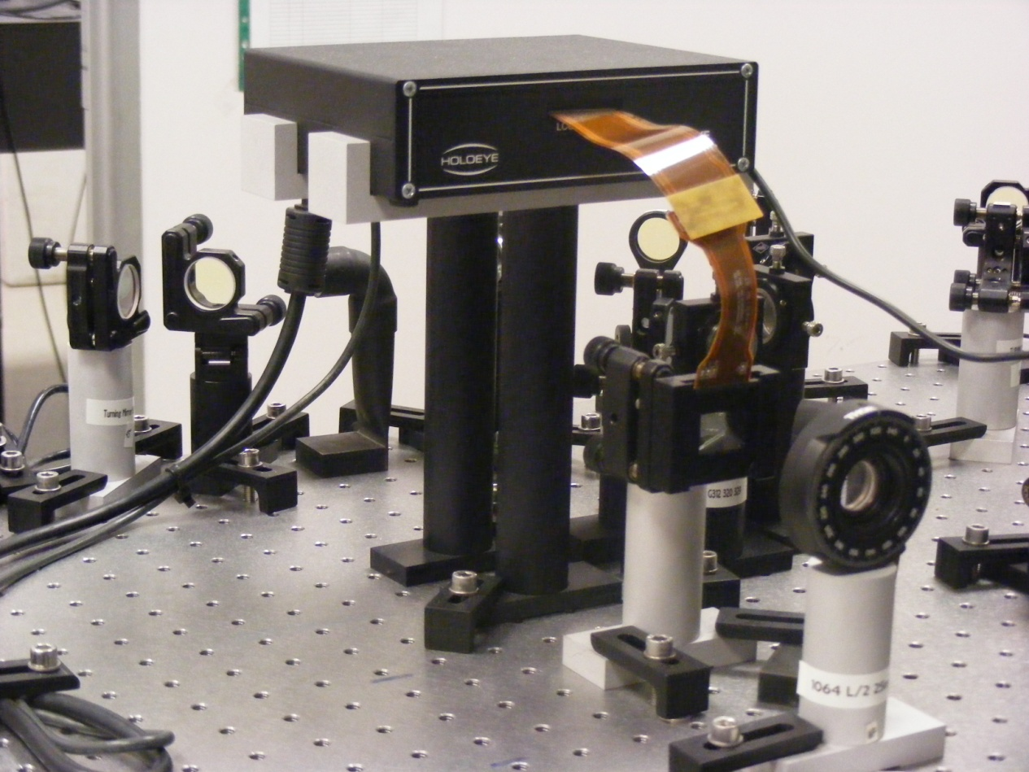
Spatial light modulator
A device for prototyping diffractive optical elements – the two are equivalent for this work

Slide 12
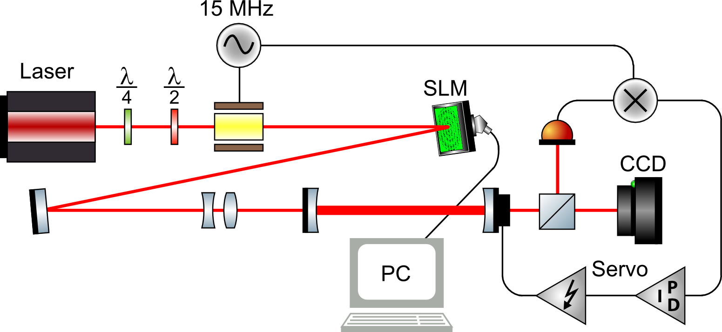
Experimental setup for LG mode generation and cleaning
Finesse = 172

Slide 13
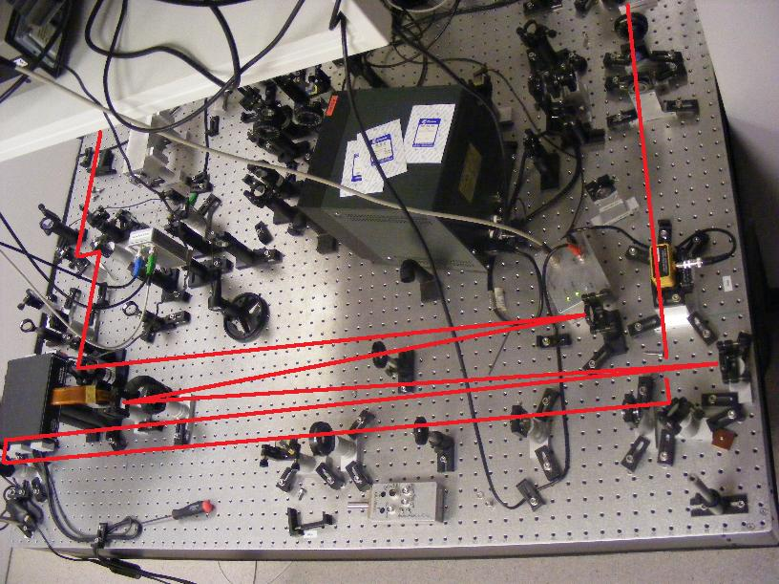
Generated LG beams

Slide 14
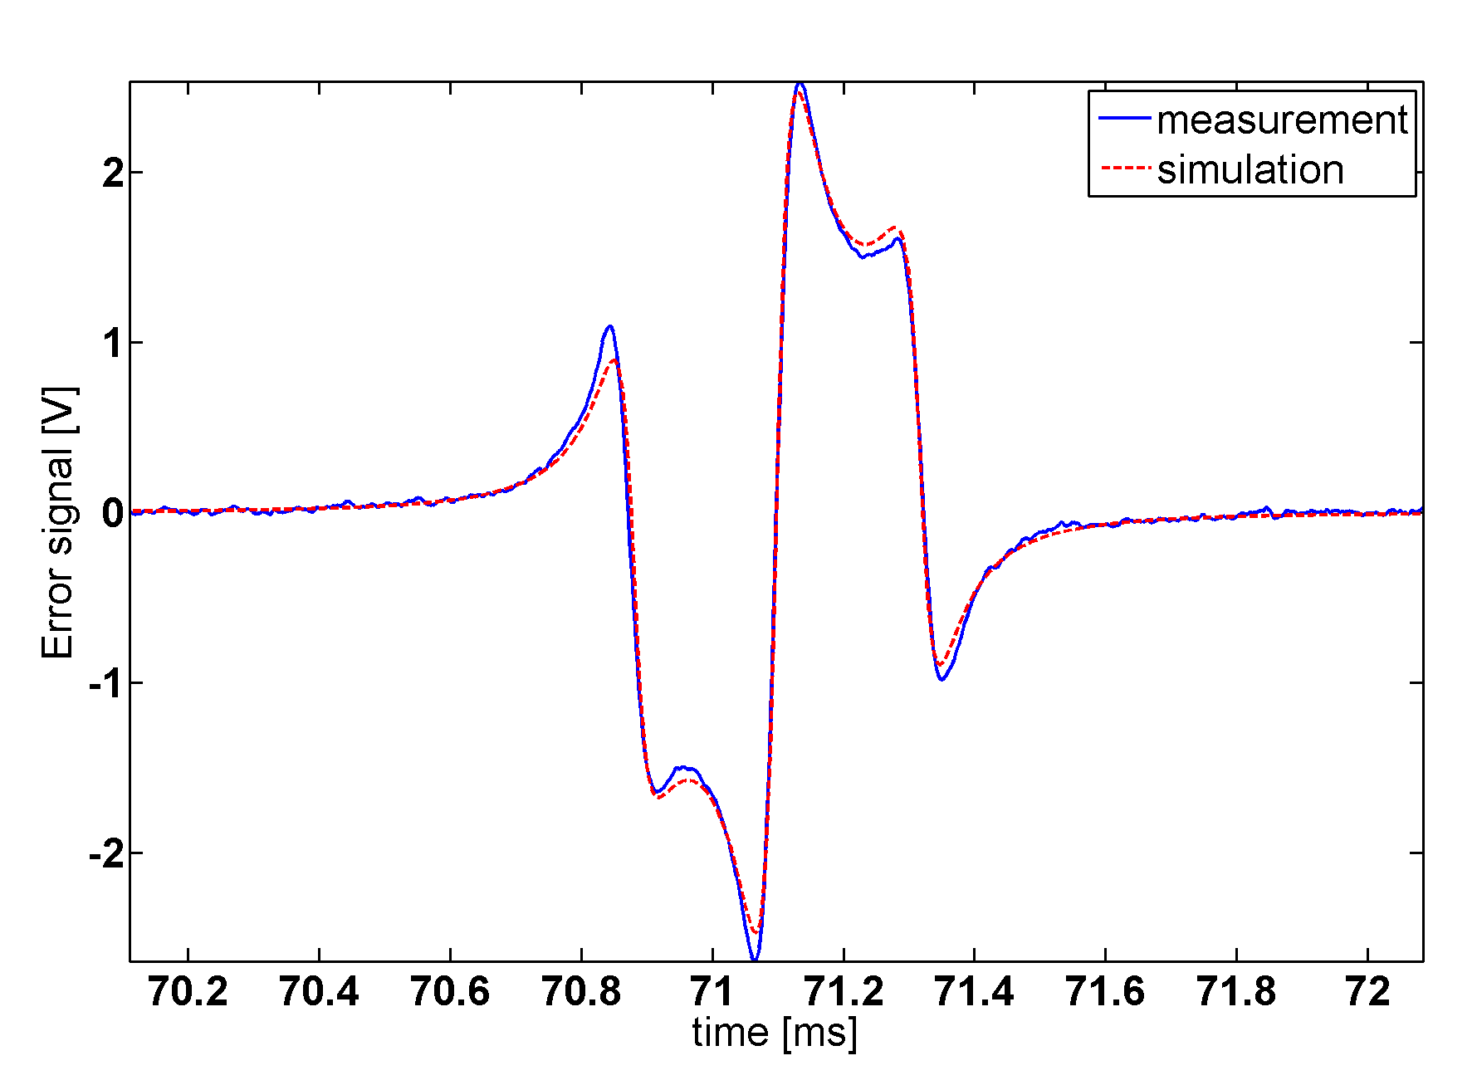
PDH error signal for a LG33 mode

Slide 15
PDH error signal for a LG33 mode
LG33 PDH signal equivalent to that for LG00

Slide 16
PDH locking of linear mode cleaner (LMC)
Input beam manually aligned to LMC optic axis
Lock acquisition is easy and repeatable
Lock is stable over long time scales (~1hr)
LMC stays in lock when input is changed from helical to sinusoidal mode
LMC could be locked to transmit modes up to order 24 (LG88)

Slide 17
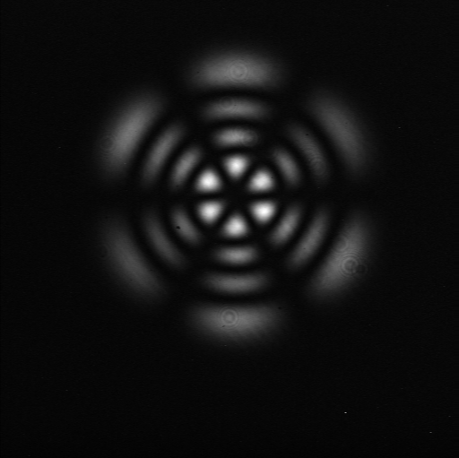
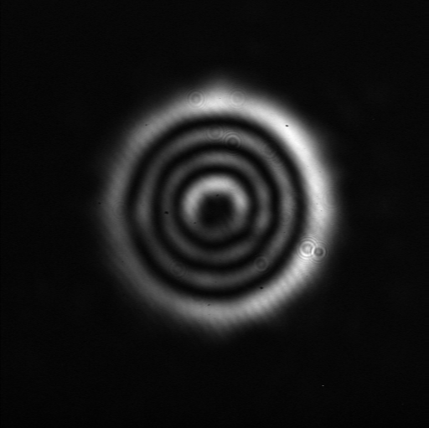
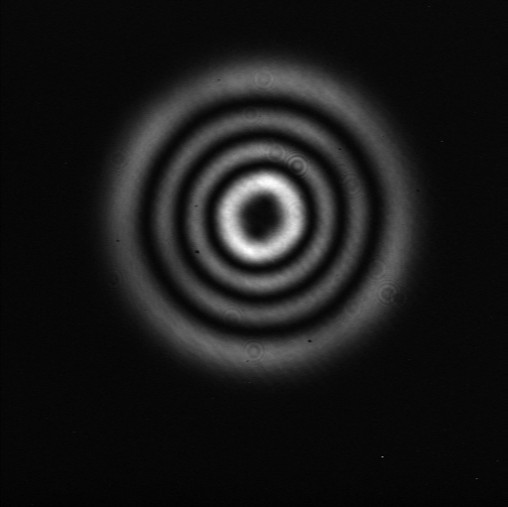
Input and transmitted LG33 beams
Sinusoidal LG33
Helical LG33

Slide 18
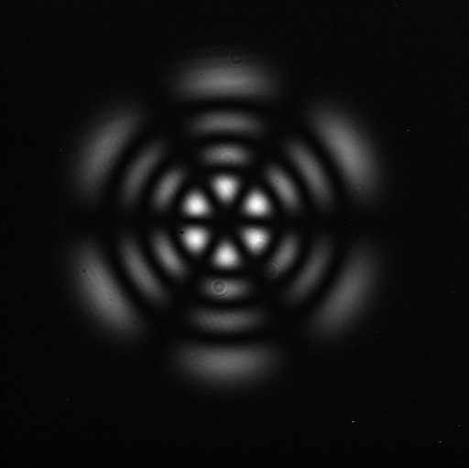
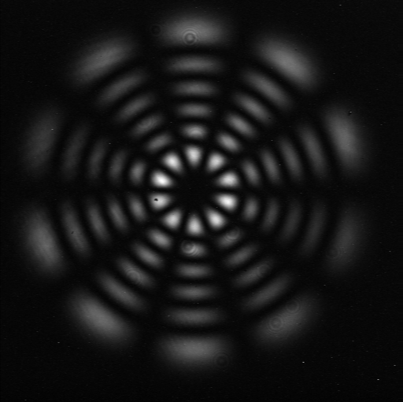
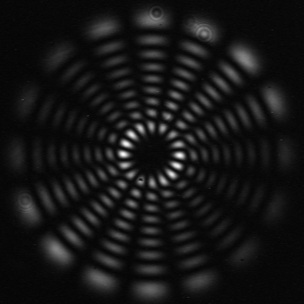
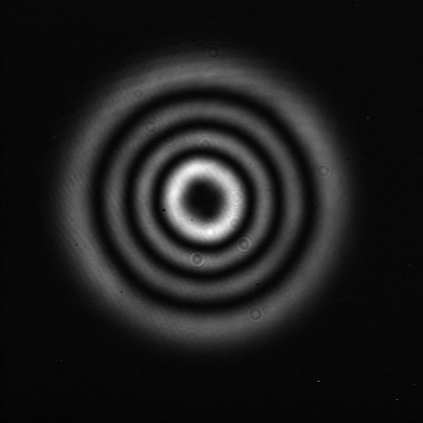
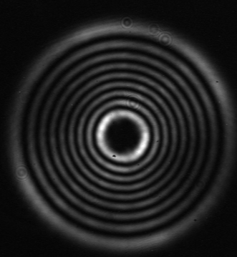
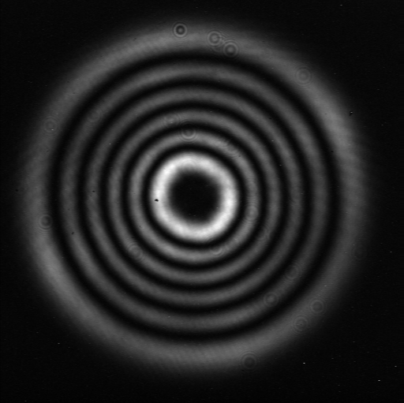
Locked to even higher order LG modes...
LG33
LG55
LG88

Slide 19
Estimating cleaned mode purity
We fitted the beam position and size to calibrate the CCD
>99% overlap with ideal LG33 intensity
Remaining ~1% due to misalignment
Input beam residual
Output beam residual
Model residual

Slide 20
Misalignment of LG modes
Misalignments are best described by addition of higher-order Hermite-Gauss (HG) modes
LG modes can be written as a sum of HG modes:
Misalignments change the distribution of HG modes, thus changing distribution of LG modes
Beijersbergen et al., Opt. Communications 96, 123-132 (1993)

Slide 21
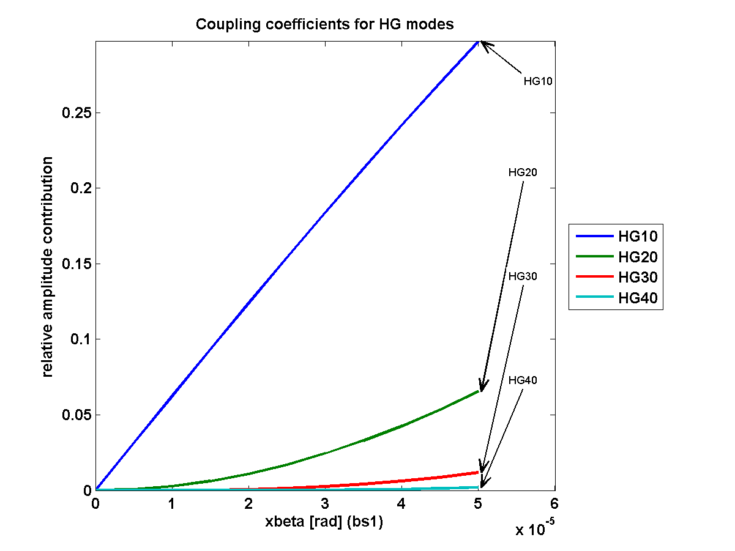
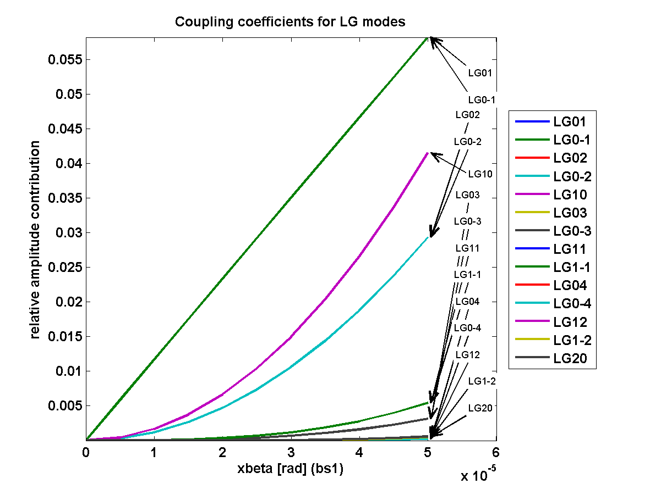
Misalignment of LG modes
Describing misalignment in two base systems
Credit: Simon Chelkowski

Slide 22
Transmitted mode ‘decomposition’ result
With small beams on off the shelf mirrors, no evidence for degradation from mirror surface defects

Slide 23
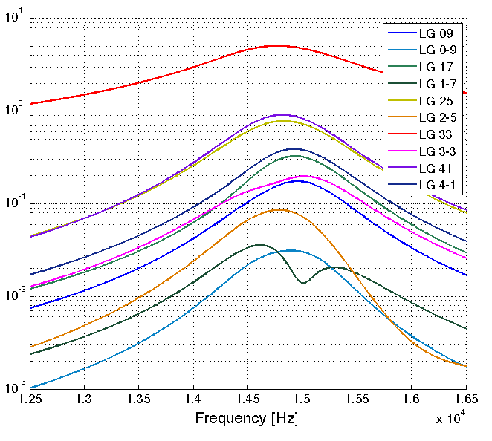
Mode degradation due to degeneracy
Mirror defects cause coupling into other modes of the same order
Amplitude [W^{1/2}]
Credit: Charlotte Bond

Slide 24
Impact of degeneracy on control signals
Simulated
example case
of astigmatic
mode cleaner
Split peak
with multiple
zero crossings
in PDH signal
Circulating Power
PDH Error Signal
Cavity tuning [deg]

Slide 25
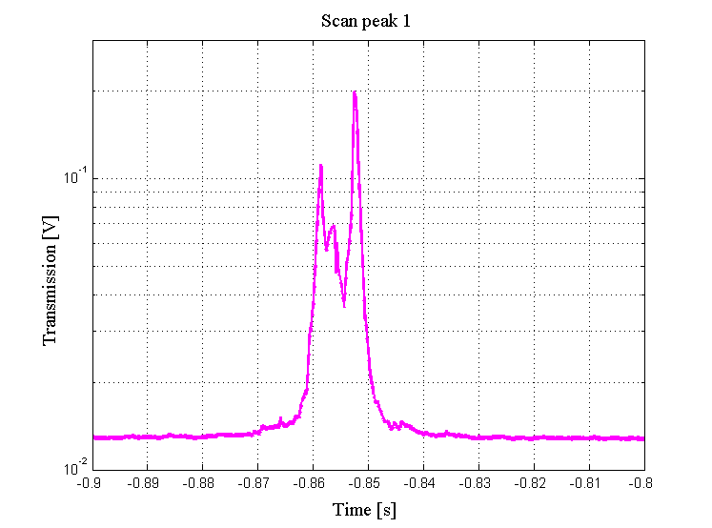
Impact of degeneracy on control signals
Measured transmission through astigmatic mode cleaner (Finesse ~6500) with LG33 mode input

Slide 26
Simulated scan of astigmatic mode cleaner

Slide 27
Measured scan of astigmatic mode cleaner

Slide 28
Conclusions
With perfect mirrors, sensing and control is very similar for LG00 and LG33
Lab demonstration has shown good longitudinal control signals for LG33 on small mirrors
Misalignment can couple slightly to degenerate modes even with perfect mirrors
Astigmatism and mirror surface defects can cause problems for control signals – investigate more

Slide 29
Future research program on LG modes
LG modes on suspended prototype interferometer
Alignment analysis of a Fabry-Perot cavity
Investigate ways of mitigating degeneracy effect
High power LG33 laser source

Slide 30
LG mode research at the Glasgow 10m IFO
Inject LG33 mode into the Glasgow 10m
Crucial to test LG modes with suspended optics, high finesse cavities and full ASC/LSC systems
We will get a better idea of the extent of degeneracy problems to expect in detectors

Slide 31
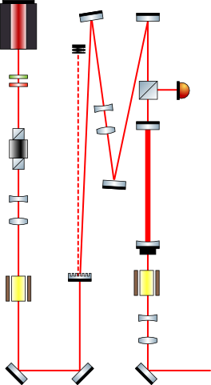
LG mode research at the Glasgow 10m IFO
F = 1000
F = 10,000
Edgar / Hild

Slide 32
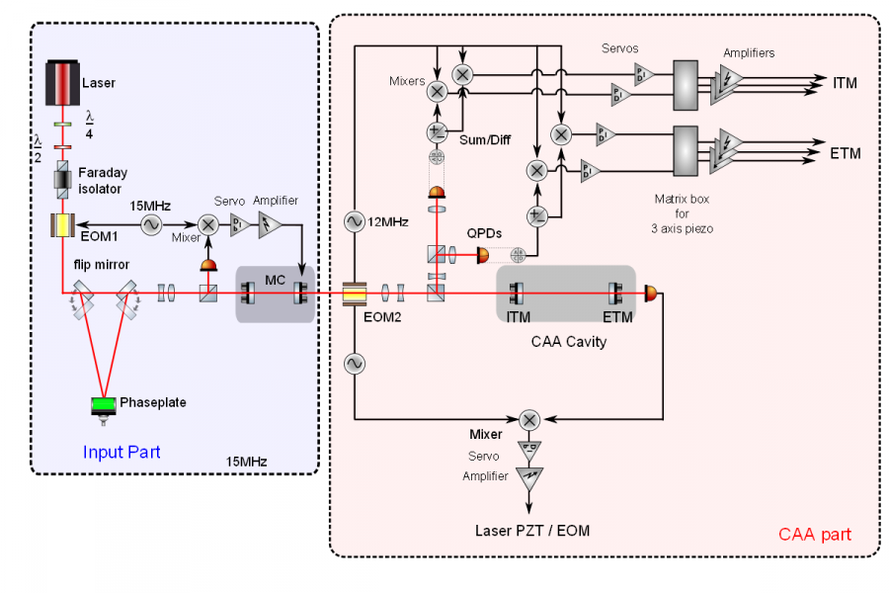
Compact auto-alignment system with LG33
Credit: Keiko Kokeyama

Slide 33
Thankyou for listening, any questions?

Slide 34
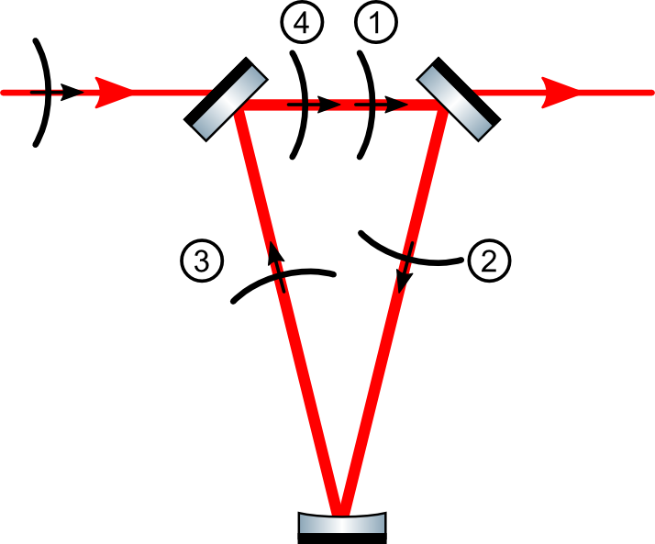
Helical modes in triangular mode cleaners (TMCs)
We expected that helical modes will not pass through a cavity with and odd number of mirrors
Only vertically (anti-)symmetric modes will pass

Slide 35
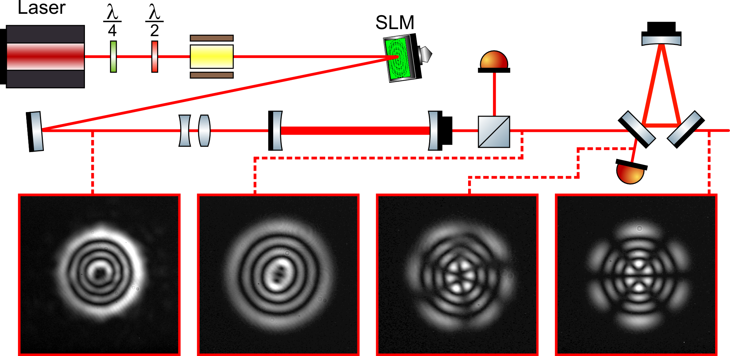
Helical modes in TMCs
Helical mode composed of vertically symmetric and anti-symmetric sinusoidal modes
TMC separates these out; only one can pass

Slide 36
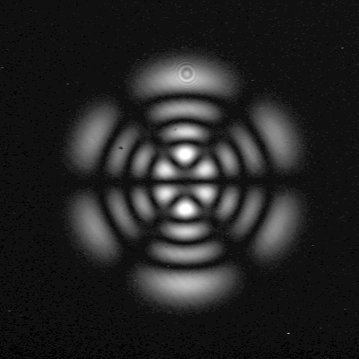
Astigmatism in TMCs
In a TMC, the beam is incident upon a curved mirror at a non-normal angle
The cavity eigenmode is therefore astigmatic
LG modes cannot describe astigmatism, so the eigenmode cannot be a pure LG mode
Contrast enhanced for clarity
Contrast enhanced for clarity

Slide 37
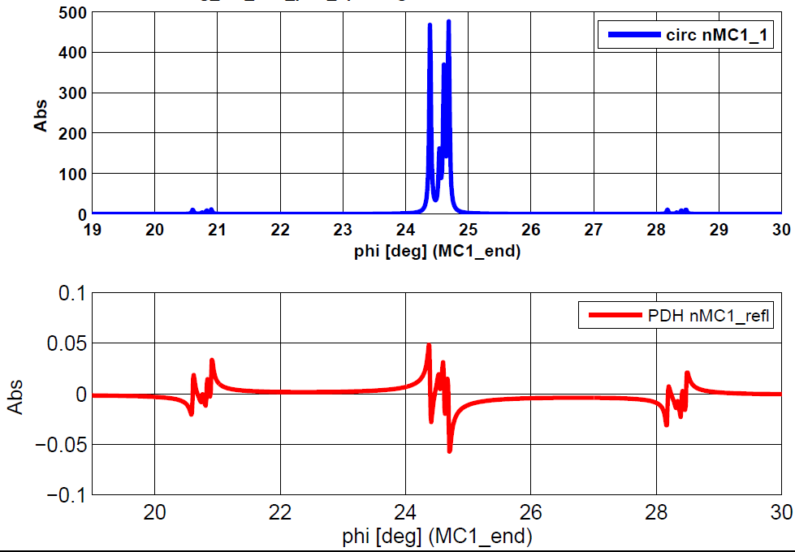
Degradation of PDH control signal
Scan of triangular mode cleaner (astigmatism)

Slide 38
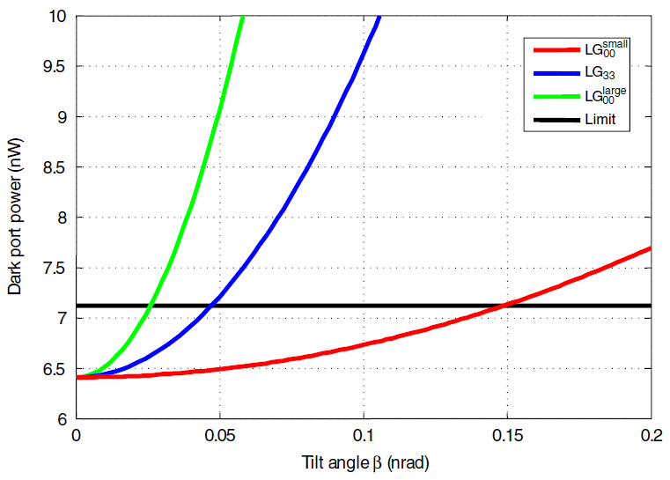
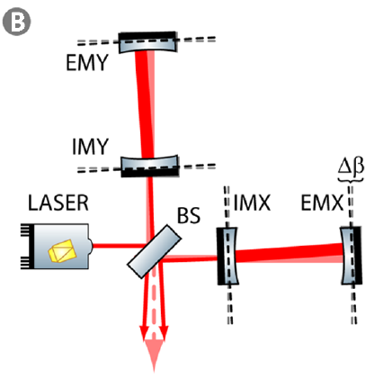
Differential arm cavity misalignment coupling to dark port power
LG00 tilt limit = 26prad
LG33 tilt limit = 46prad

Slide 39
Differential arm cavity misalignment coupling to dark port power
LG00 tilt limit = 26prad
LG33 tilt limit = 46prad
LG33 better than LG00 here

Slide 40
Input mode purity estimations
Measured LMC throughput efficiency = 63%
Helical input power = 2.93mW, output = 1.21mW
Sinusoidal input power = 1.53mW, output = 0.496mW
purity
~66%
purity
>99%
purity
~51%
purity
>99%

Slide 41
Coupling of tilt to phase in FP cavity
We investigated the tilt to phase coupling in a 3km cavity
Cavity tuning ( )

Slide 42
Coupling of tilt to phase in FP cavity
We investigated the tilt to phase coupling in a 3km cavity
LG33 much better than LG00; beam parameters the dominant factor here

