Slide 1
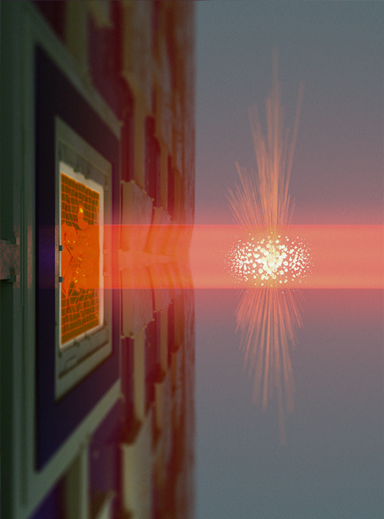
GWD beyond SQL
with the negative mass spin oscillator
Eugene Polzik
Niels Bohr Institute
Copenhagen
John
Templeton
Foundation
EUREKA
program
Image credit Bastian Leonhardt Strube and Mads Vadsholt

Slide 2
Slide 2
X, P – noncommuting variables
Standard Quantum Limit
for motion of a free mass

Slide 3
Motion in reference frame with negative mass
P+P₀, X-X₀ – commuting variables
can be measured precisely
Slide 3
Beyond SQL
${X(t)}_{X0}$ = ${X(0)}_{X0}+\left(\dot{X}−{\dot{X}}_{0}\right)t$
${=X(0)}_{X0}+ \left(P+P_{0}\right)$t /m=
${=X(0)}_{X0}+$ classical dynamics
P_{P0}
m₀= - m
X_{X0}

Slide 4
Spin ensemble = negative mass harmonic oscillator
J_{z}
Slide 4
B
J_{y}~ P
J_{x}∼ X
1/2
-1/2
Negative mass oscillator
Holstein-Primakoff

Slide 5
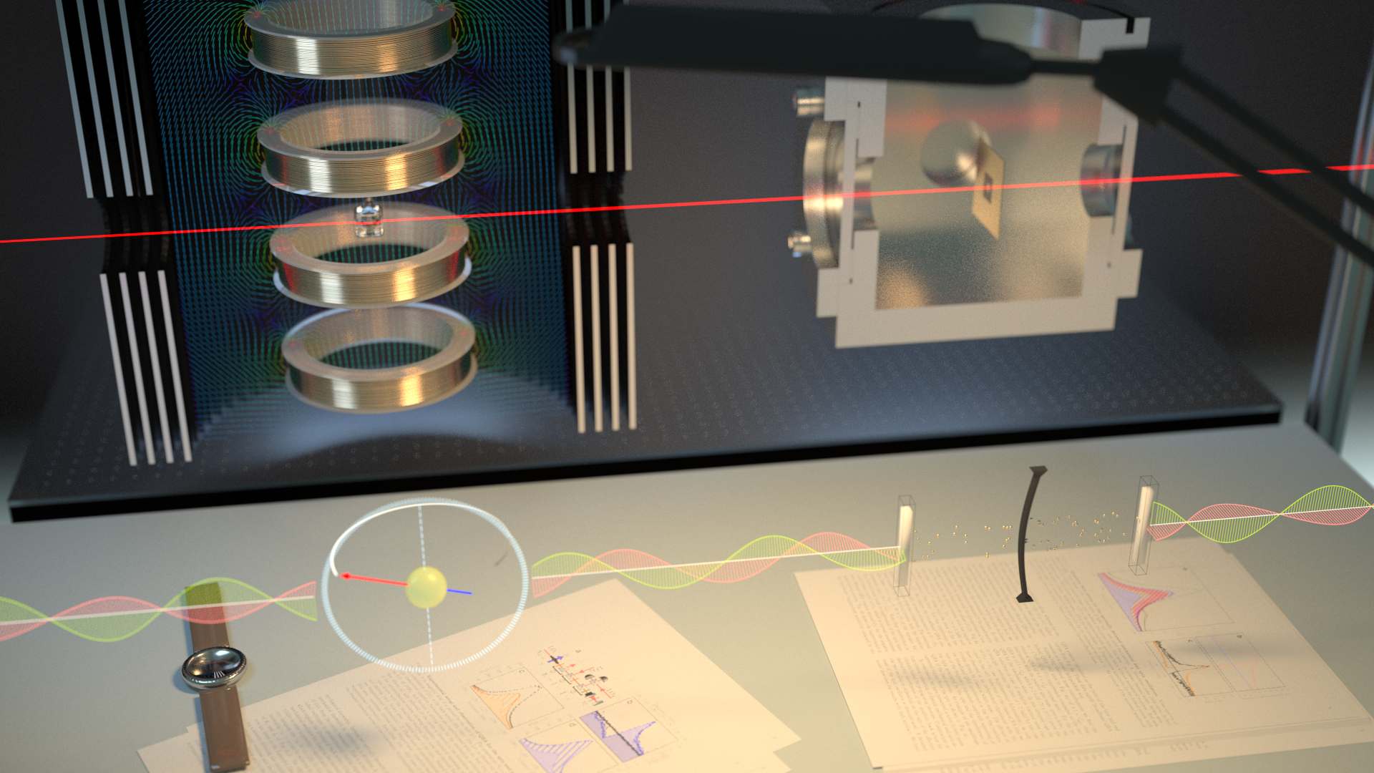
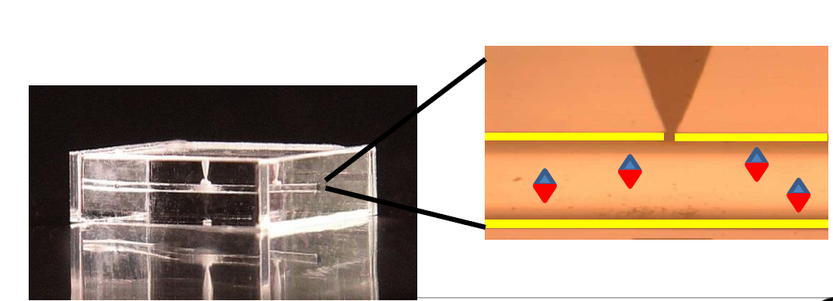
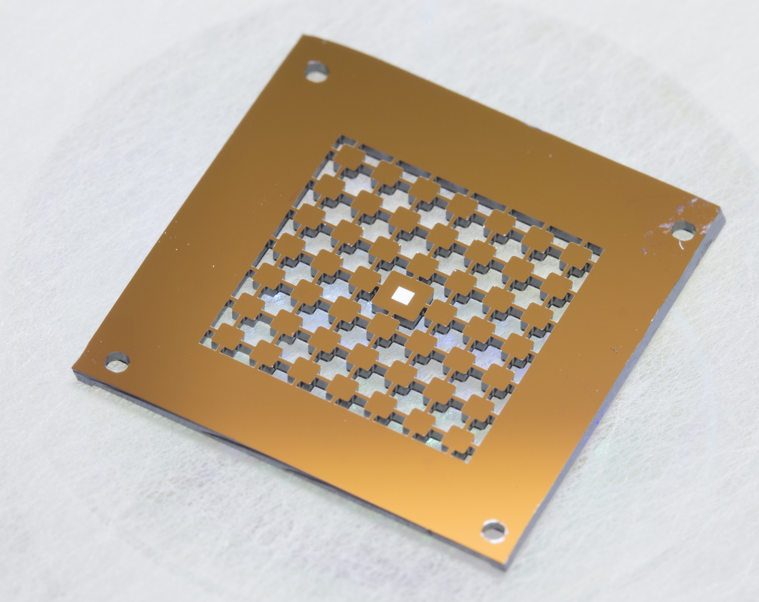
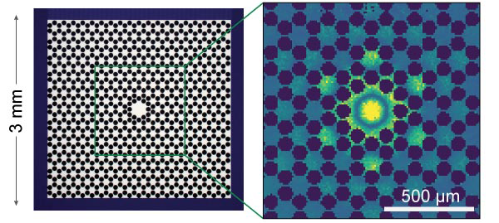
Experimental demonstration for SPIN and Nano-MECHANICS
Room temperature spin
quantum oscillator
Mechanical oscillator with
Q = 1 billion
Slide 5
Image credit
Bastian Leonhardt Strube and Mads Vadsholt

Slide 6
Slide 6
J
Magnetic
spin
states
Phonon
states
n=3
B
n=2
n=1
$$Ω_{m}$$
n=0
Negative mass
oscillator
Notes:
Trajectories without quantum
uncertainties with a
negative mass reference frame

Slide 7
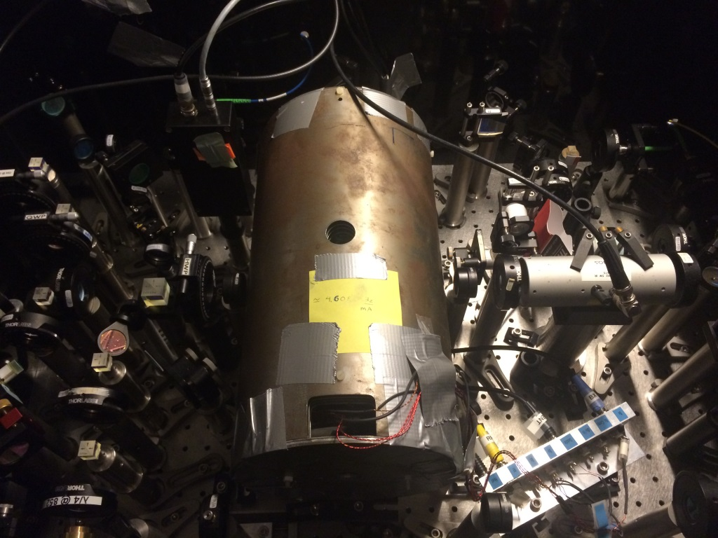
Slide 7
$H=Ω_{L}\left(P^{2}+X^{2}\right)⇔{−Ω}_{L}\left({J_{z}^{2}}^{}+{J_{y}^{2}}^{}\right)$/J

Slide 8
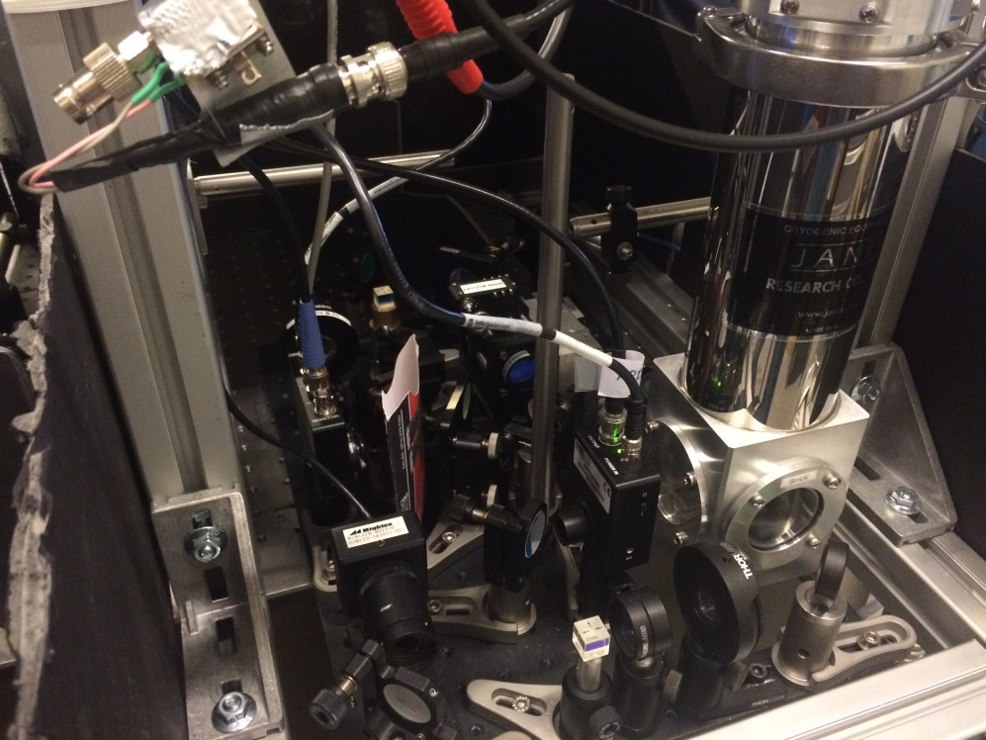
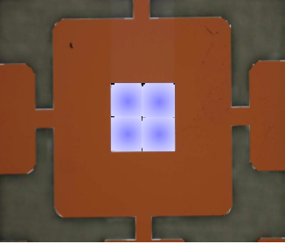
Slide 8
SiN membrane, Q=2·10⁷

Slide 9
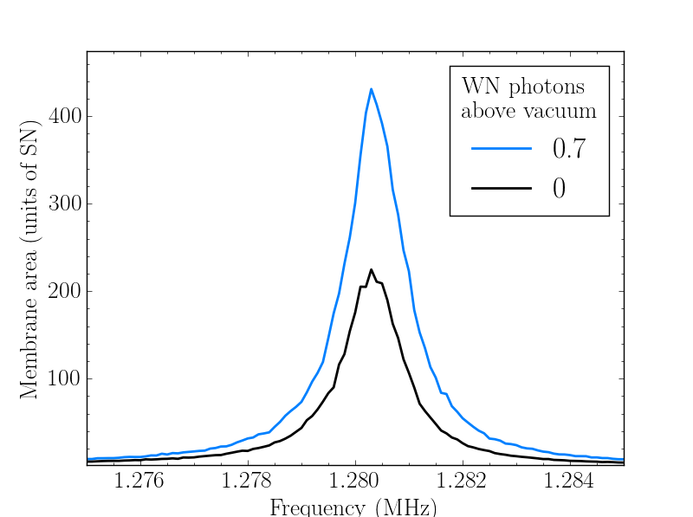
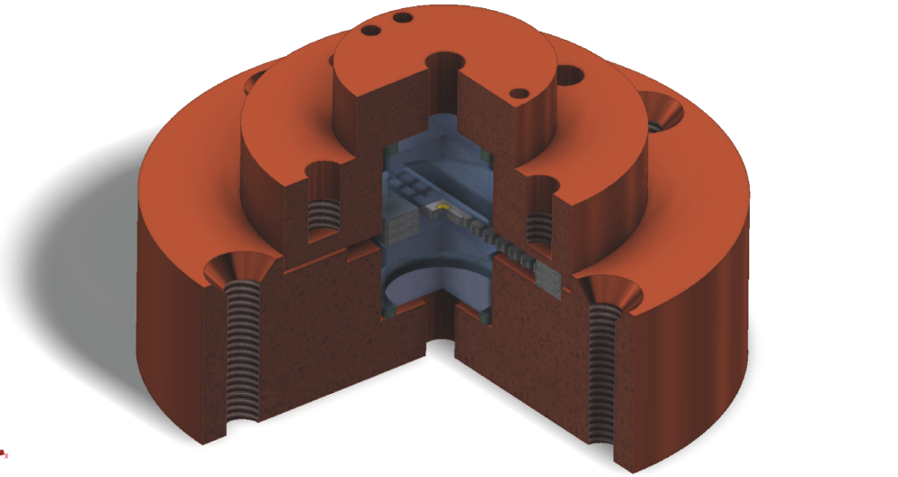
Mechanical oscillator.
Cooling + Q back action
Slide 9
Q= 1.4 10⁷
Thermal
+ 2.4 vacuum BA
vacuum BA
Thermal
(near
ground)
See also: Regal group, Science 2013; Stamper-Kurn group, Nat. Phys. 2016

Slide 10
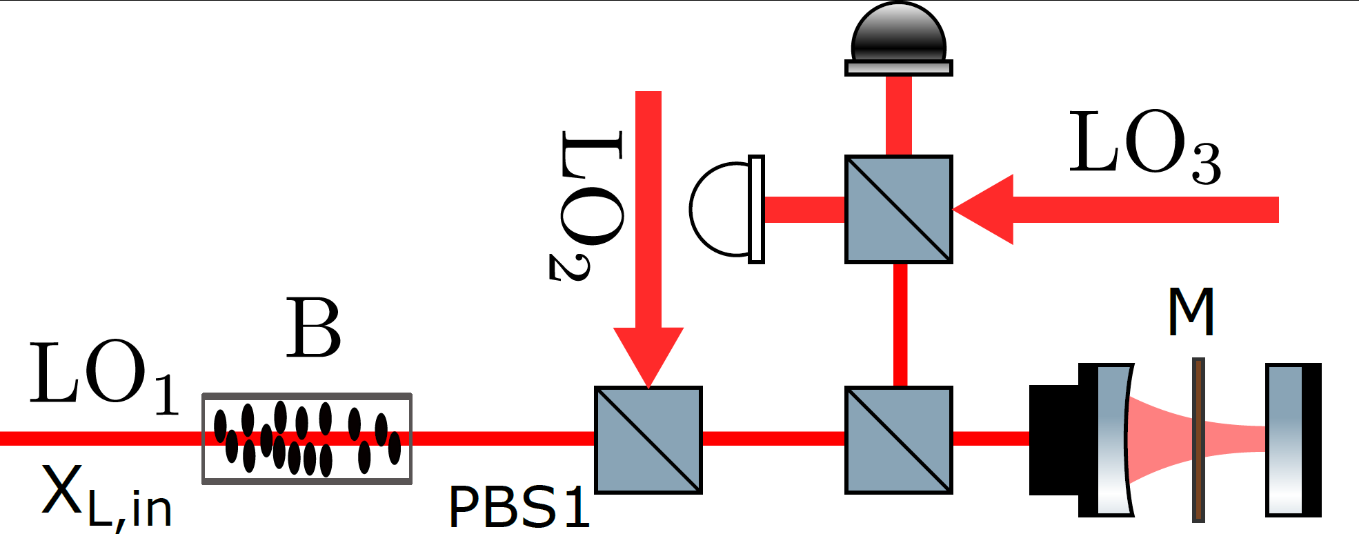
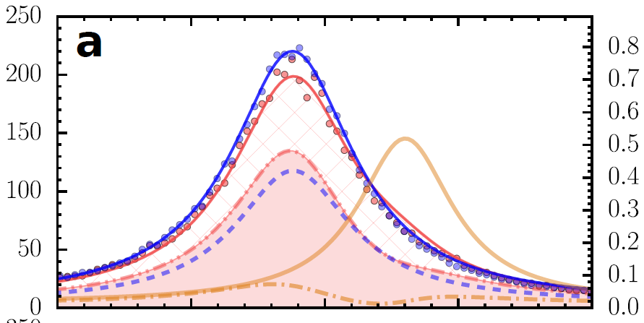
Quantum back action evasion
in the spin
reference frame
Slide 10
QBA
reduction:
$$Var\left[X−X_{0}\right]$$
= 0.69
$$Var\left[X\right]$$
Membrane
Hybrid
Neg
Spin OFF
Spin ON
2kHz
Thermal
membrane
Thermal
joint
C. B. Møller et al.

Slide 11
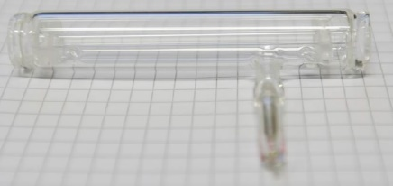
Proposal: F. Khalili and E.S.P. Quantum back action evading detection of gravitational waves in a negative mass reference frame. Phys. Rev. Lett. July 2018
Advanced proposal in preparation.
Slide 11
Gravitational Wave
Interferometer
Atomic Spin
System
D1
852nm
1064nm
Entangled
Light
Phase rotator
Simulating
Gravitational Wave
Interferometer
2 m² portable breadboard
D2
No change is GWD core optics required

Slide 12
Slide 12
Expected improvement in sensitivity (variance) for aLIGO
(ET – similar)
Losses in GWI
and atomic
channels
0
5%
10%
Frequency (Hz)
ET parameters taken from ET-0106C-10.pdf

Slide 13
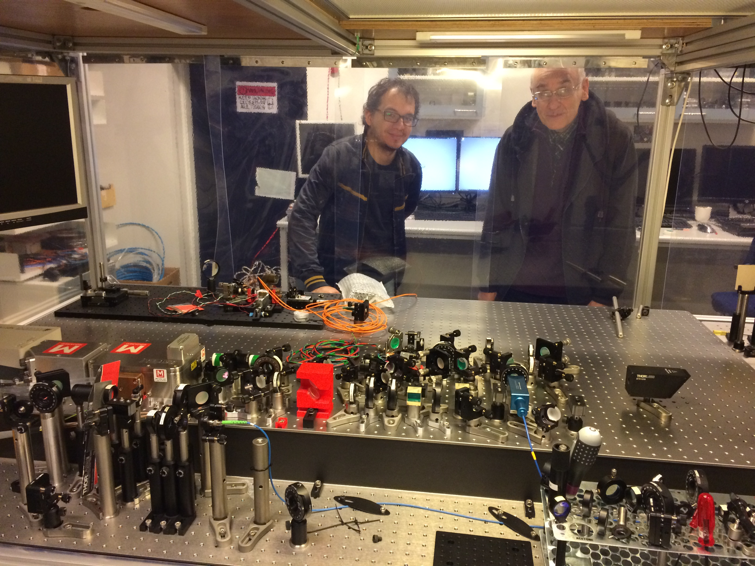
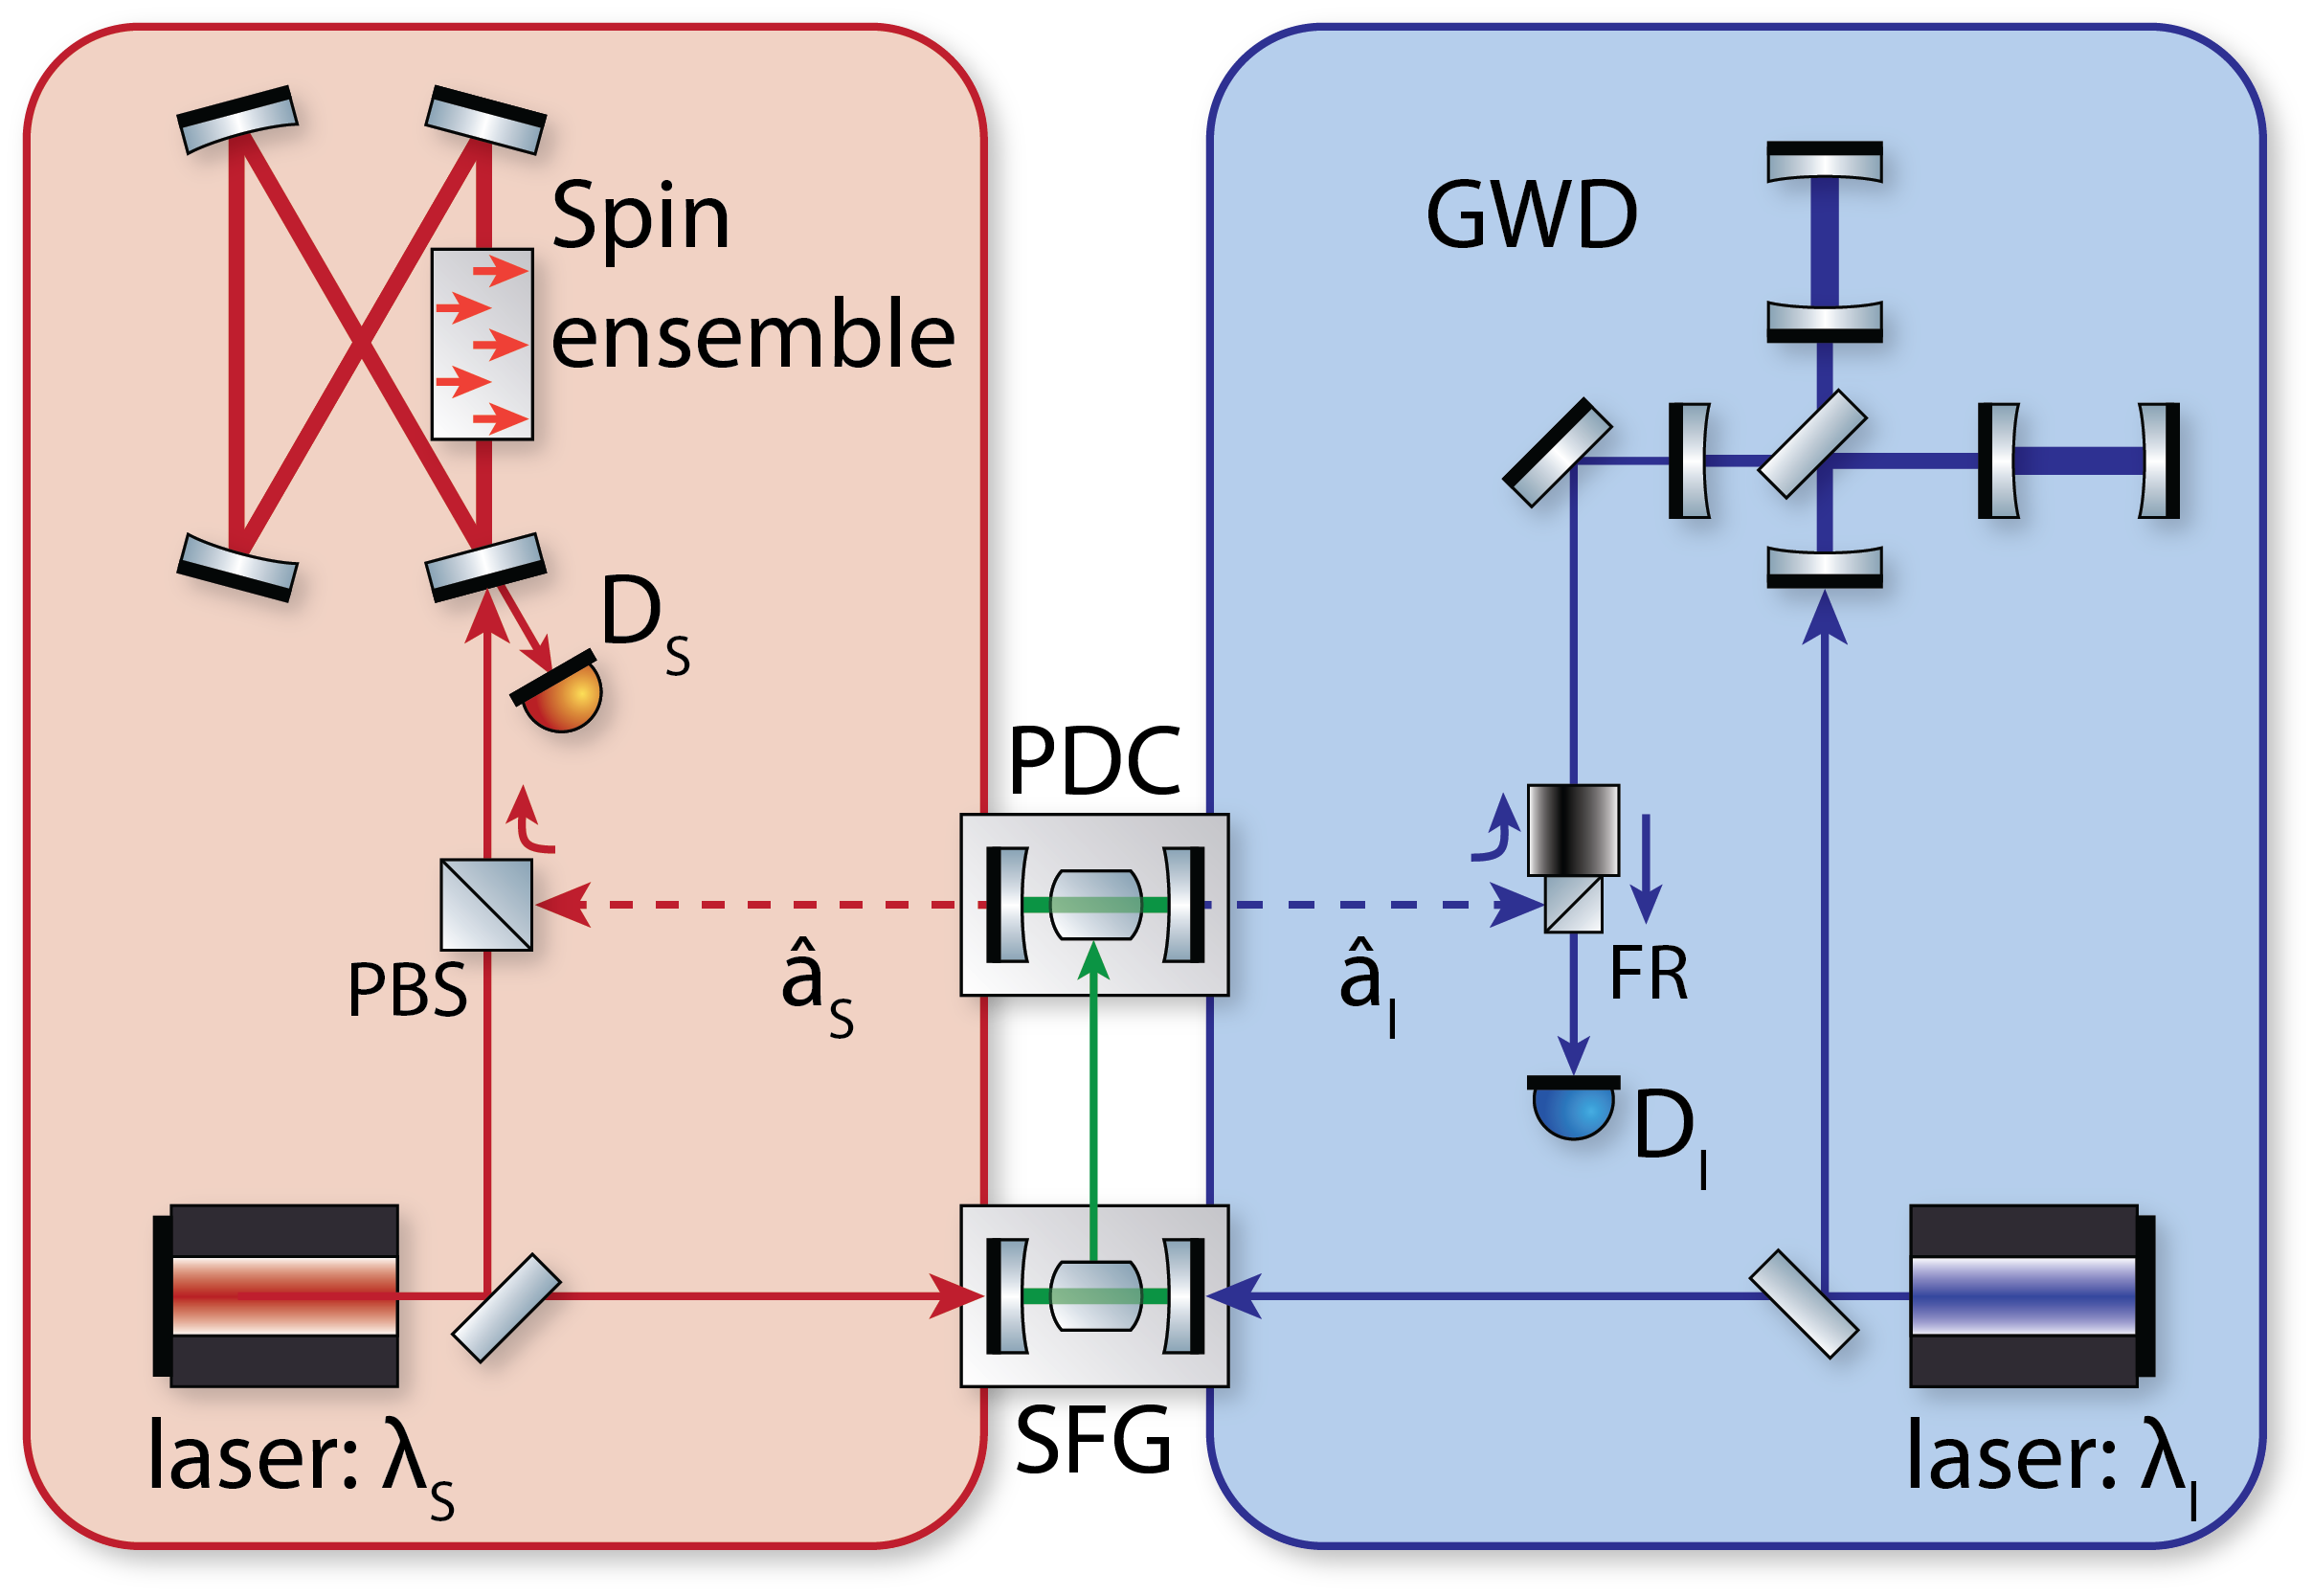
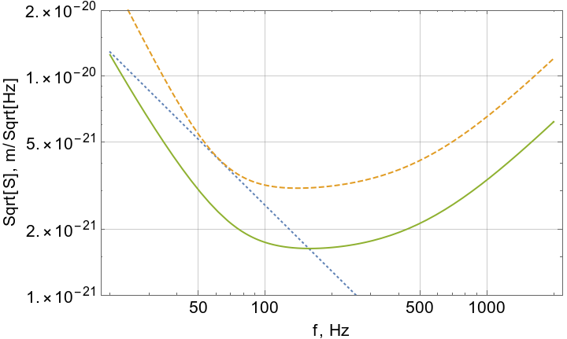
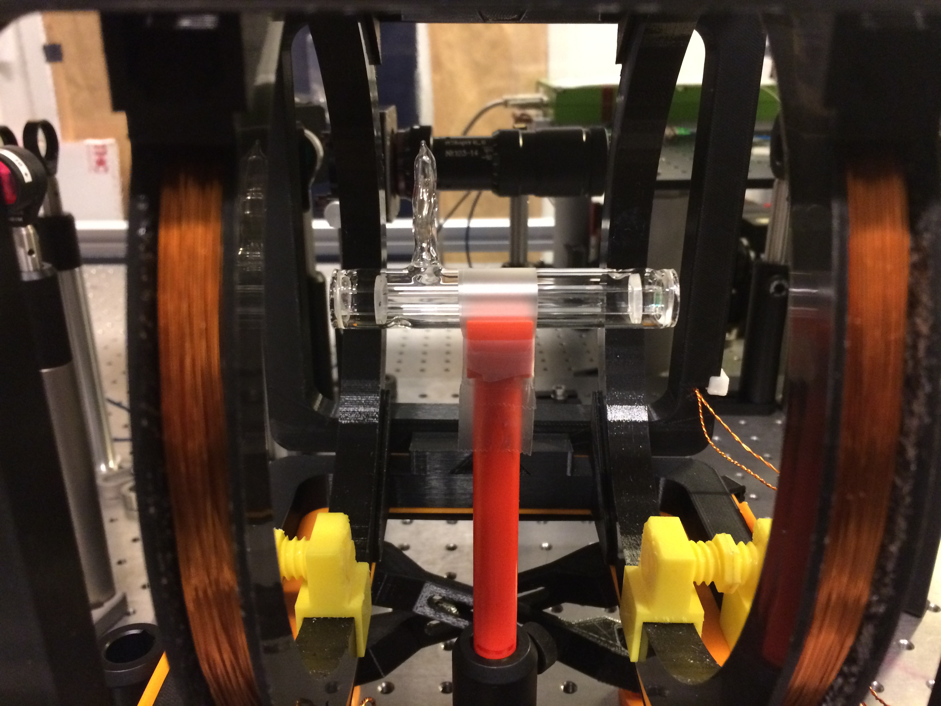
Slide 13
$$φ$$
$$φ(ν)$$
Collaboration with Danish Institute for Fundamental Metrology

Slide 14
Summary:
Back action evasion for measurement of motion
experimentally demonstrated
Status: entangled light source + atomic spin
system for low frequency QBA evasion
under construction
Challenge: as usual – optical losses
Image credit: Bastian Leonhardt Strube and Mads Vadsholt

Slide 15
Challenge: two oscillators are very different
Slide 15
Mechanical oscillator:
Bandwidth 0.1 Hz
5*10⁵ thermal
quanta at 4K
Spin oscillator:
Bandwidth ~ 500 Hz
1-2 thermal excitations

Slide 16
Slide 16
F. Khalili and E.S.P. Phys.Rev.Lett. July 2018
Simulation for LIGO

Slide 17
Probing the hybrid system with EPR entangled light modes
Slide 17
$$P_{L1,out}=−P_{L1,in}+force terms+Γ_{M}χ_{M}X_{L1,in}$$
$$P_{L2,out}=−P_{L2,in}+force terms+Γ_{S}χ_{S}X_{L2,in}$$
D1
Spins
852nm
1064nm
GWI
D2
Entangled
light
$$P_{L1,out}−P_{L2,out}=−P_{L1,in}+P_{L2,in}+force terms$$
$$+Γ_{M}χ_{M}X_{L1,in}−Γ_{S}χ_{S}X_{L2,in}$$
$$Γ_{S}χ_{S}=−Γ_{M}χ_{M}$$
${{(P}_{L1,in}−P_{L2,in})}^{2}$ =${ e}^{−2r}$
${{(X}_{L1,in}+X_{L2,in})}^{2}$ =${ e}^{−2r}$
$$P_{L1,out}−P_{L2,out}⇒force terms$$

Slide 18
Slide 18
Measurement beyond SQL
1. Define trajectory relative to a quantum reference
2. Reference system has an effective negative mass
3. Entangled state of the reference and
the probed systems is generated
See also:
Tsai and Caves, PRL 2010
M. Ozawa
“Establishing Einstein-Podolsky-Rosen channels between nanomechanics and
atomic ensembles”. K. Hammerer, M. Aspelmeyer, ESP, P. Zoller. PRL 102, 020501 (2009).
“Trajectories without quantum uncertainties”. K. Hammerer and ESP, Annalen der Physik . (2015)

Slide 19
Quantum back action onto spin oscillator
${J_{z}}^{lab}={J_{z}}^{rot}cosΩt−{J_{y}}^{rot}$sin $Ω$t
Ground+
2.2 vacuum
BA
Slide 19
E
y
z
vacuum BA
B
m_{F}=4
1.38 MHz
m_{F}=3
Cos Ωt
(Almost)
Ground
state
Lock-in
amplifier
X ~ J_{z}^{rot}(t)
+ Back action noise
Sin Ωt
P ~ J_{y}^{rot}(t)
+ Back action noise

Slide 20
Quantum Optomechanics
Slide 20
SiN membrane
high - Q
$$=gX_{M}X_{L} g=χ_{Par}{=χ}_{BS}$$
phoTon
phoNon
…

