Slide 1
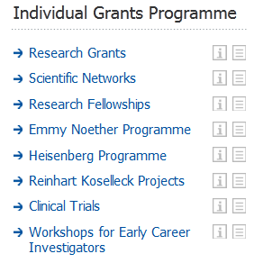
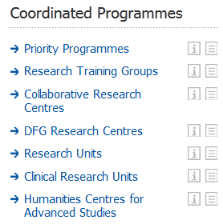
Research Grants: grad. students, post-doc equipment (3 years)
Research Training Groups: 10-15 grad. student stipends (2x4.5 years)
Collaborative Research Center: 10-20 grants, (3x5 years)
Excellence Cluster: 6 Mio € (2x5 years)

Slide 2
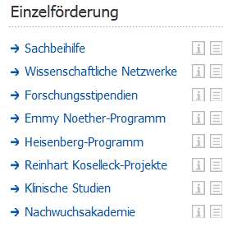
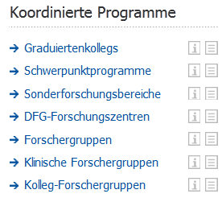
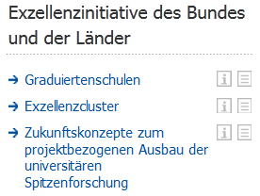
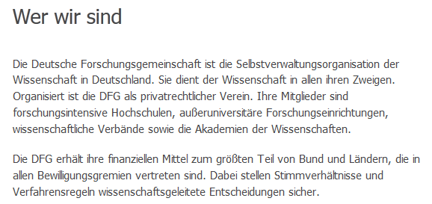

Slide 3
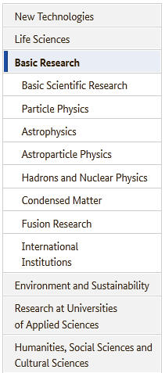
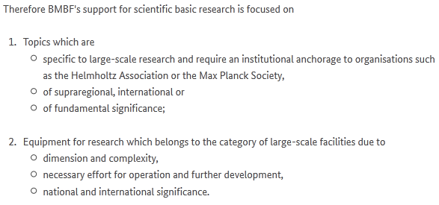
GEO 600 Gravitational Wave Detector

Slide 4
GEO 600 Gravitational Wave Detector
Advanced LIGO pre-stabilized Laser System

Slide 5
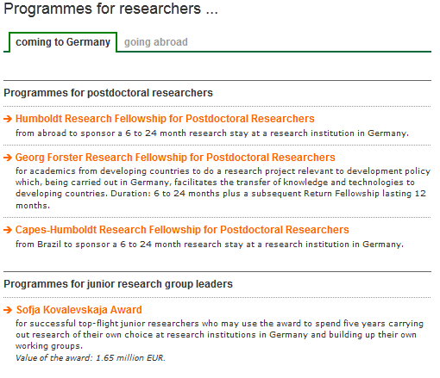
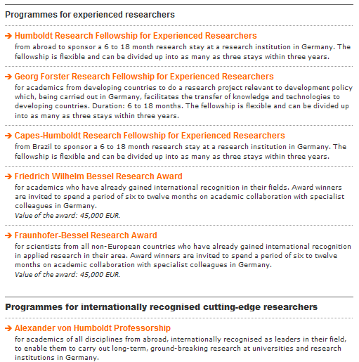
Feodor Lynen fellowship: post-doc by former Humbold awardee in the US

Slide 6
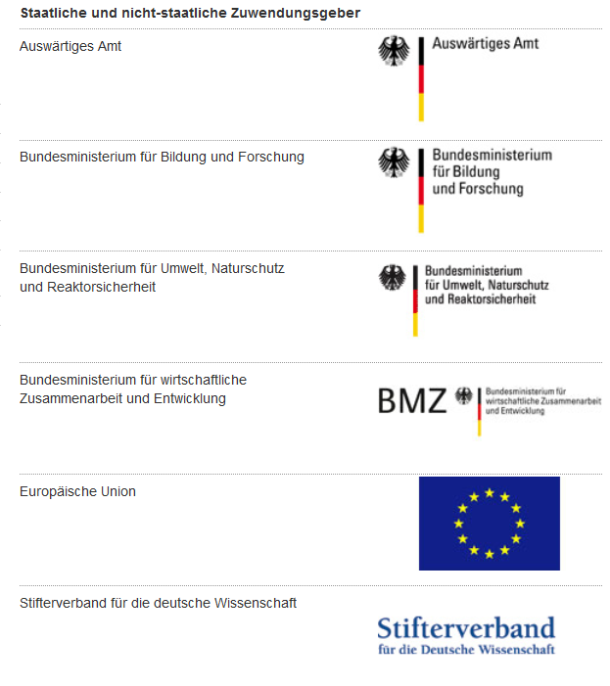

Slide 7
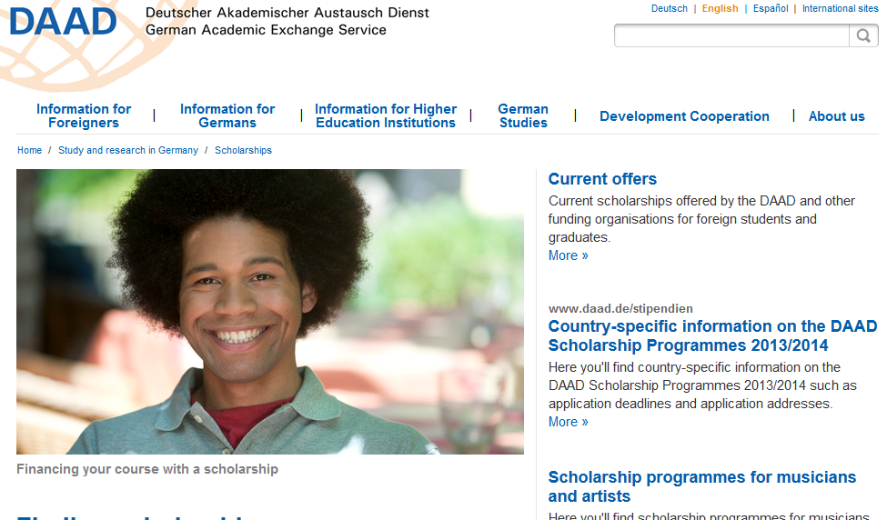
one of my PhD students worked at LIGO for one year

