Slide 1
Active Seismic Isolation in GEO
Holger Wittel
14.12.2010

Slide 2
Motivation
Recently increased seismic activity at GEO during day time
Lock losses
Try to reinstate active seismic isolation system

Slide 3
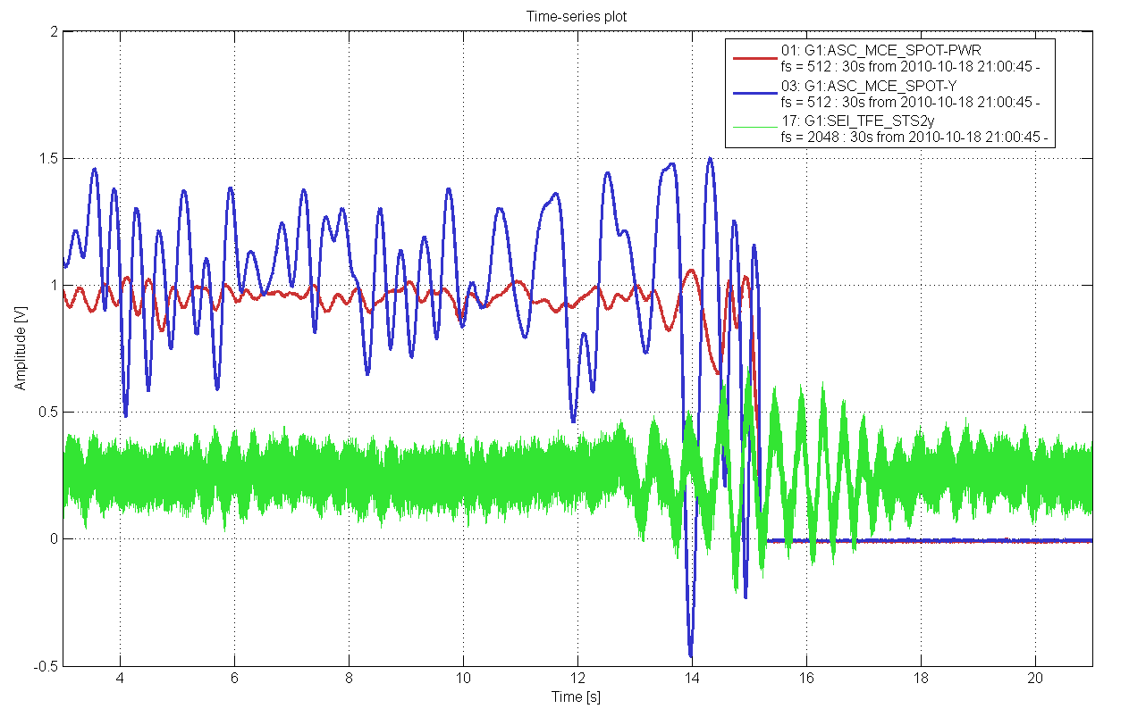
Silent night ...
Strong seismic transients even at nighttime!

Slide 4
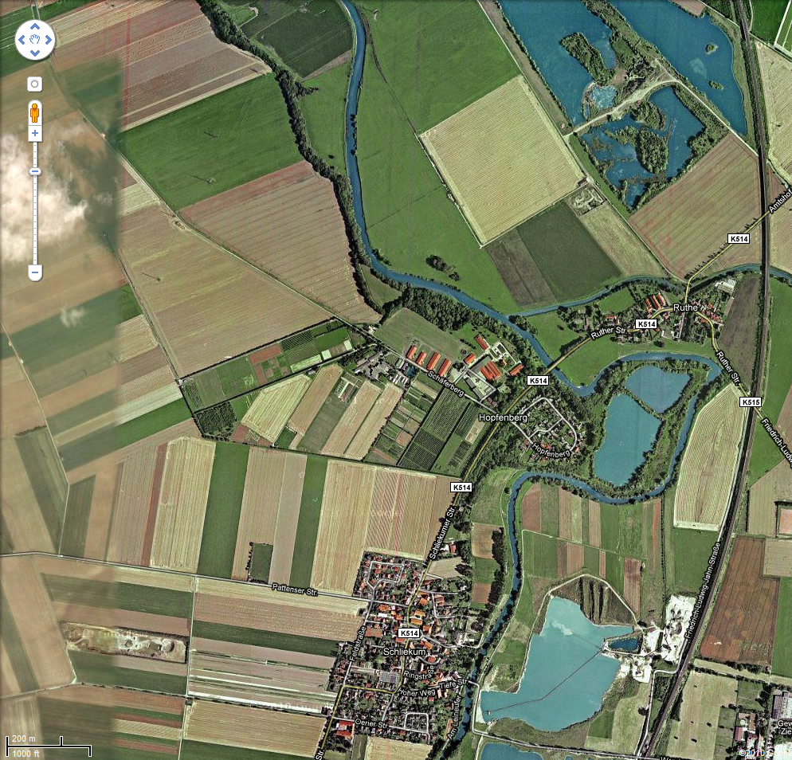
gravel mine 2
GEO
gravel mine 1

Slide 5
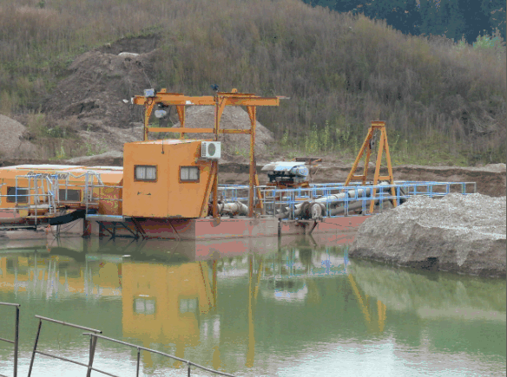
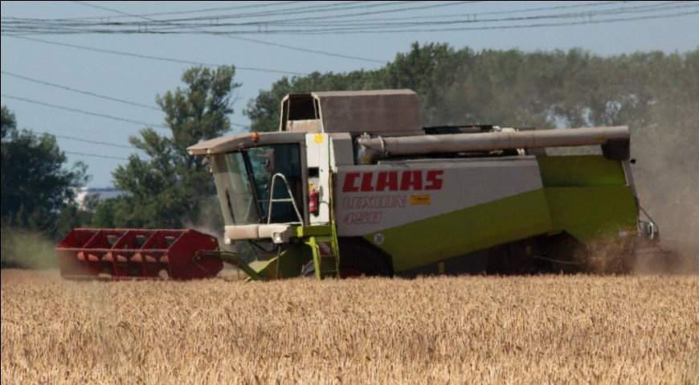
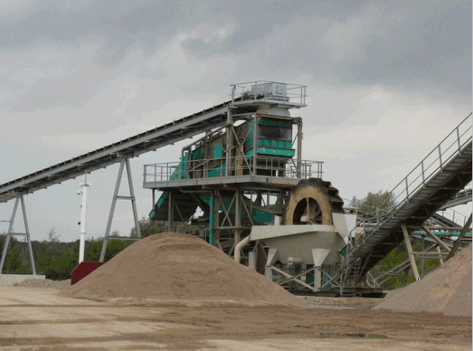
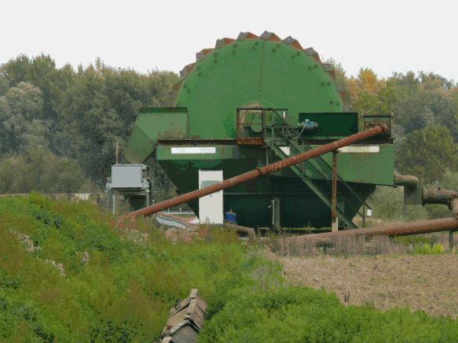
The bad guys

Slide 6
Seismic isolation
Good seismic isolation through triple pendulum + rubber stacks at high frequencies (> resonance at a few Hz)
Enough loop gain at low frequencies (<1Hz)
More suppression around 1 Hz possible?
(still local control dampening there)
Use piezos for active seismic isolation

Slide 7
Ingredients for active seismic isolation
PZT stacks with max range of 25µm
Geophones on top of the PZTs
(for checking the performance)
STS2 seismometer next to the vacuum tanks
as input for the feed forward

Slide 8
The stacks
Rubber stack
PZTs & geophones

Slide 9
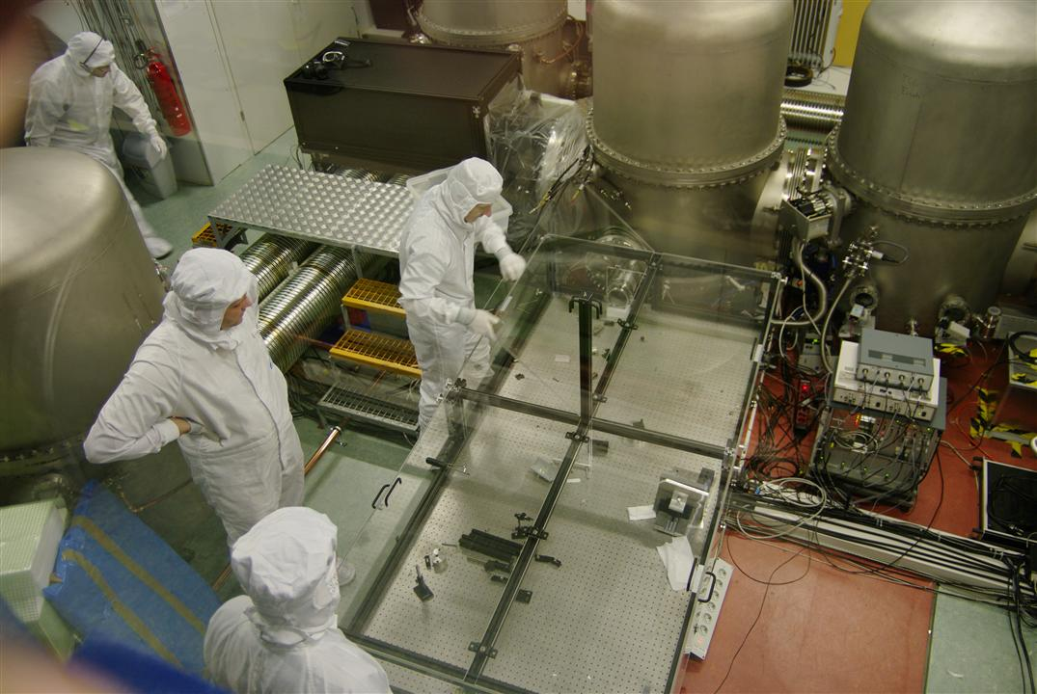
PZTs broken?!
Geophones show no response to PZT injections
Alternative:
act on the
foundation

Slide 10
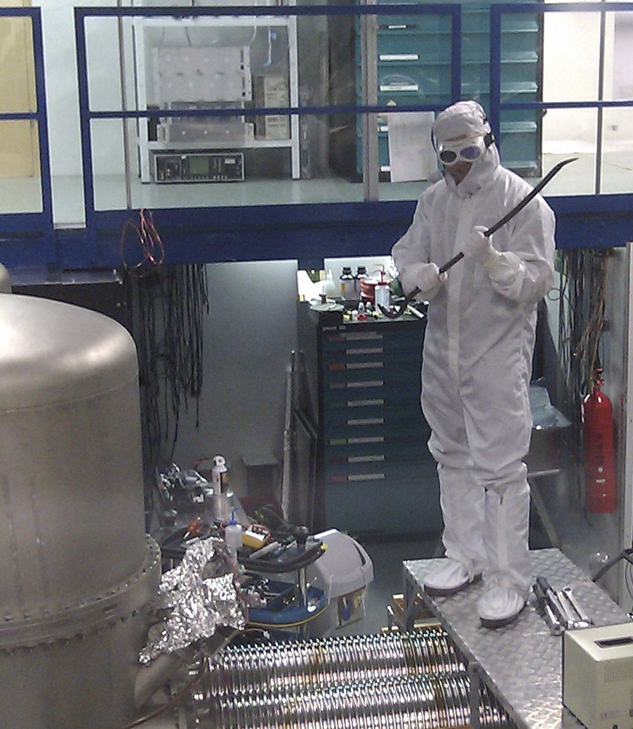
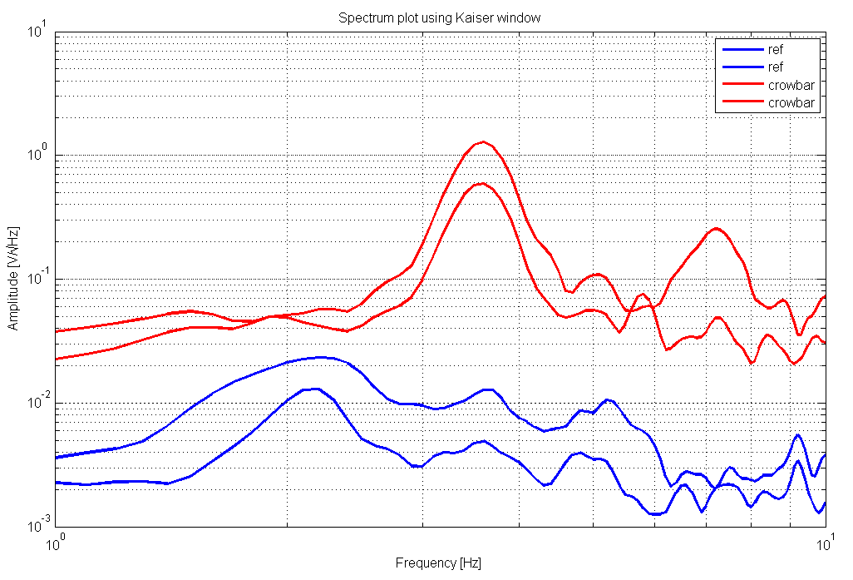
Shaking the foundation of GEO
Hydraulic shaking of the foundation
Take crowbar first

Slide 11
Relief
More thorough investigation revealed:
The piezos are ok.
Proceed with piezo seismic isolation system,
beam splitter only for now

Slide 12
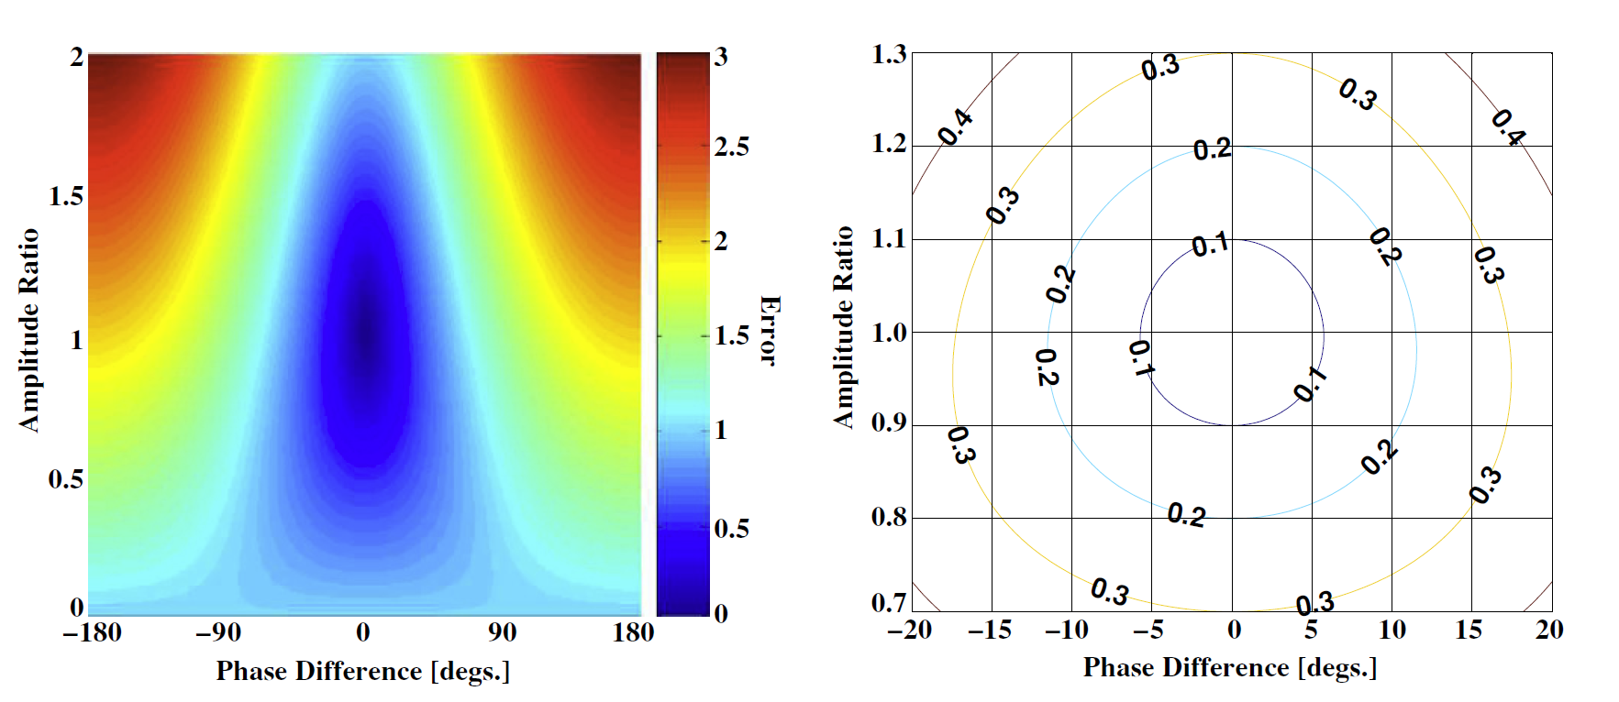
Feed forward?
Stable
Simple
Geophones not good below 2 Hz
Image taken from J R Smith: Feedforward correction of mirror misalignment fluctuations for the GEO600 gravitational wave detector

Slide 13
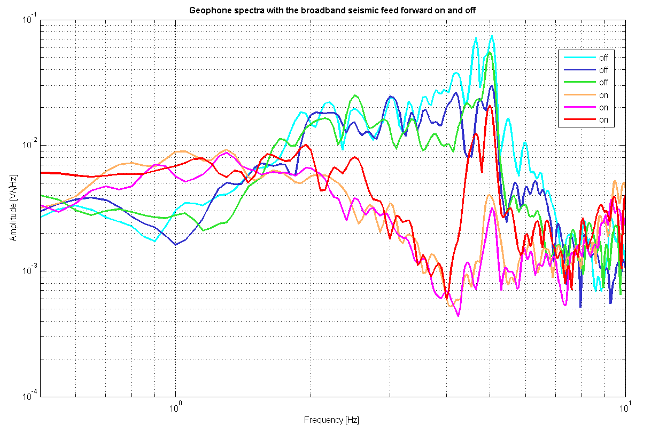
Broadband feed forward

Slide 14
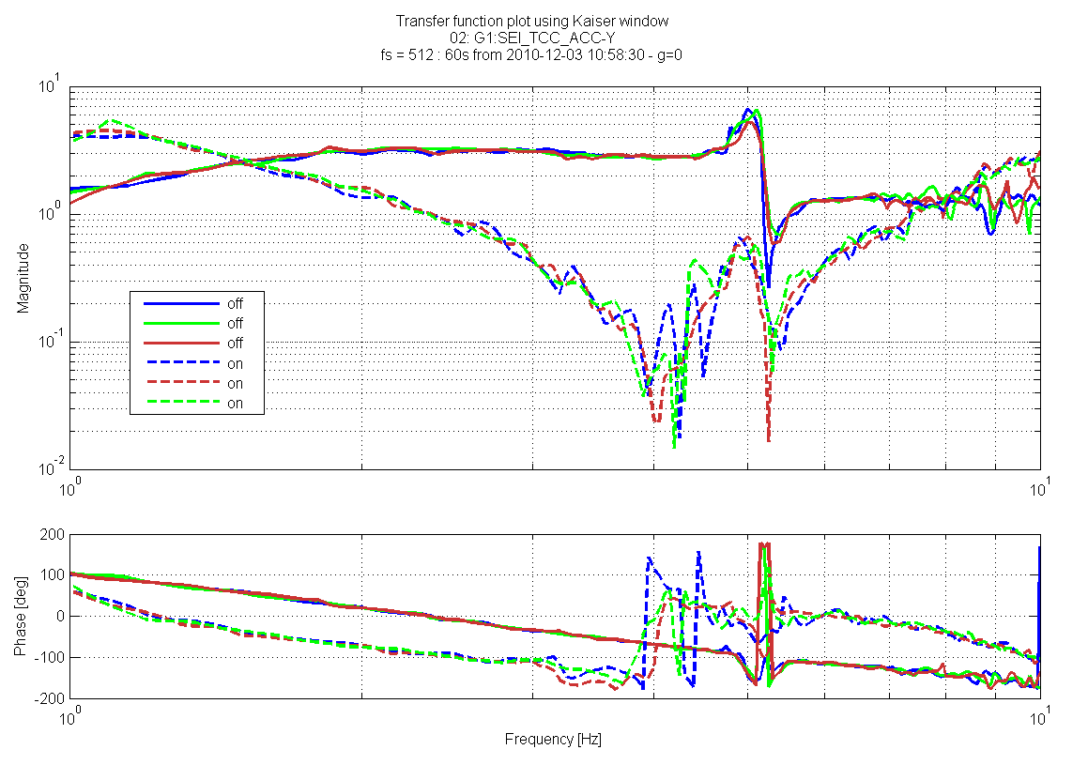
Transfer function STS2-> geophone

Slide 15
Narrowband ff
We only care about the resonances at 0.55, 1.2 and 2.2 Hz
Make good transfer functions for those frequencies
Narrow bandpass:
right phase and gain at one frequency

Slide 16
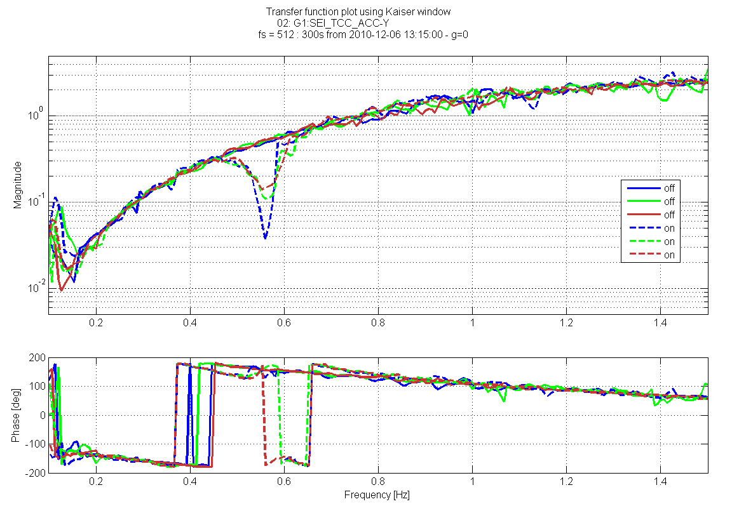
0.55Hz feed forward

Slide 17
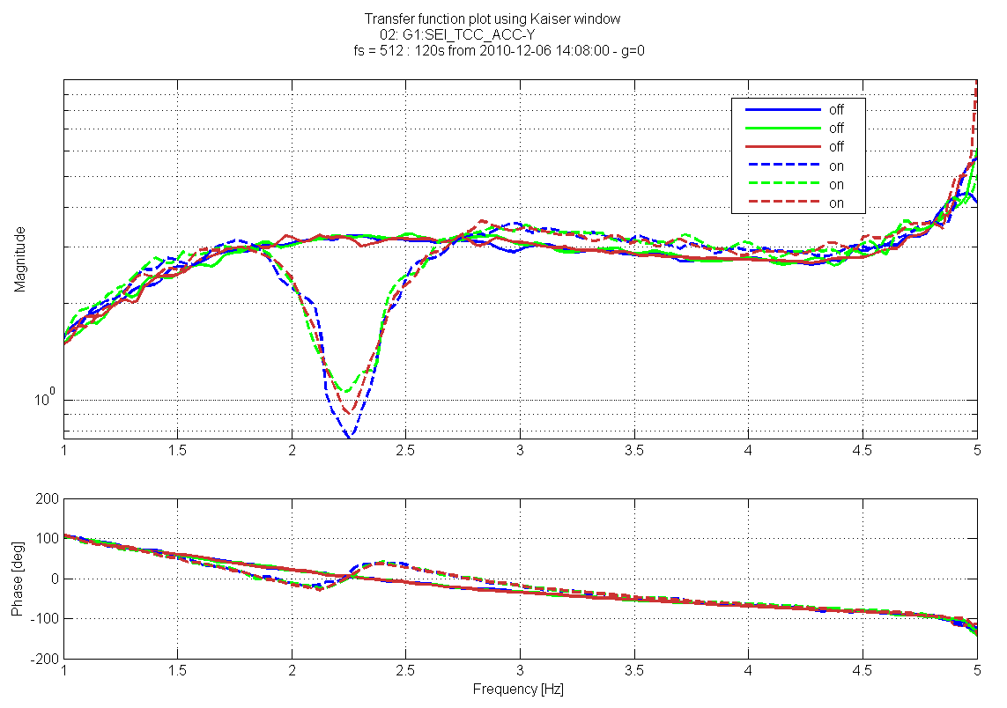
2.2Hz feed forward

Slide 18
Summary
PZT feed forward works and provides suppression of the ambient seismic.
Transfer functions are a good meassure of performance.
Check the cables!
The broadband solution has better suppression than the narrowband ones, it is working at too high frequencies though.

Slide 19
Outlook
Shifted broadband ff
More playing with filters
If necessary:
Upper mass ff
Spot position sensing
Optical lever

