Slide 1
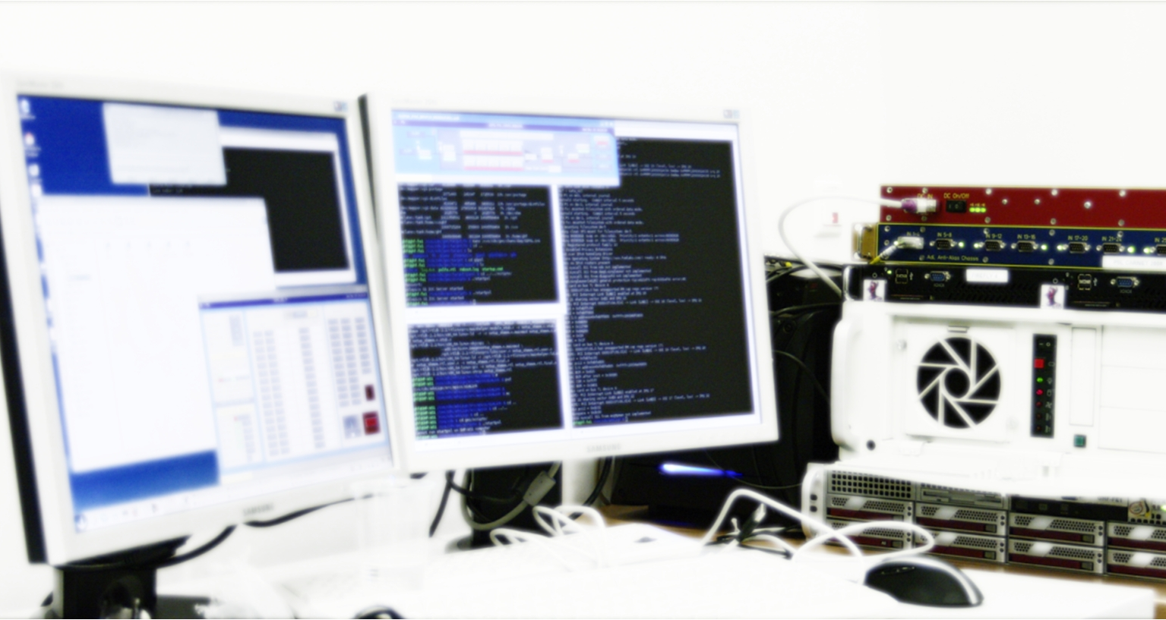
State-of-the-art digital control: Introducing LIGO CDS
Christian Gräf, AEI 10 m Prototype Team
January 2010 – GEO-ISC KickOff meeting

Slide 2
The future of GW interferometry controls …
will be a mostly digital one!

Slide 3
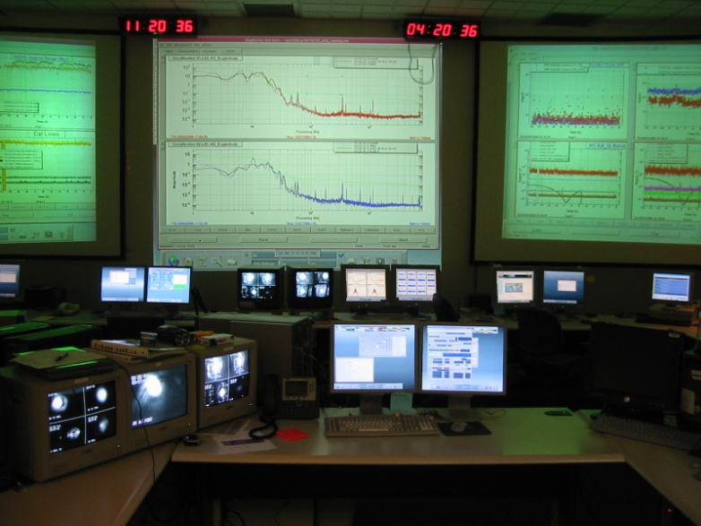
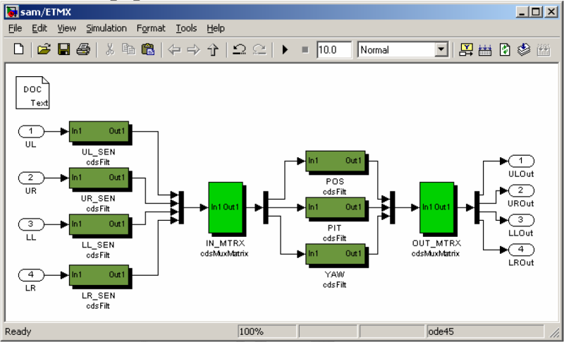
The LIGO Control and Data System
LIGO CDS corner stones:
Based on Opteron/Xeon multi core CPUs, “off-the-shelf“ hardware
Easy to scale to specific demands
Runs RT Linux kernel modules to guarantee for deterministic operation, interfaced via EPICS from user space
Attempts to cover all steps from controller design to implementation, steering of the running application and data storage
Simulink interface facilitates servo controller design
Set of user software for most standard tasks provided
Operated at 2kHz for SEI/ISI and 16kHz for SUS systems, PDE@MIT operates at 65kHz, aiming for 130kHz operation in the near future

Slide 4
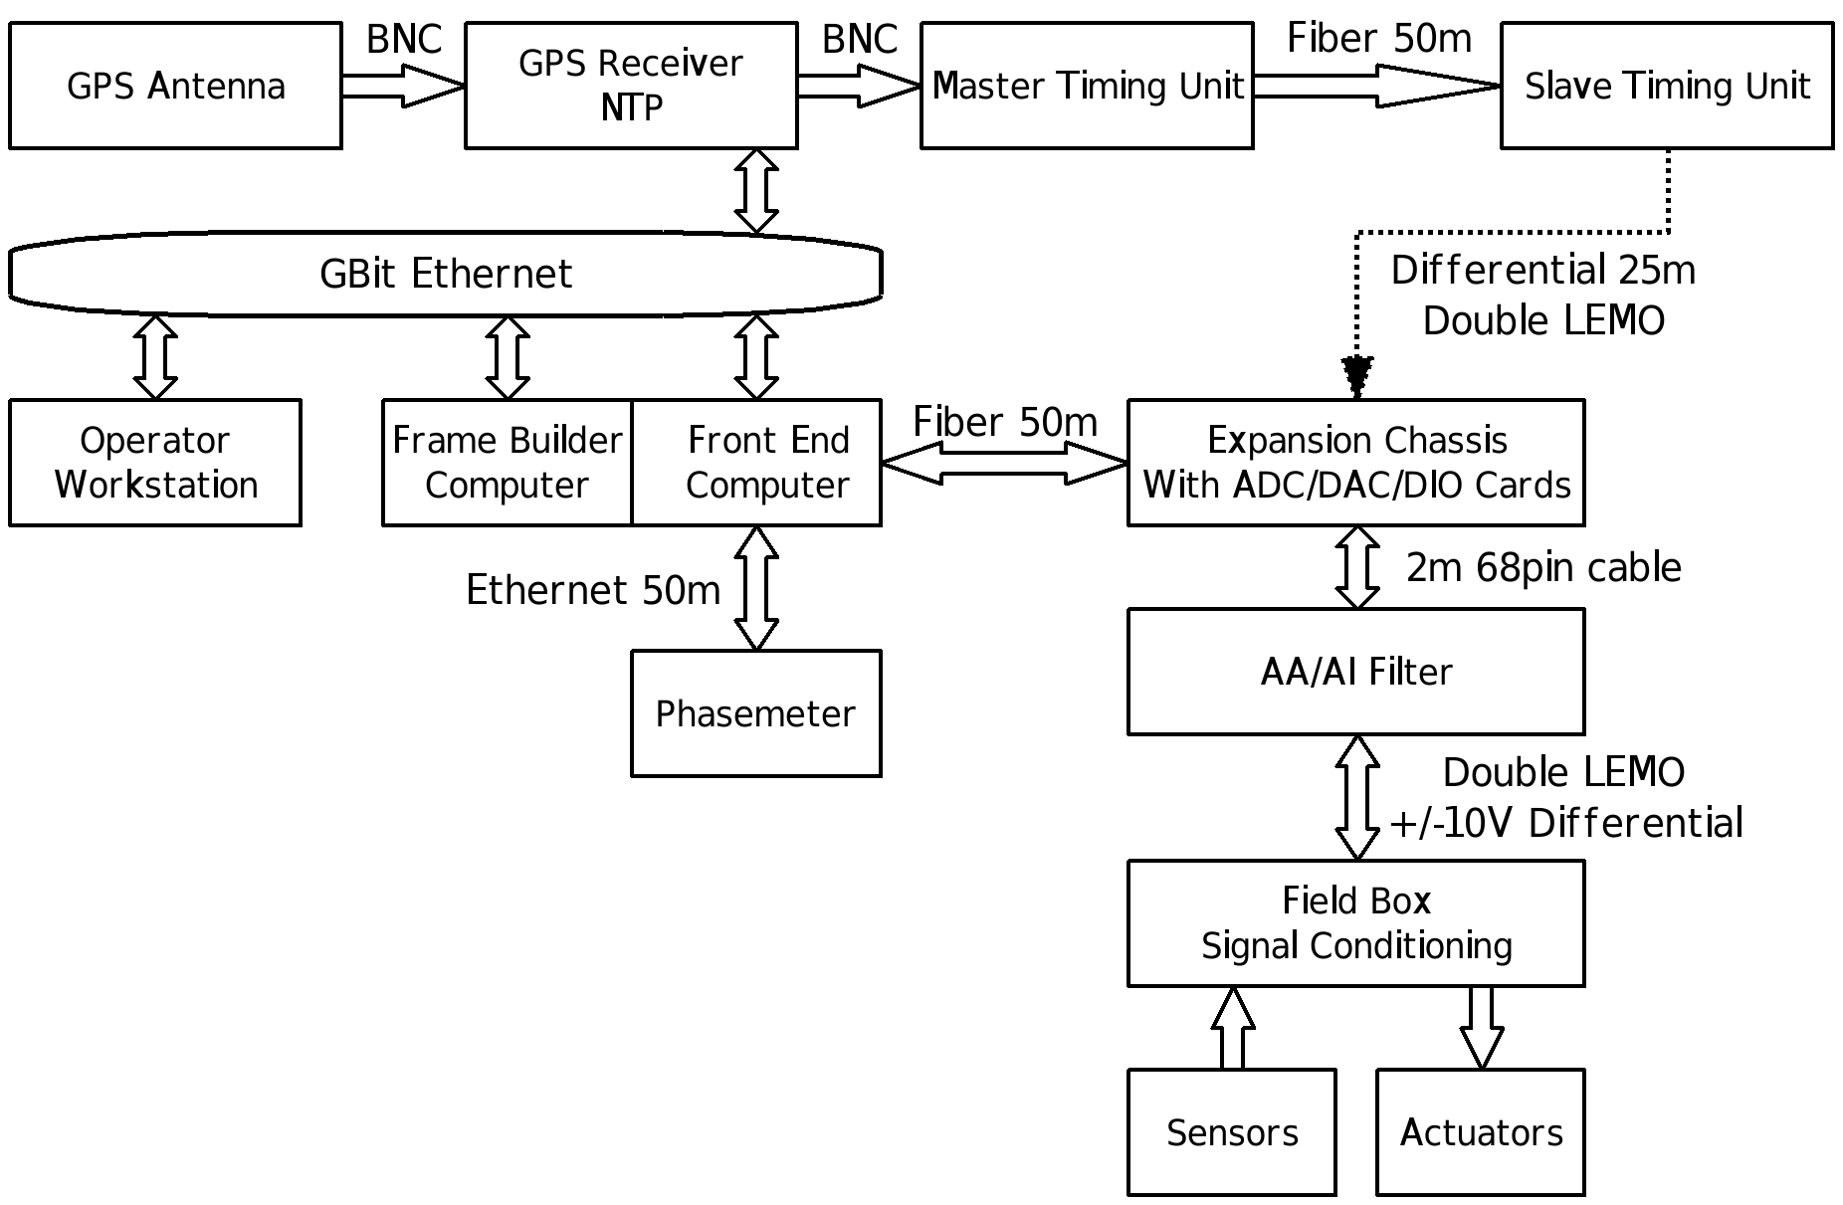
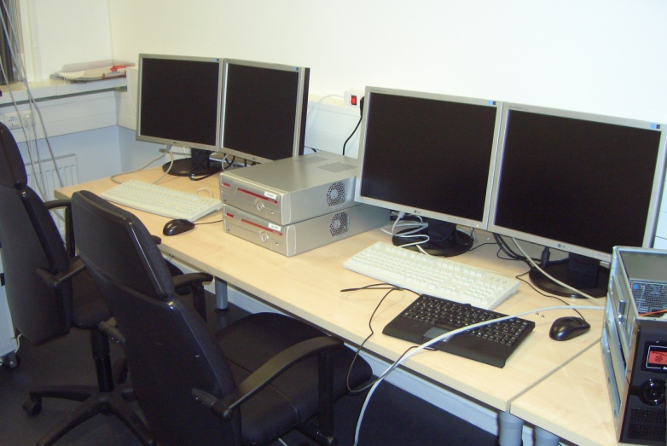
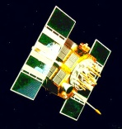
CDS Hardware Overview

Slide 5
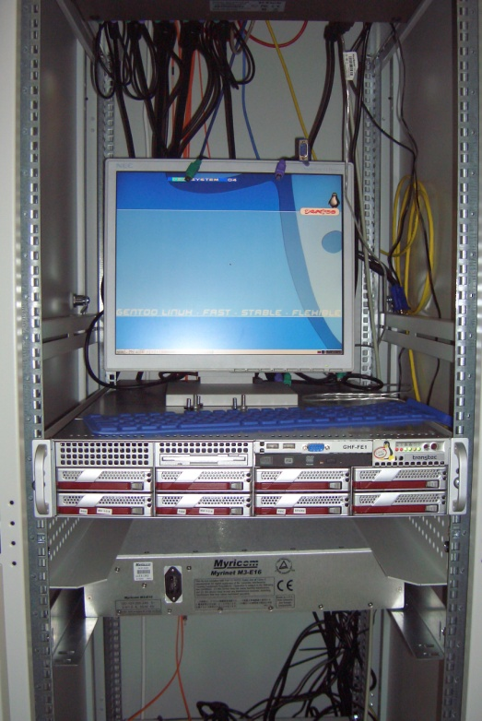
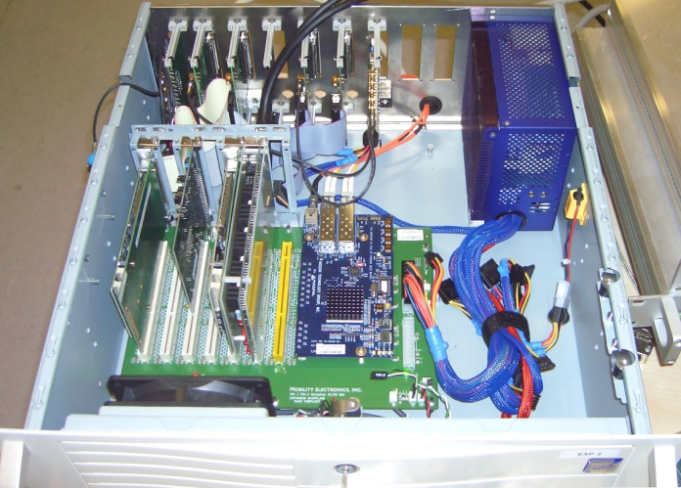
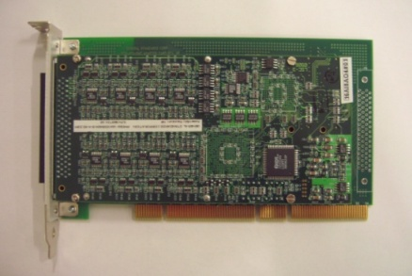
CDS Hardware Overview

Slide 6
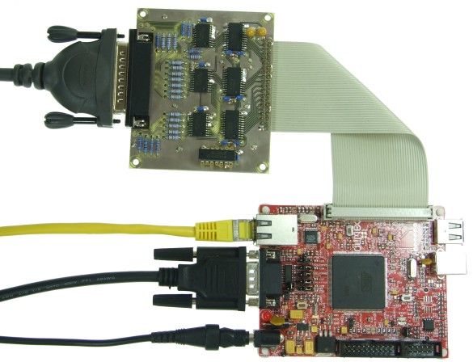
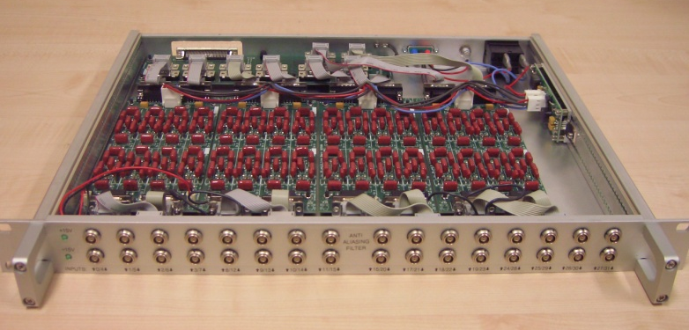
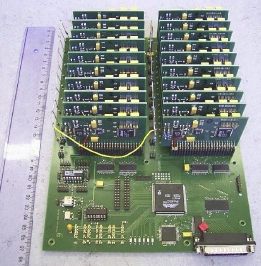
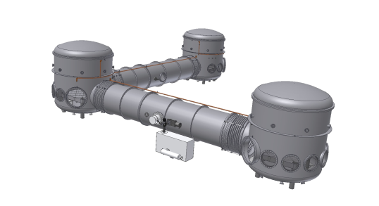
CDS Hardware Overview
Notes:
…
There is one specialty in the case of the PT experiment, that is the so called phase meter, developed by the LISA group. In the PT the phase meter is used for processing of the signals for the spi. In order to connect the PM directly to the CDS, a custom PMI has been built by the PT group.

Slide 7
EPICS and its role for the CDS

Slide 8
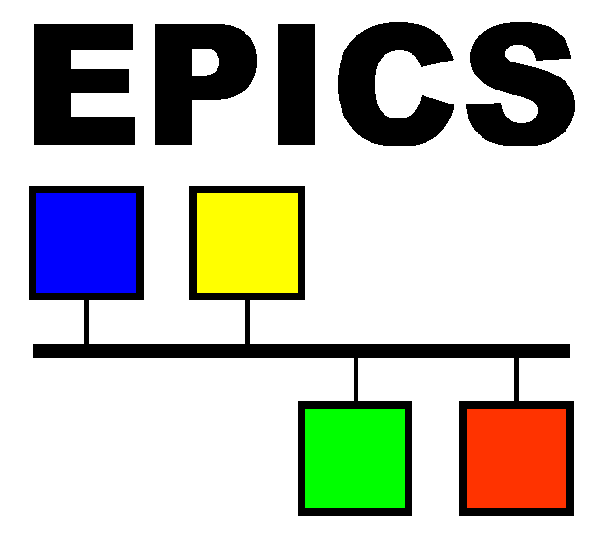
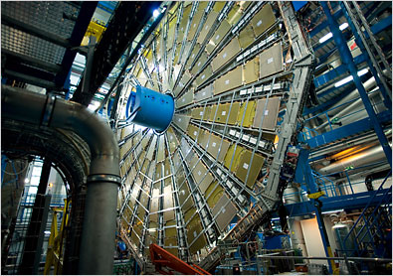
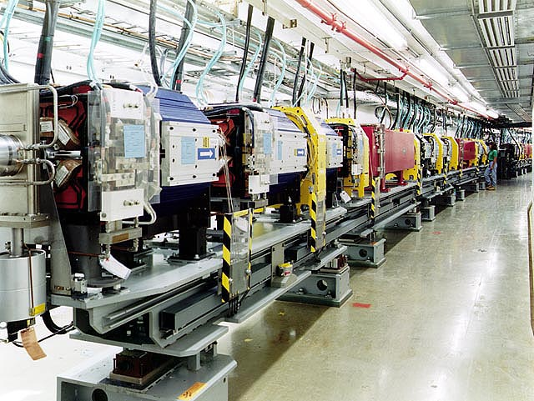
EPICS and its role for the CDS
Experimental Physics and Industrial Control System
Originally developed by the particle accelerator community
Control system architecture
Collection of software tools
Open source software, well maintained, many bugs fixed
In CDS: User interaction with the RT kernel module via shared memory

Slide 9
EPICS and its role for the CDS
“Kernel space“
Experimental Physics and Industrial Control System
Originally developed by the particle accelerator community
Control system architecture
Collection of software tools
Open source software, well maintained, many bugs fixed
In CDS: User interaction with the RT kernel module via shared memory
RT kernel
module
User application
“User space“

Slide 10
EPICS and its role for the CDS
“Kernel space“
Experimental Physics and Industrial Control System
Originally developed by the particle accelerator community
Control system architecture
Collection of software tools
Open source software, well maintained, many bugs fixed
In CDS: User interaction with the RT kernel module via shared memory
RT kernel
module
Shared Memory
User application
“User space“

Slide 11
EPICS and its role for the CDS
“Kernel space“
Experimental Physics and Industrial Control System
Originally developed by the particle accelerator community
Control system architecture
Collection of software tools
Open source software, well maintained, many bugs fixed
In CDS: User interaction with the RT kernel module via shared memory
RT kernel
module
Shared Memory
User application
“User space“

Slide 12
EPICS and its role for the CDS
“Kernel space“
Experimental Physics and Industrial Control System
Originally developed by the particle accelerator community
Control system architecture
Collection of software tools
Open source software, well maintained, many bugs fixed
In CDS: User interaction with the RT kernel module via shared memory
RT module +
EPICS “plug in“
Shared Memory
EPICS
Application
“User space“

Slide 13
EPICS: structure and functionality
Network based client/server communication system
„Channel Access“ communication protocol, via Ethernet
Almost freely scalable
Numerous APIs available for user application programming
Channel Access Clients
Channel Access Servers

Slide 14
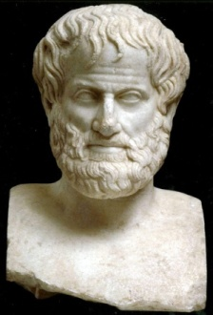
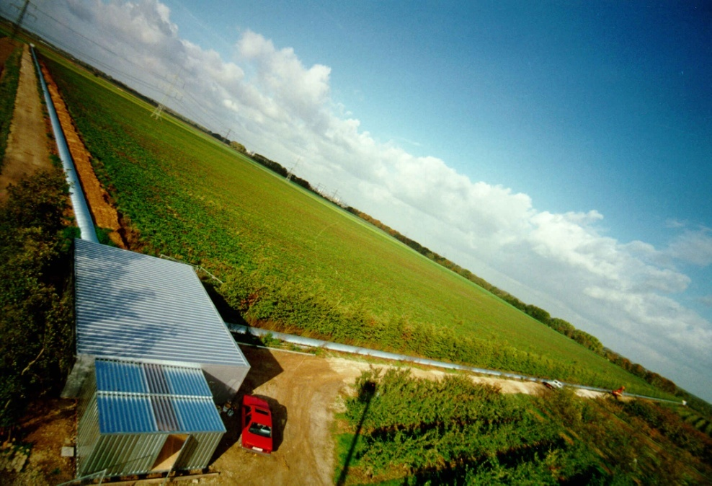
EPICS Channel Access example
Set channel
“G1:GHF-PSL_GAIN“
to value “42“
CA servers hold “channel databases“
Unambiguous channel names, accessible from any client in the network
CA communication example:
Client sends requests as network broadcast messages
Server with corresponding data base entry acknowledges request and executes command
Channel Access Clients
Channel Access Servers
Ok,
G1:GHF-PSL_GAIN=42

Slide 15
CDS core software functionality

Slide 16
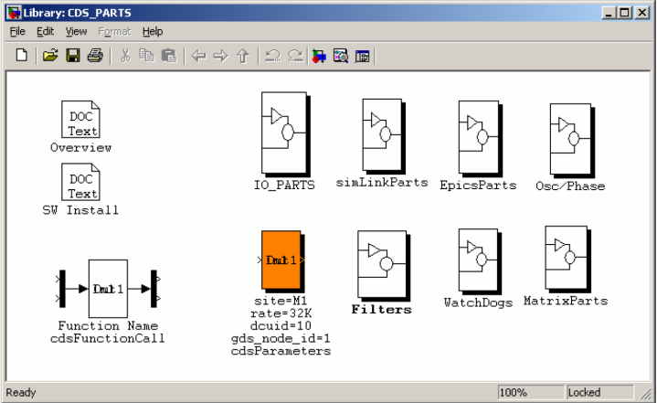
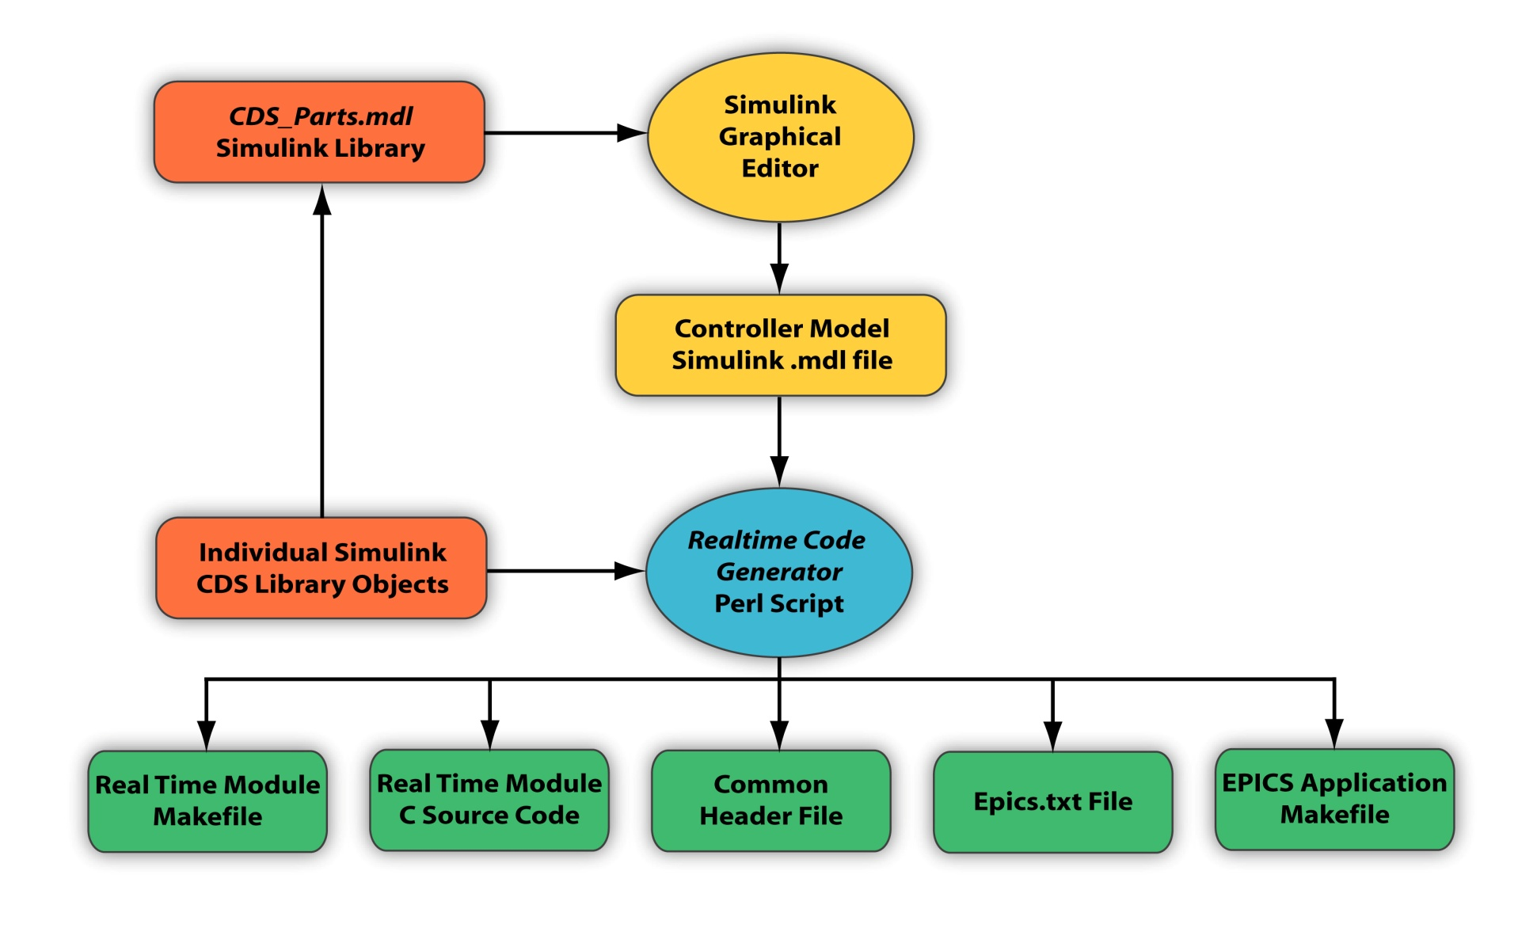
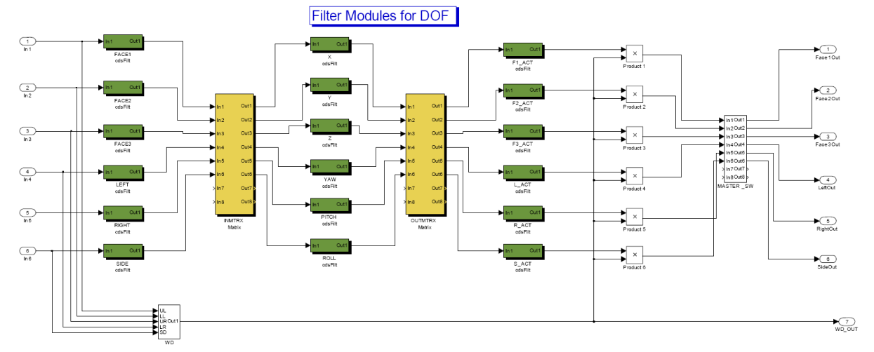
CDS Real Time application design
Simulink based “drag-and-drop“ design with CDS library objects

Slide 17
CDS Real Time application design
Simulink based “drag-and-drop“ design with CDS library objects
Graphical model parsed by RCG Perl script
Generation of RT module C-code
Generation of corresponding EPICS application input files

Slide 18
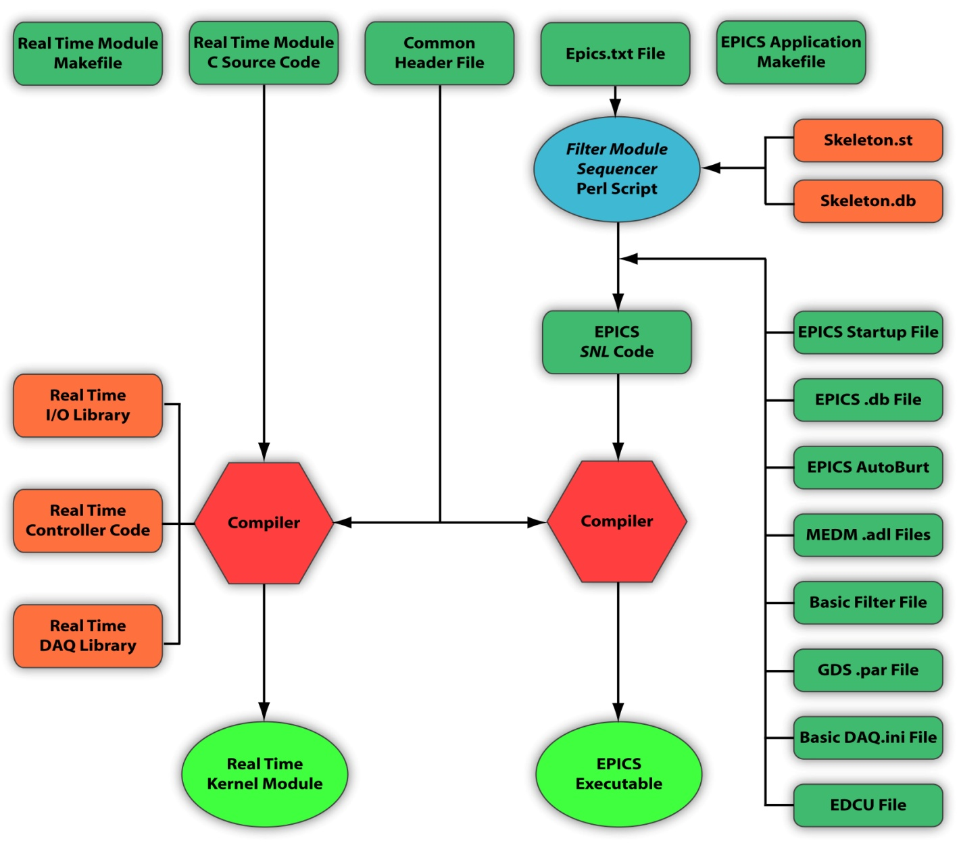
CDS Real Time application design
User application compiled from RT module C-code and from EPICS SNL-code
Resulting RT module loaded into Linux kernel running on dedicated CPU core

Slide 19
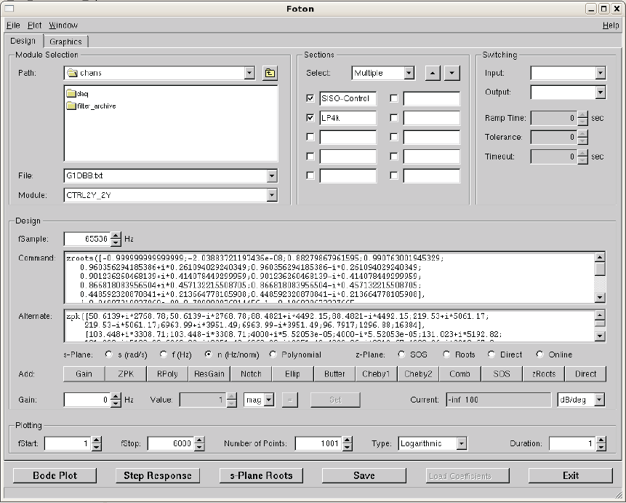
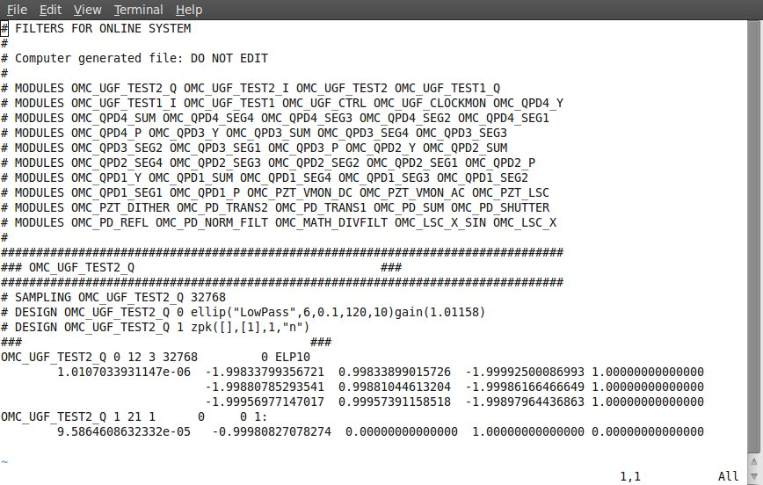
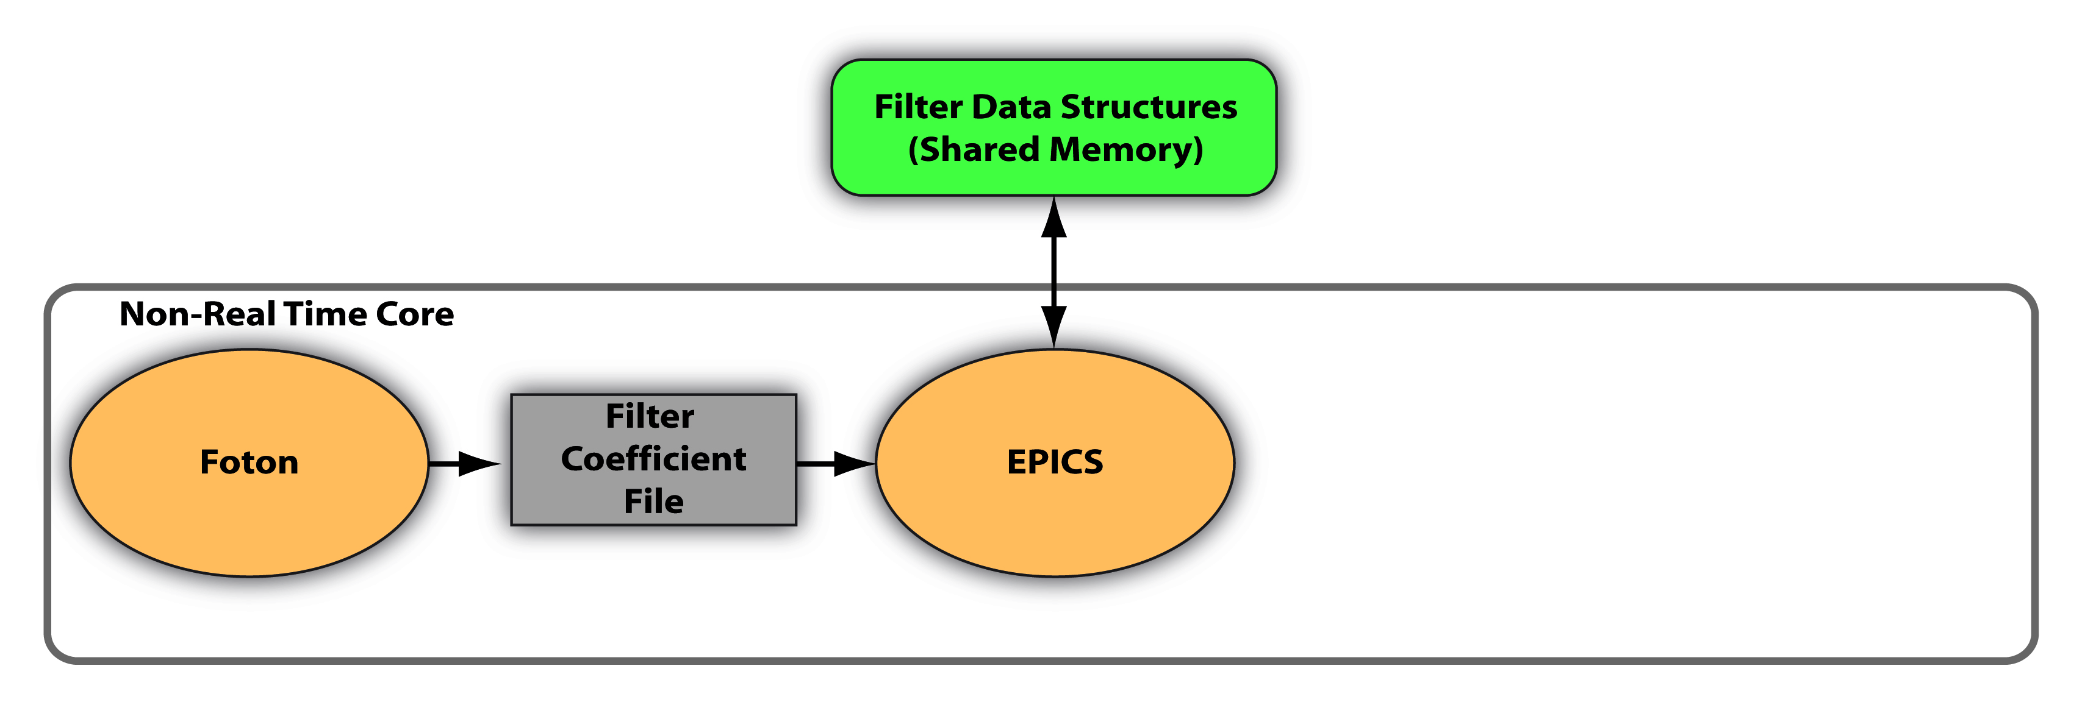
Digital filtering work flow
Realtime filtering performed by user application module in kernel space:
Foton software for computation of filter coefficients
Coefficient file handed over to shared memory by EPICS task

Slide 20
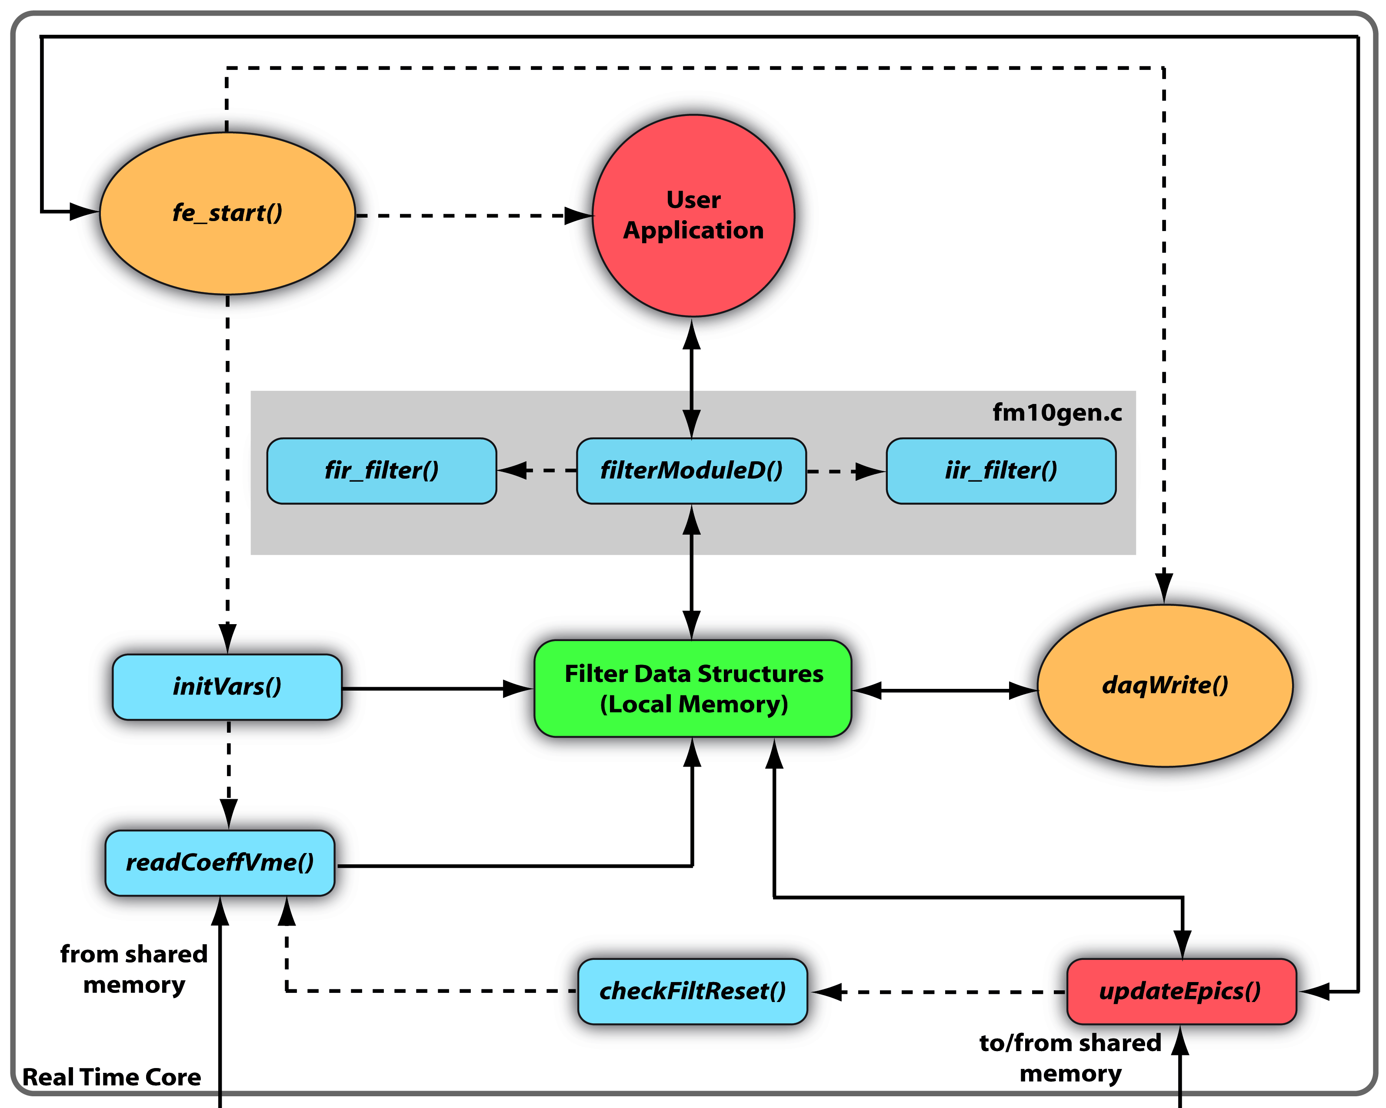
Digital filtering work flow
Coefficients copied to local memory, handed over to user application RT kernel module
Function filterModuleD() represents standard CDS filtering unit and reads the coefficients into the user application
Infinite loop in fe_start() loops over user application – continuous filtering of input data

Slide 21
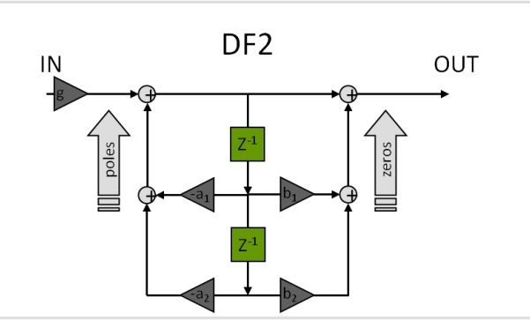
CDS Standard Filter Module
Basic building block in CDS for digital filtering:
Allows definition of up to 10 IIR filters, each with up to 10 SOS
Filters can be defined to be engaged instantaneously or ramped up for various trigger conditions
Filters can be changed on-the-fly during operation
Test and excitation points for diagnostics provided
Monitoring and remote steering via EPICS

Slide 22
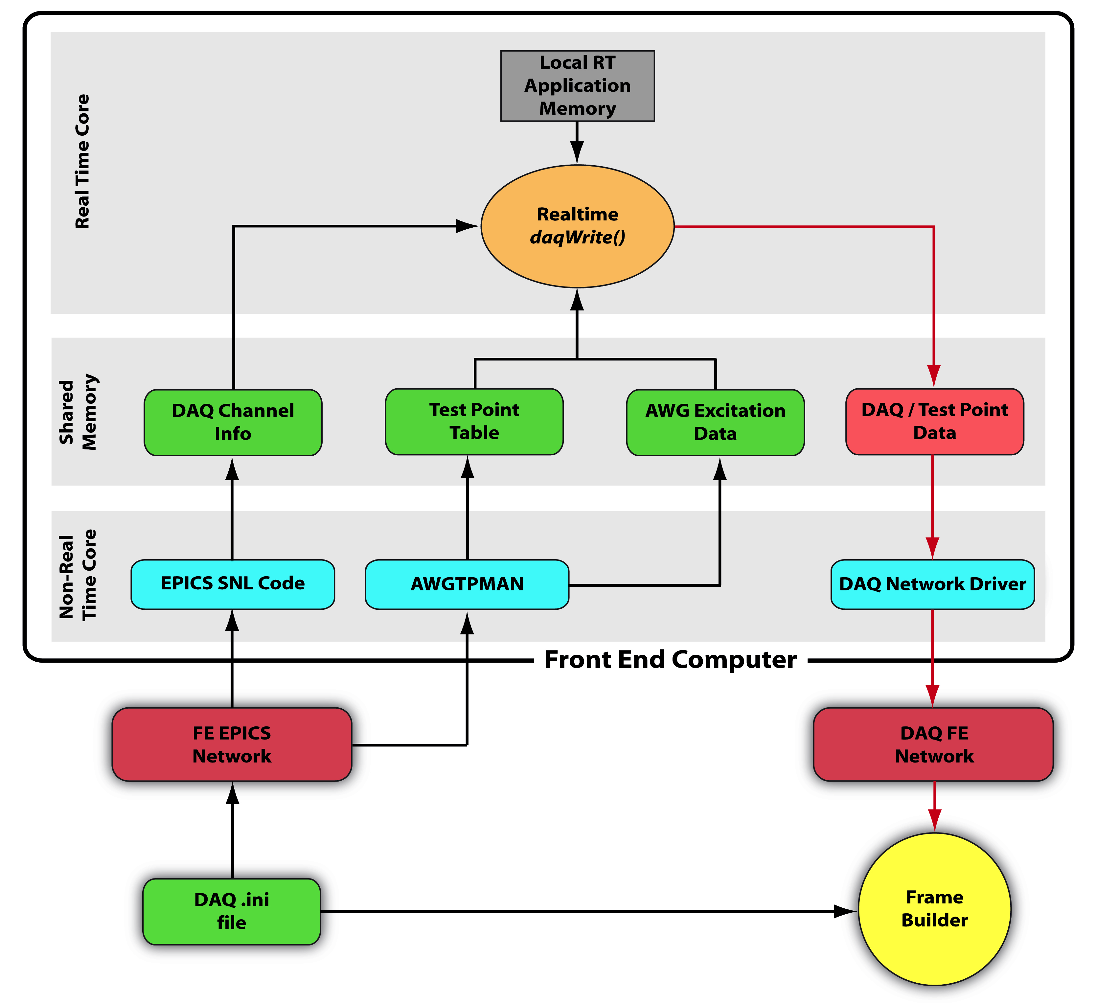
DAQ and System Identification
CDS Data Acquisition:
DAQ channels defined by operator in DAQ channel list file
Channel list passed to EPICS module on FE machine
Read by RT daqWrite() function from shared memory
Data written to DAQ network via shared memory for analysis/storage on frame builder machine

Slide 23
DAQ and System Identification
CDS system identification:
Test points defined by operator in DAQ file
AWGTPMAN application on non-RT core manages test points and excitations
AWG generates arbitrary excitation signals and injects them into the RT application for stimulus response test
Test point data accesible from WS via DAQ network

Slide 24
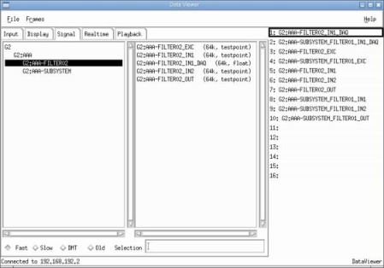
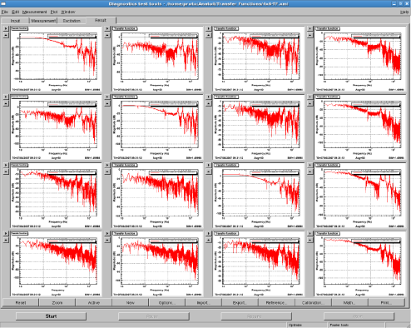
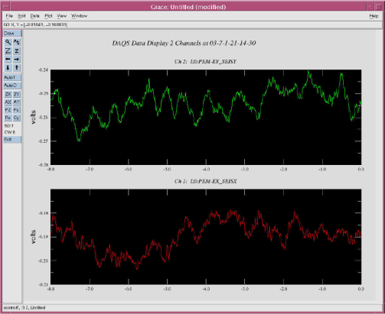
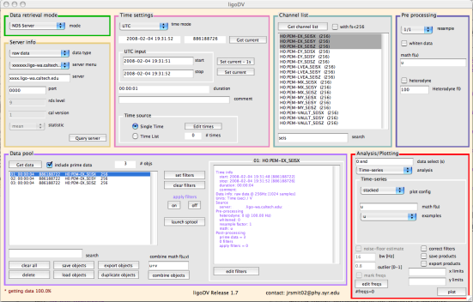
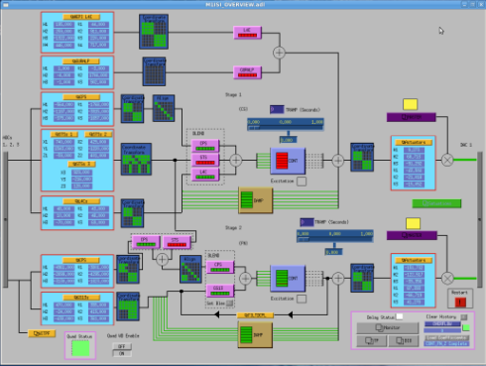
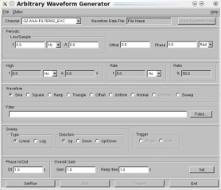
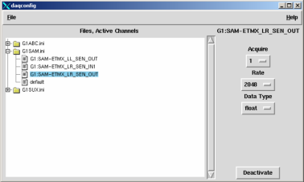
CDS User software
FOTON – Filter coefficient calculation
DTT – Diagnostics, SysId
DataViewer – Displays online data
ligoDV – Offline data analysis
MEDM – Operator Screens
AWGGUI – Manual wave form injection
DAQCONFIG – DAQ Channel config tool
(Developed by GEO scientists)

Slide 25
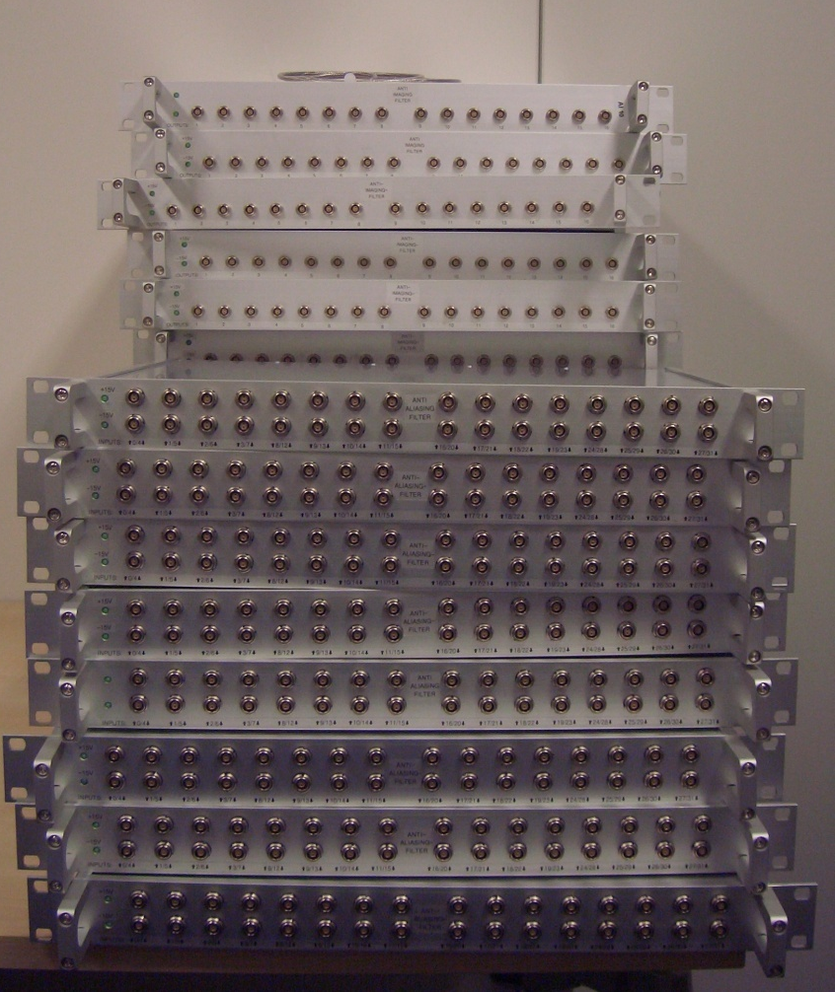
CDS@AEI: status and outlook
A large amount of hardware is already in place
CDS user software tools not as stable as desired, some have poor usability: needs some more work
First in-house developed hardware (phase meter interface) recently completed
Ongoing efforts to create in-house documentation
Web-based CMS and bug tracking system dedicated to CDS
Regular RT-meetings held to discuss problems
CDS is ready to go into operation – and has already done so!

Slide 26
Thank you for your attention

