Slide 1
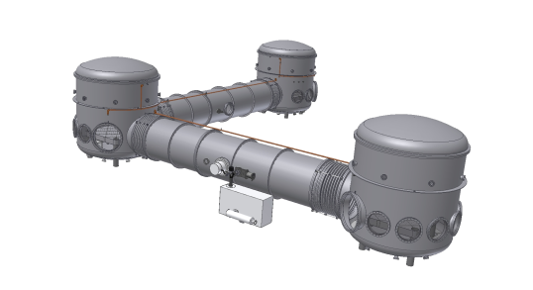
AEI 10m Prototype
Length Sensing and Control
of the AEI 10m sub-SQL Interferometer
Christian Gräf, AEI 10 m Prototype Team
Dezember 2010 – GEO Simulation and ISC meeting

Slide 2
The sub-SQL IFO experiment
The sub-SQL IFO in a nut shell:
First experiment to be built in the PT environment (besides GRACE follow-on, LISA, TNI, ...)
Core IFO: Fabry-Pérot Michelson-based, optimized for low thermal noise
Goal: exclusively quantum-noise limited sensitivity at ≈200 Hz, reaching for the Standard Quantum Limit of interferometry
Design requirements recently completed by LSC sub-system!

Slide 3
The Prototype environment
Some technical highlights:
High performance vacuum system
SAS-style optical tables, interferometrically linked with SPI
PSL front end, fiber coupled, suspended frequency ref. Cavity
Monolithic suspensions, very light mirrors and thin fibers
Digital control and data system
...

Slide 4
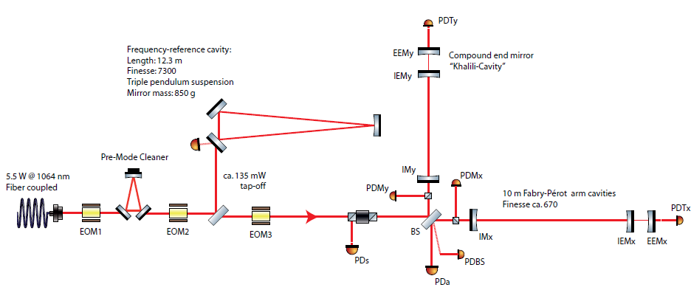
Optical layout
~

Slide 5
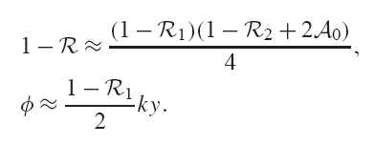
CTN reduction: Khalili Cavities
Replace end mirror with overcoupled compound cavity
Small number of coating layers on IETM, highly reflecting EETM
Cavity held on anti-resonance to act as a reflector
Rear mirror thermal noise contribution effectively suppressed by cavity, less noise coupling from EETM
Reduction of EETM coating thermal noise approximately by a factor of three
“Khalili Cavity“

Slide 6
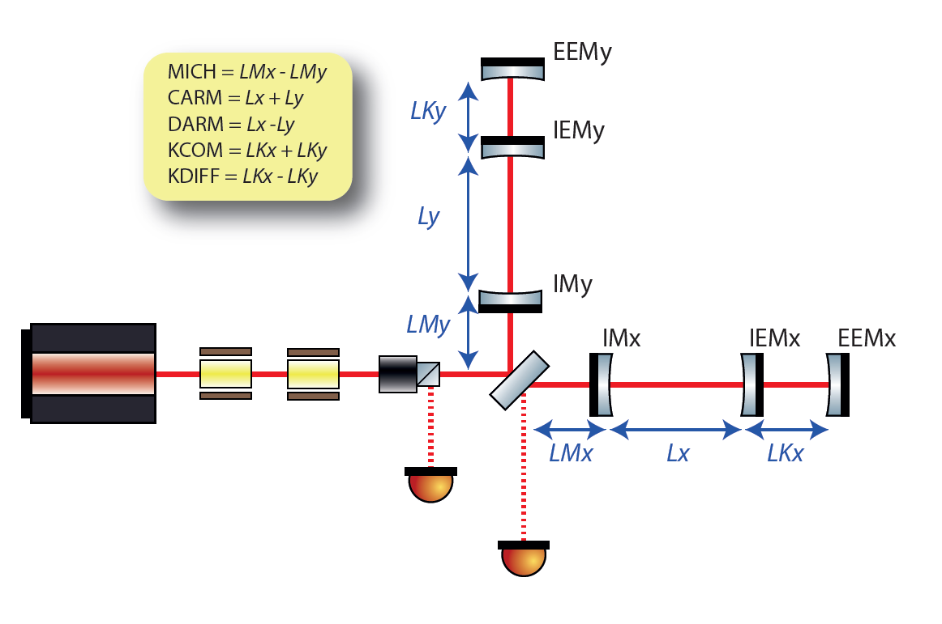
Longitudinal DOF
In total, five longitudinal DOF need to be stabilized:
Small Michelson differential mode (MICH)
Arm cavity common and differential mode (CARM, DARM)
End mirror (Khalili) cavity common and differential mode (KCOM, KDIFF)

Slide 7
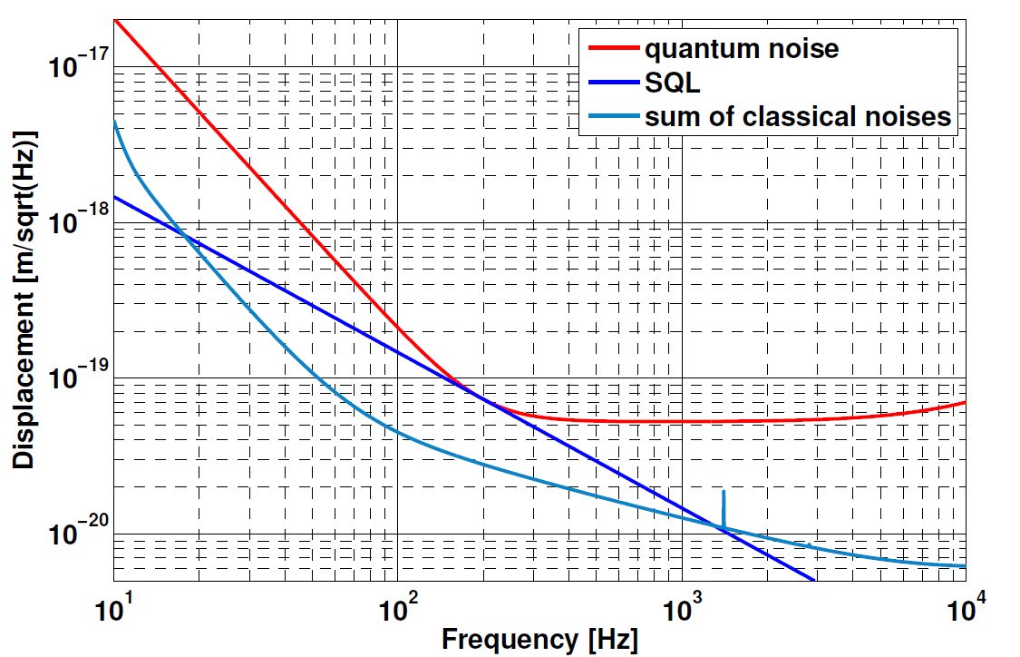
Longitudinal control requirements
Primary requirement for LSC sub-system: compatibility with the sensitivity goal
Suppress DARM fluctuations in order to reach QN limited sensitivity of the diff. arm cavity mode
Fluctuations of remaining four DOF must not impair DARM sensitivity, i.e. noise contributions must be below DARM sensitivity
Stabilize RMS deviation of each length-DOF to within 1% of its corresponding line width

Slide 8
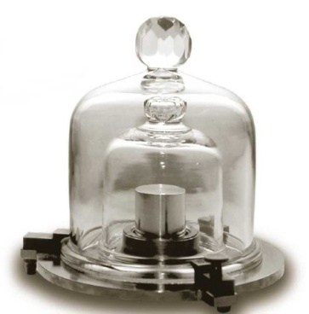
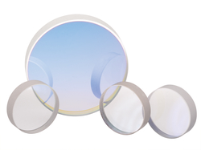
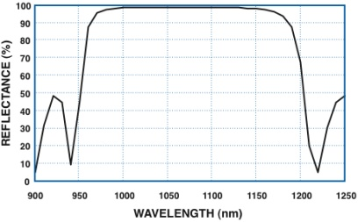
Fixed parameters
Mirror mass
Mirror aspect ratio
Mirror reflectivities
Laser spot size
Optimal mirror mass, m=12g
Mirrors with m=100g preferred
Optimal radius: a=2.43cm
Optimal thickness: h=2.45cm
N=2,
N=8, R=99.07% for IM
N=2, R=51.151% for IEM
N=15, R=99.997% for EEM
Spot radius of w=9.7mm on
arm cavity mirrors

Slide 9
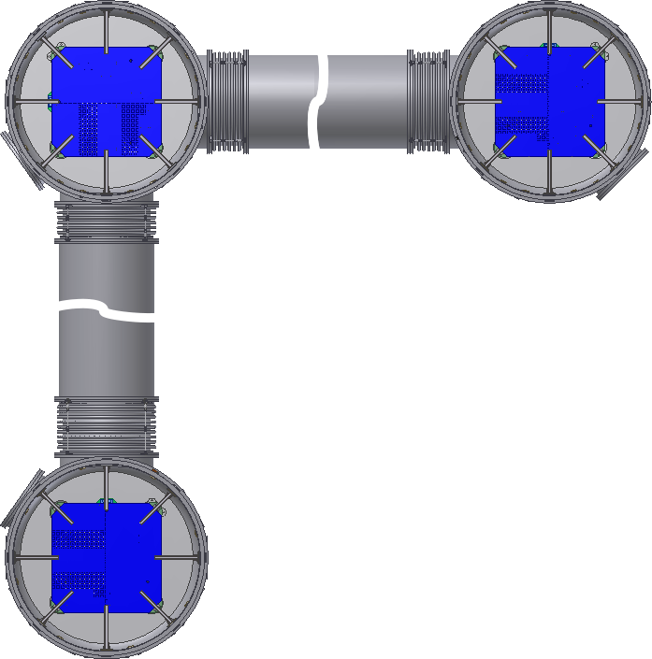
Spatial issues
Macroscopic IFO lengths
Not fixed (directly) in Kentaro‘s design
IFO must be accomodated to infrastructure
Beam size criterion needs to be fulfilled
Spatial constraints imposed by
Vacuum system
Optical table dimensions
And many more of which some needed to be estimated
Table center to center: 11.65m
Table edge-to-edge: 9.90m
Table area: 1.75m x 1.75m
Equipped with threaded holes: 1.7m x 1.69m
Notes:
BS cage foot print: 519mm x 474mm
Main optics foot print: 150mm x 100mm

Slide 10
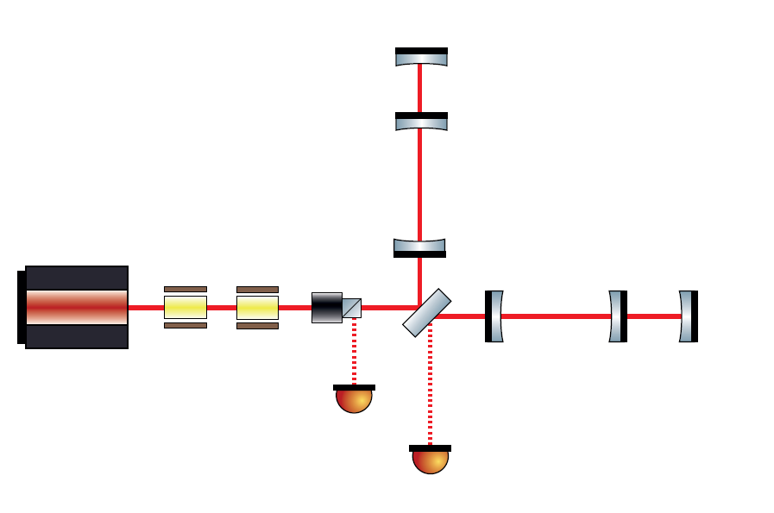
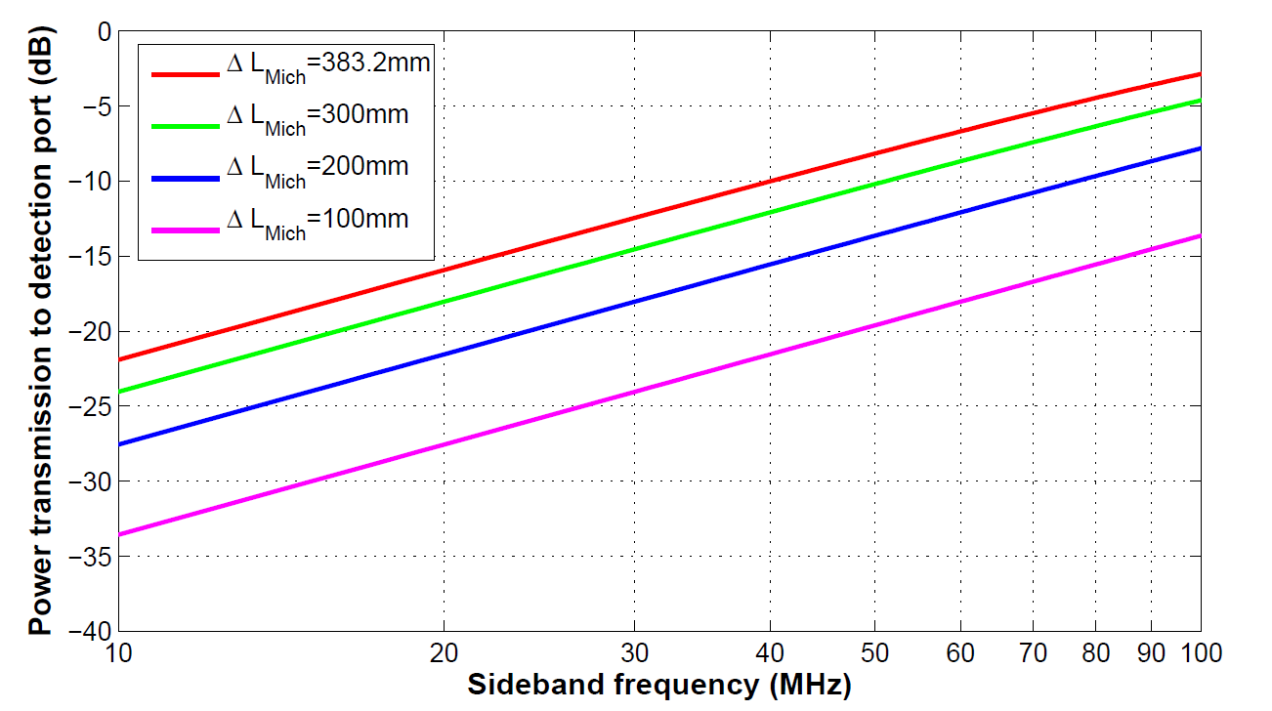
subSQL IFO lengths: Central MI
Central Michelson arms:
Avg length: 333mm -- 823mm
Primary impact on LSC:
Separation of PickOff beams for length signal extraction
The longer beam propagation, the better!
Central MI (Schnupp-) asymmetry:
PM side band transmission to the dark port, e.g. for KC control
Schnupp asymmetry at the expense of max. central MI avg. arm length
Supposedly DC/Homodyne readout for DARM, i.e. T=-10dB@75MHz seem sufficient

Slide 11
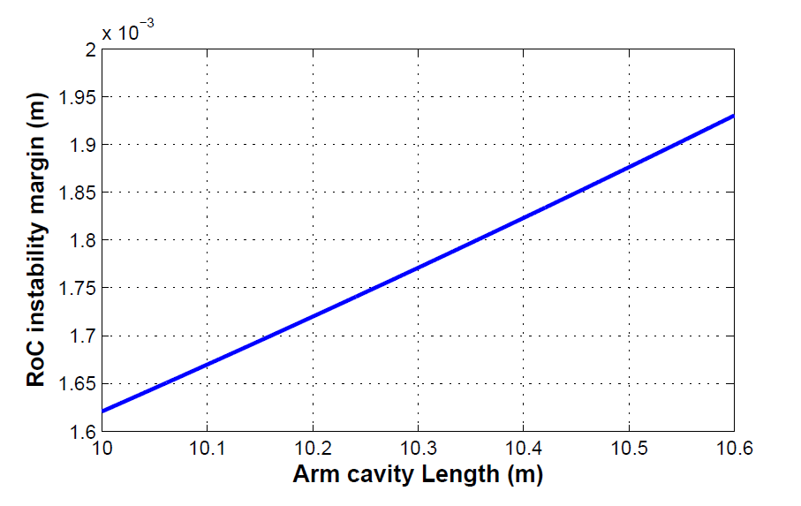
subSQL IFO lengths: Arm Cavities
Arm cavity length:
Min. length: 10.023m
Max. Length constrained by
central MI /MI asymmetry
KC length
Fulfill spot size criterion -> cavity operated near instability, g = -0.999x
RoC margin to instability
Symmetric cavity assumed
Tolerable RoC error ~1mm
Longer cavity, more margin
10m -> 10.5m: 16% increase

Slide 12
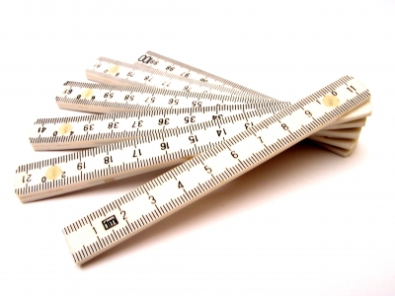
subSQL IFO lengths: Khalili Cavities
End mirror cavity length:
Impact on KC control sideband frequencies
Min. length of ~75cm to keep PM frequency below ~100MHz
Aim for KC length of ~ 100cm
Space reserved behind end mirrors:
For monitor PDs/heterodyne control signal extraction
Aux. Laser-based control schemes: frontal PM supportive/stand-alone
Estimated length of ~30cm should be sufficient (c.f. aLIGO TransMon Tables ~85cm x 70cm)

Slide 13
subSQL IFO lengths: Khalili Cavities
End mirror cavity length:
Impact on KC control sideband frequencies
Min. length of ~75cm to keep PM frequency below ~100MHz
Aim for KC length of ~ 100cm
Space reserved behind end mirrors:
For monitor PDs/heterodyne control signal extraction
Aux. Laser-based control schemes: frontal PM supportive/stand-alone
Estimated length of ~30cm should be sufficient (c.f. aLIGO TransMon Tables ~85cm x 70cm)
Subject to ongoing discussions!

Slide 14
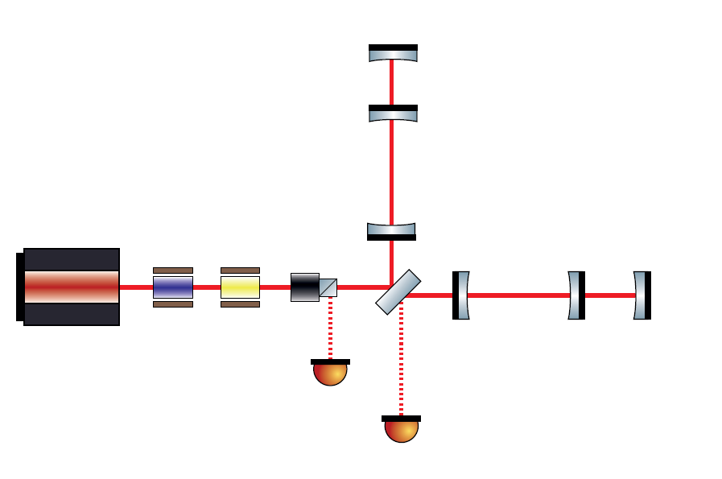
Control strategy candidates
Frontal PM + PDH-style heterodyne signal extraction:
Applied in a multitude of experiments, high level of experience available
Comparably low technical effort
Currently focussing on this approach as our preferred method
A variant: Frontal AM-PM mix:
Potentially better decoupling of coupled-DOF length signals
Succesfully implemented e.g. in Glasgow Prototype
... this is work in progress !
PM-PM
PM-AM

Slide 15
Control strategy candidates
“Straight forward“ approaches may turn out to be not suitable for controlling this topology in terms of robustness!
Alternatives under consideration:
One option: Auxiliary Laser-based control schemes, e.g. injected from the rear sides of EEMs (“sub-carrier“)
Challenge: Mode overlap of science laser and aux. lasers, i.e. proper alignment
Restrict to acquisition phase, i.e. hand-over to frontal PM based control after lock acquisition
Known to work but a high level of additional complexity is introduced
PM-PM
PM-AM

Slide 16
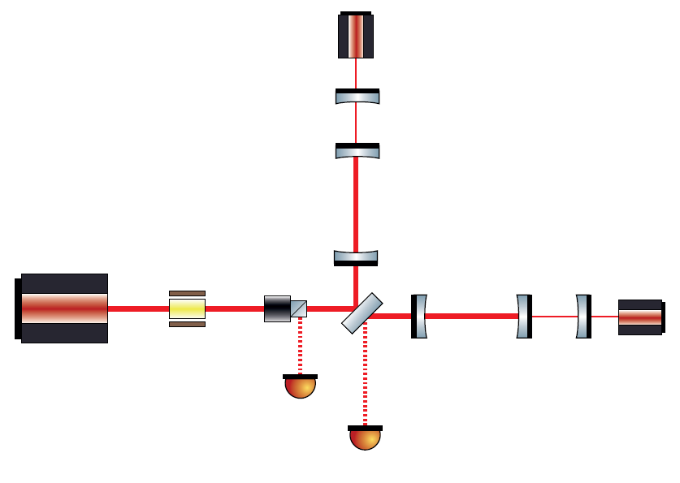
Control strategy candidates
“Straight forward“ approaches may turn out to be not suitable for controlling this topology in terms of robustness!
Aux. Lasers at 1064nm, offs. phase-locked:
PDH-based, continuous tuning of KCs
Succesfully demonstrated at bench-top scale in the past (e.g for VSRM)
BUT: KCs are – seen from the back – very strongly undercoupled, i.e. tiny phase changes around resonance, low-quality error signals
Beam leakage into the subSQL IFO, generation of SSBs, may cause trouble
PM-PM
Aux. Lasers @1064nm

Slide 17
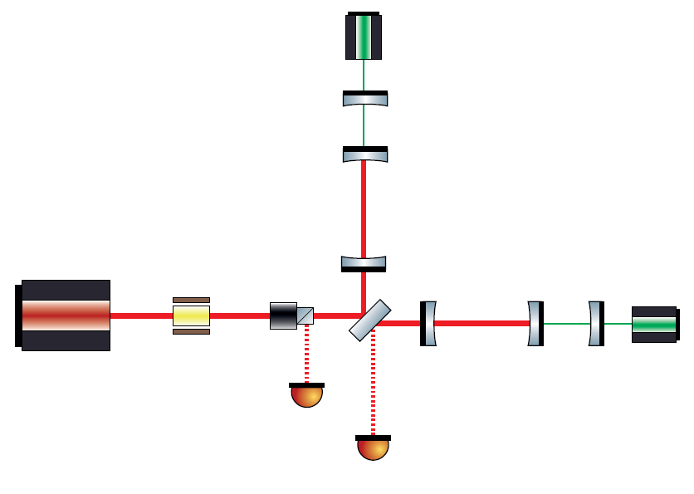
Control strategy candidates
“Straight forward“ approaches may turn out to be not suitable for controlling this topology in terms of robustness!
Non-1064nm auxiliary lasers:
Technical effort even higher, coating modification of IFO mirrors required
Would solve some problems
Succesfully demonstrated at bench-top scale in the past at ANU
AdvLIGO pre-lock acquisition system “ALS“ builds on 532nm aux. lasers
... work in progress!
PM-PM
Aux. Laser
non-1064nm

Slide 18
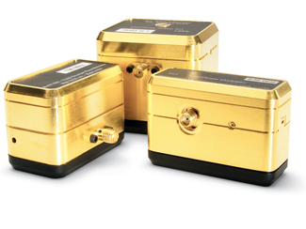
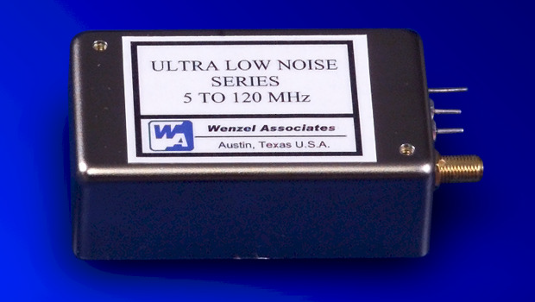
RF sideband generation
Frontal PM sideband requirements:
Constrain range of phase modulation frequencies:
Fast detection electronics more challenging
Small active areas more likely to get damaged during lock-loss
Less pointing noise coupling on larger substrates
Best-effort approach for RF sources:
Wenzel OCXO units are industry standard for lowest phase noise oscillators

Slide 19
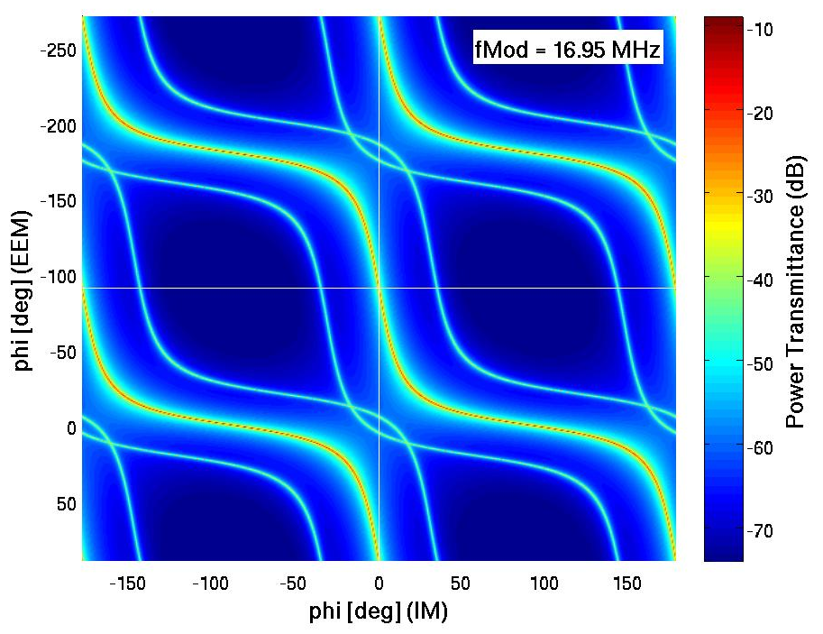
KC control sideband frequencies
Coupled cavity resonance map picture:
Looking for PM sidebands with optimal length signal decoupling

Slide 20
KC control sideband frequencies
Coupled cavity resonance map picture:
Looking for PM sidebands with optimal length signal decoupling

Slide 21
KC control sideband frequencies

Slide 22
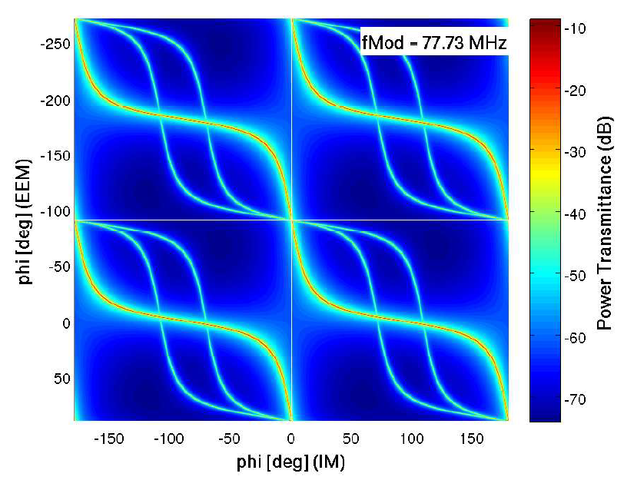
KC control sideband frequencies
Coupled cavity resonance map picture:
Large power gradients lead to steep error signals and vice versa
For KC, intersect with vertical axis perpendicularly

Slide 23
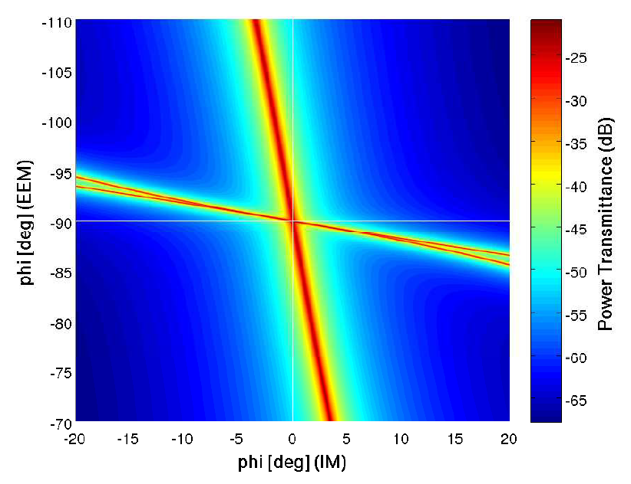
KC control sideband frequencies
Coupled cavity resonance map picture:
Large power gradients lead to steep error signals and vice versa
For KC, intersect with vertical axis perpendicularly

Slide 24
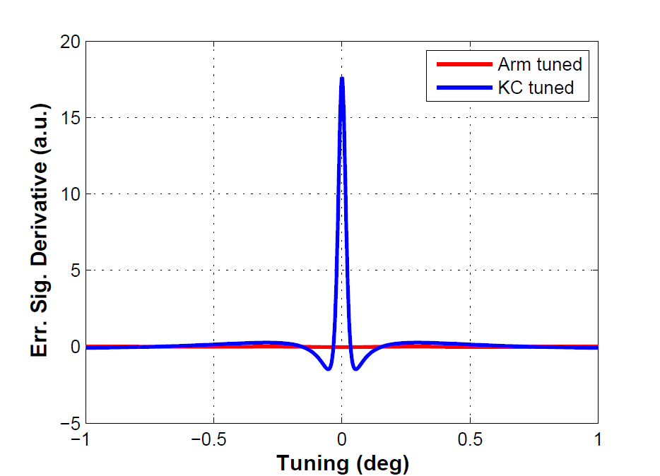
KC control sideband frequencies
Coupled cavity resonance map picture:
Large power gradients lead to steep error signals and vice versa
For KC, intersect with vertical axis perpendicularly
KC error signal with reduced coupling to arm cavity

Slide 25
KC control sideband frequencies
Coupled cavity resonance map picture:
Large power gradients lead to steep error signals and vice versa
For KC, intersect with vertical axis perpendicularly
KC error signal with reduced coupling to arm cavity
Separate treatment of KC and Arm leads to non-optimal results!

Slide 26
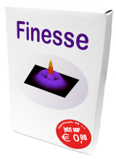
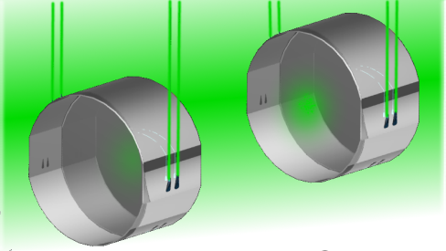
Simulation tools
FINESSE is our reference simulation
Used to validate other results against
It‘s fast! Good for quick prototyping
Where alignment matters: can cope with HOMs
Does not directly include radiation pressure
OPTICKLE is AdvLIGO reference
Matlab-based, fairly slow but easy to extend and to integrate to other modelling software
Includes radiation pressure effects directly
Optickle
Sub-SQL IFO LSC conceptual design is underway! Stay tuned...

Slide 27
Thank you for your attention
Visit us at http://10m-prototype.aei.uni-hannover.de

Slide 29
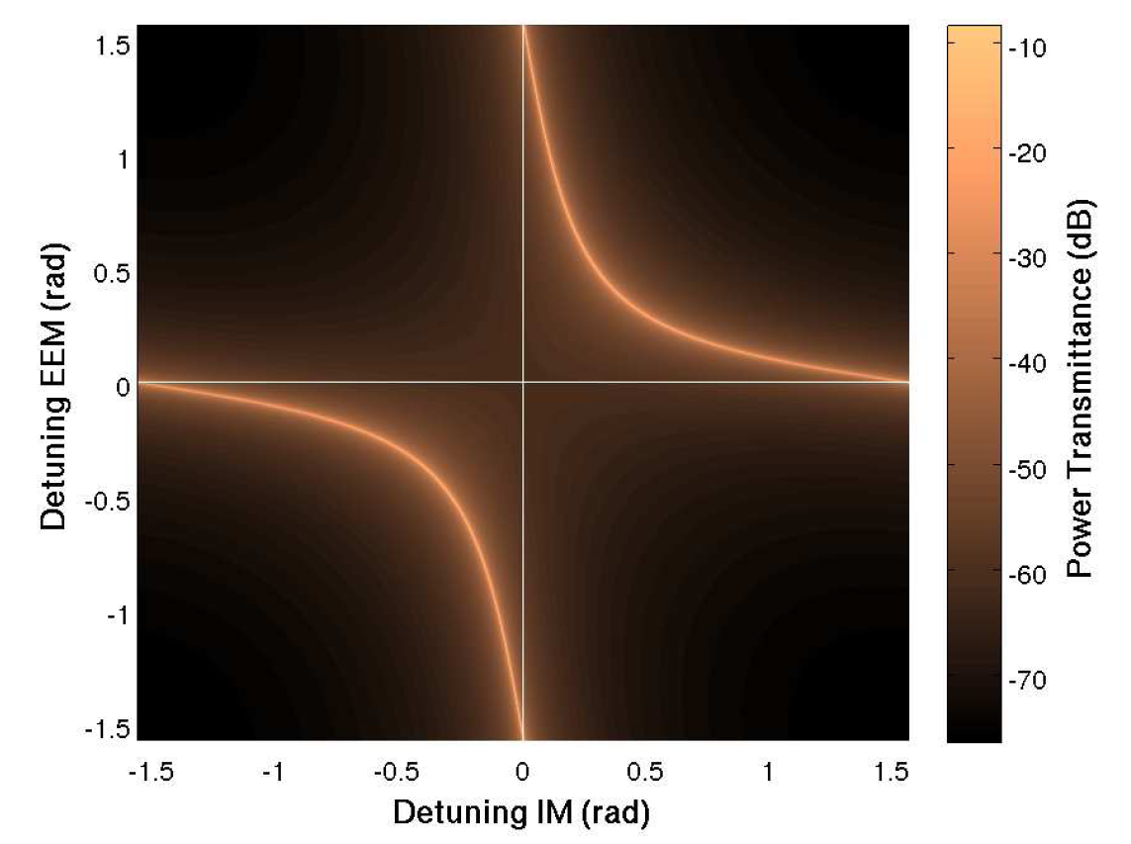
Coupled cavities and PM
Sub-SQL IFO arm is a three-mirror-coupled-cavity:
Analytically: cavity with one mirror replaced by a cavity, 2DOF system
Practical consequence: “Two mirror cavity intuition“ is misleading!
Tuning either mirror affects fields in both cavities
Our anticipated operating point (0deg,90deg) is a resonant state of the 3MCC

Slide 30
Some coupled cavity properties
Sub-SQL IFO arm is a three-mirror-coupled-cavity:
Analytically: cavity with one mirror replaced by a cavity, 2DOF system
Practical consequence: “Two mirror cavity intuition“ is misleading!
Tuning either mirror affects fields in both cavities
Our anticipated operating point (0deg,90deg) is a resonant state of the 3MCC

Slide 31
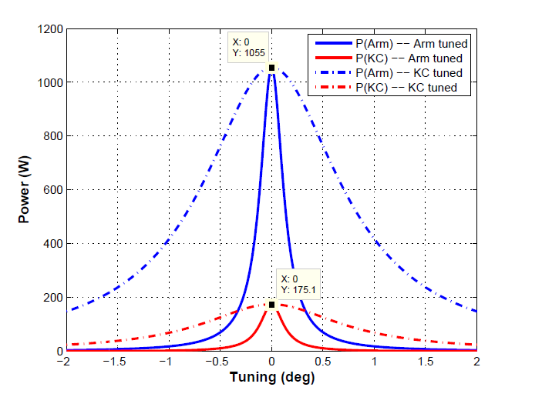
Some coupled cavity properties
Sub-SQL IFO arm is a three-mirror-coupled-cavity:
Analytically: cavity with one mirror replaced by a cavity, 2DOF system
Practical consequence: “Two mirror cavity intuition“ is misleading!
Tuning either mirror affects fields in both cavities
Our anticipated operating point (0deg,90deg) is a resonant state of the 3MCC

